Slide 1
TeamWorks Financials
Mo Moghazy, Vinod Sadu and Stefanie Gallagher

Slide 2
TeamWorks Financial Modules
Asset Management (AM)
Accounts Payable (AP)
Accounts Receivable (AR)
Commitment Control (KK)
General Ledger (GL)
Purchasing (PO)
Project Costing (PC)

Slide 3
TeamWorks Financial Support Facts and Performance Measures
Active Agencies in Teamworks:85
Number of Customers Supported: 102,185
Employees: 6,830
Suppliers: 226,270
PeopleSoft Version: 9.2.38
People Tools Version: 8.58.19
Number of Tickets: 48,525
Resolved Within SLA: 96.89%

Slide 4
Chartfield Setup and Changes
Chartfield set up and changes- Effective Dates:
Use the NEXT available effective date.
(Ex: 01/01/1900, 01/02/1900, 01/03/1900)
Impact to various Accounting and Budget trees.
May result in Commitment Control errors.
Reduce potential Next Gen data inaccuracies.
.

Slide 5
Commitment Control
Commitment Control Errors
For information regarding list of Commitment Control budget errors and resolution please visit SAO website using the following link https://sao.georgia.gov/budget-exceptions
Unposted journals:
Please ensure ALL system generated journals (AP, AR, Payroll, Travel, etc.) are posted prior to month end close, to ensure expenses and revenue transactions are posted within the appropriate accounting period.

Slide 6
Vendor Setup and Printing on Checks/1099 Copy B’s
Issue: There is some confusion on where vendor information in the Supplier Name, the Additional Name, the Payment Alternate Name 1 and 2 fields and the Withholding Alternate Name 1 and 2 fields print on the checks and 1099 Copy B’s.
Explanation:
Checks:
Only Supplier Name and Address appear on the check.
The Additional Name does not appear on the check.
If there is a Payment Alternate Name 1, then it will replace Supplier Name.
Payment Alternate Name 2 does not appear on the check.
NOTE: If “DBA” is in the first line of the address—it will appear on the check.
1099 Copy B’s:
The Supplier Name and Additional Name display on the 1099M and 1099N Copy B’s in addition with the address. This is different than the checks.
If there is a Withholding Alternate Name 1 or Withholding Alternate Name 1 and 2, then it will replace Supplier Name and Additional Name. This is different than the checks.
NOTE: If “DBA” is in the first line of the address—it will appear on the 1099M and 1099N Copy B’s.

Slide 7
Reconciliations Resources
Where: https://sao.georgia.gov/teamworks/teamworks-financials
What:
Asset Management: https://sao.georgia.gov/teamworks/teamworks-financials/asset-management/am-reconciliation-procedures
Accounts Receivable: https://sao.georgia.gov/accounts-receivable-reconciliation-procedures
Accounts Payable: https://sao.georgia.gov/accounts-payable/ap-reconciliation-procedures
Commitment Control: https://sao.georgia.gov/commitment-control-0/kk-reconciliation-procedures
Purchasing: https://sao.georgia.gov/document/Purchase Order

Slide 8
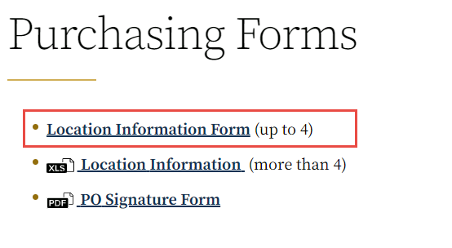
New Electronic Forms
AP Forms:
New Bank Account Request Form
Agency Request To Inactivate Bank Account
Payment Unreconciled Request Form
Purchasing Forms
Location Information Form
All forms are located on the SAO website at: https://sao.georgia.gov/

Slide 9
Questions
Additional questions may be directed to:
FSCM@sao.ga.gov

