Slide 1
SWAR FMC Presentation January 28, 2020

Slide 2
Agenda
Upcoming GASBs
GASB 84 – Fiduciary Activities
GASB 87 – Leases
Other GASBs
Tie Beginning Fund Balance Reminders
Internal Controls Status
Upcoming Training
FY2019 CAFR
FY2020 Other items

Slide 3
Upcoming GASBs

Slide 4
Upcoming GASBs
FY2020:
No. 84: Fiduciary Activities
No. 90: Majority Equity Interests
FY2021
No. 87: Leases
No. 89: Accounting for Interest Cost Incurred before the End of a Construction Period
TBD: Omnibus 20xx
FY2022
No. 91: Conduit Debt
TBD: Subscription Based Information Technology Arrangements (SBITAs)
TBD: Public-Private and Public-Public Partnerships and Availability Payment Arrangements
TBD: Internal Revenue Code 457 Deferred Compensation Plans

Slide 5
GASB No. 84 – Fiduciary Activities
Effective Fiscal Year 2020
Survey was sent to CFOs in May 2019
Due to large volume of activities to review, some agencies are still under evaluation and will be contacted within the next month
REMEMBER: Some activities may change presentation due to survey assessment
SAO to provide additional guidance
SAO may still ask for some additional support for implementation documentation purposes

Slide 6
Effective Fiscal Year 2020
GASB No. 84 – Fiduciary Activities
KEY AREAS TO REMEMBER
Funds Held for Others should NOT be used for fiduciary funds
Revenue and Expenditure accounts MUST be used
Net Position will be reported in custodial funds (formerly agency funds)

Slide 7
GASB No. 87 – Leases
Effective Fiscal Year 2021
Next few weeks:
SAO will send out surveys to agencies with lease data
Will be part of confirmation of prior year reporting
Will include questions to help agencies determine application of GASB 87 criteria, for example:
Free rent periods or prepayments
Lease Incentives
Multiple Components (ex: lease includes janitorial services, paper/toner, maintenance, etc.)
Survey will include Lessor data
Agreements meeting GASB definition of lease not in SAO database
SAO will train agencies on how to complete the survey
Reminder on fiscal funding clauses:
Renewal periods are included in lease term, even if there is a fiscal funding clause, unless it is reasonably certain that the fiscal funding clause will be exercised

Slide 8
GASB No. 87 – Leases
Effective Fiscal Year 2021
Fiscal Year 2021:
Updated year-end form, “Lease Agreement Data Form”
Updated lease policies will be posted on SAO’s Website

Slide 9
GASB No. TBD – SBITA
Effective Fiscal Year 2022
Subscription-Based Information Technology Arrangements:
Applies to subscription based IT arrangements (i.e. Cloud computing)
Will be very similar to GASB 87 leases

Slide 10
Tie Beginning Fund Balance Reminders

Slide 11
Tie Beginning Fund Balance
Once the BCR is published & SAO sends notification (typically November of each year), each budget unit should:
Record entries for return of surplus by program and fund source
Record entries for prior-year carryover by program & fund source
Check compliance with accounting policy using reconciliation
26 of 40 agencies not yet tied in

Slide 12
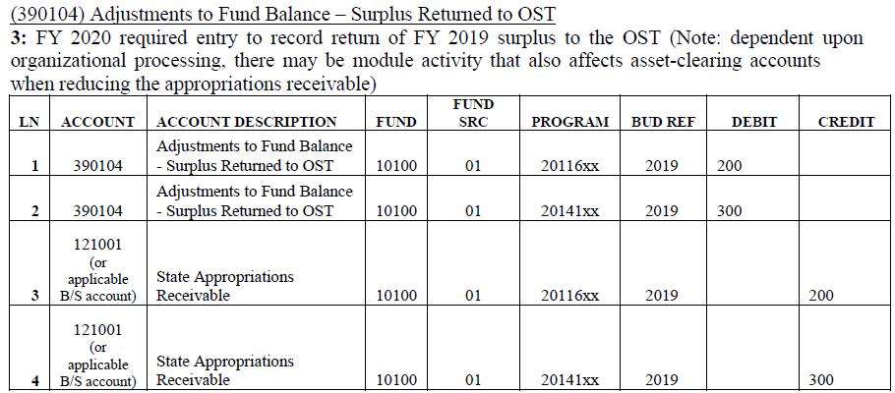
Tie in Beginning Fund Balance
Return of Surplus
* Or applicable Balance Sheet account

Slide 13
Tie in Beginning Fund Balance
Prior Year Carry-Over
FY19Jun 2019
FY20Nov 2019
*
* If the entry to record Reserves in Jun 2019 was not made in TeamWorks, record the following instead for
Prior Year Carry-Over:
NOTE: Read the Prior Year Carry-Over Policy for more details on reserve of STATE FUNDS.
https://sao.georgia.gov/policies-and-procedures/accounting-policy-manual

Slide 14
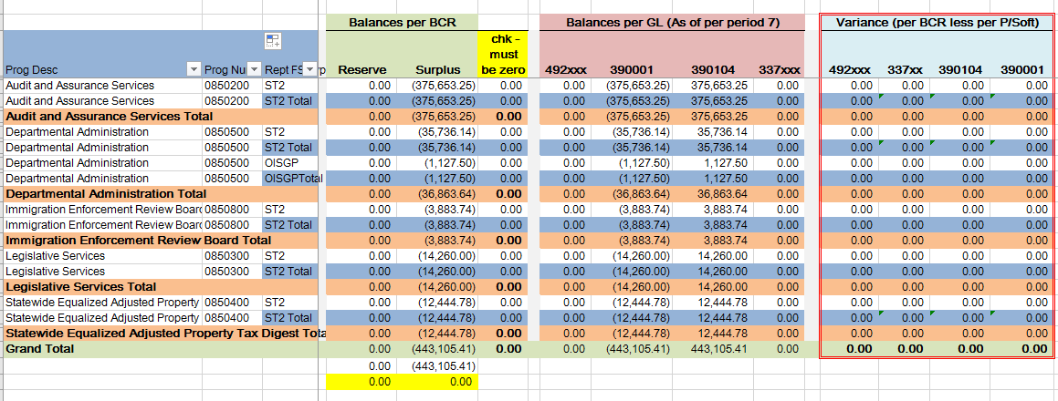
Tie Beginning Fund Balance
The variance columns on the recon indicate compliance status:

Slide 15
Internal Controls

Slide 16
Internal Controls – What does the future hold….
Spring submission of RA/CA template will be performed through Onspring software:
Standardized library of control activities
More reporting capabilities
Note – select agencies piloted this software last fall
Etc.
Additional questions relating to IT internal controls
More Testing of Internal Controls listed:
Additional questions
Requests for Documents
Communication to CFO or Agency Head (as necessary)
Etc.
Best Practice Guides or Additional Trainings

Slide 17
Upcoming Training
AGA GASB Update webinar
Wednesday February 5th, 2-3:50 pm, West Tower Rooms 1514A and 1514B
Note: you must attend this webinar in person (there is not a remote viewing option)

Slide 18
2019 CAFR

Slide 19
2019 CAFR/BCR Challenges
Most challenging areas:
Post Closing Adjustment form
Number of lines on PCA form
Debits / Credits not matching
Multiple fund types or AJEs on one form
Year-end forms submitted with errors or incomplete
Differences between agencies for amounts that should tie
Capital Asset transfers (receiving agency must record net book value amount that sending agency had)
Pass-through information for federal money on SEFA
Inter-org form amounts not matching; explanations of differences not provided
Agency managed GO bond project amounts not in sync between agency and GSFIC
Program transfers
Clearing Account balances in total and by fund type
Cash and Deposit form information not tying to general ledger

Slide 20
FY2020 Other items
SAO will continue with its Governance review of agency data
SAO will collect funding source mapping in June 2020
New questions and/or forms as needed for recent GASB pronouncements
SAO will work with agencies on Program Transfers to ensure reserve amounts at sending organization are recorded as carry-over (492001), then recorded as program transfer (493001) at both agencies.

Slide 21
Questions?

