Slide 1
GASB 87 Leases

Slide 2
Agenda
Objective
Definition of a lease
Exclusions
Lessor/Lessee Reporting
Multiple Components
Combination Leases
Renewal Options
Intergovernmental Agreements
Thresholds
Things to Consider

Slide 3
Objectives
Be in compliance with GASB 87, effective beginning July 1, 2020 (FY21)
Establishes a single model for lease accounting based on the foundational principle that leases are financings of the right to use an underlying asset.

Slide 4
GASB 87 Implementation
Process of Implementation:
GASB 87 Workshop (6/4/19)
July 1, 2020 – New accounting for leases begins
CAFR FY2021 – New reporting requirement changes
Operating leases population analysis
These leases will now become capital
Copiers & postage meters
Threshold determination – TBD

Slide 5
Definition of Lease
Old lease definition:
A lease is defined as an agreement between a lessor (vendor) and a lessee (State/agency) that conveys the lessee the right to use property or equipment for a specified period of time for predetermined cash payments (rents). A lease agreement must be evaluated to determine whether the transaction and related disclosures should be reported as a capital or operating lease.
New definition of a lease:
A contract that conveys control of the right to use another entity’s nonfinancial asset (underlying asset) as specified in the contract for a period of time in an exchange or exchange-like transaction
Conveying control requires both of the following:
the right to obtain the present service capacity from use of the underlying asset, and
the right to determine the nature and manner of use of the underlying asset
Significant difference – no operating leases anymore

Slide 6
Leases Scope Exclusions
Intangible assets (mineral rights, patents, software, copyrights)
Except for the sublease of an intangible right-to-use asset
Biological assets (including timber, living plants, and living animals)
Inventory
Service concession arrangements (GASB Statement 60)
Assets financed with outstanding conduit debt (unless both the asset and conduit debt are reported by lessor)
Supply contracts (such as typical power purchase agreements, which do not convey control of the right to use the underlying power generating facility)
Exceptions for lessors
Leases of assets that are investments (under GASB 72 definition)
Certain regulated leases (e.g., airport-airline agreements)

Slide 7
Lessor/Lessee Reporting
Essentially all leases will be capital leases
Exceptions (lessors and lessees)
Short-term leases
Leases that transfer ownership and do not contain termination options (see prior slide)
No classification of leases into operating/capital or other categories
Underlying assumption that leases are financial arrangements

Slide 8
Lessor/Lessee Reporting
Lessee:
Recognize lease liability and lease asset at the commencement of the lease
Lease Liability – measured at the PV of payments expected to be made during the lease term, less any lease incentives.
Lease Asset – measured at the amount of the lease liability, plus any payments made to the lessor at or before commencement of the lease term and certain direct costs.

Slide 9
Lessor/Lessee Reporting
Lessee | Lessor
Lease payments made: Reduction of liability Interest expense | Lease payment received: Reduction of receivable Interest revenue
Amortization of lease asset: Shorter of uselife of underlying asset or lease term | Reduction of deferred inflow of resources - revenue: Over term of lease Systematic and rationale manner Governmental funds if available

Slide 10
Lessor/Lessee Reporting
Remeasure Lease Liability if one or more of the following changes has occurred:
Change in lease term
Residual value guarantee being paid has changed in certainty
Assessment of likelihood of exercising option has changed
a change in estimated amounts of payments
Change in the interest rate the lessor charges the lessee
A change in the variable payments such that they now meet the criteria for measuring the lease liability.

Slide 11
Lessor/Lessee Reporting
Lease term - period during which a lessee has a noncancelable right to use an underlying asset
Plus the following periods if applicable:
Lessee’s option to extend if it is reasonably certain
Lessee’s option to terminate the lease if it is reasonably certain
Lessor’s option to extend the lease if it is reasonably certain
Lessor’s option to terminate the lease if it is reasonably certain
Reassess term only if:
the reasonably certain conclusion on options were wrong
An event that requires an extension or termination takes place

Slide 12
Short-term leases
Accounting for Short-term Leases:
Short-term is defined as a lease that, at the commencement of the lease, has a maximum possible lease term of 12 months, including any options to extend regardless of their probability of being exercised.
For a lease that is cancelable by both the lessee or the lessor, such as a rolling month-to-month lease or a year-to-year lease, the maximum possible term is the noncancelable period, including any notice periods.

Slide 13
Short-term leases
Accounting for Short-term Leases:
LESSEE — lease payments recognized as expenses/expenditures based on the payment provisions of the contract
No recognition of assets or liabilities associated with the right to use the underlying asset for short-term leases
LESSOR — lease payments recognized as revenue based on the payment provisions of the contract
No recognition of receivables or deferred inflows associated with the lease
No resource flows recognized during rent holiday periods
No required disclosures

Slide 14
Leases – Basis of Accounting
LESSEE—Recognition & Measurement
Budgetary basis – no impact
Modified accrual - Governmental funds
Report payables when due
Don’t report lease (capital) assets
Full accrual accounting – Entity-Wide, Proprietary, Component Units
Recognize a liability for future lease payments (the “lease liability”) and an intangible capital asset for the right to use the underlying asset (the “lease asset”)
Lease data to be submitted on Lease Agreement Data form at year-end (FY21 form will be updated as needed for GASB 87)

Slide 15
Borrowing rate
Incremental Borrowing rate:
It is required that the lessee will use the State's (lessee's) own incremental borrowing rate as a discount rate used to calculate the present value unless the lessee is aware of the lessor's implicit rate of return.
The State’s rate is based on bond sale rates during the fiscal year
This determination is made only in the year of the lease's inception and does not need to be updated annually.
The rate that combines the fiscal year the lease began and the number of years that is closest to the number of years in the lease term should be listed on the year end form
For example, if the lease began in FY 2009 and was for a term of 9 years, select the 10-year rate of 4.0024% as the rate

Slide 16
Multiple Components
Contract with lease and nonlease components
• Separate lease component from nonlease component
Example: Allocate cost of toner vs copier
• Treat as separate contracts
Multiple underlying assets in same lease and assets have different lease terms
• Each underlying asset treated as separate component (lessee and lessor)
Allocate contract price to each component using reasonableness and professional judgment
Prices for each component in the contract (if available)
Stand-alone prices for similar assets
If cannot determine allocation, treat as a single-lease unit

Slide 17
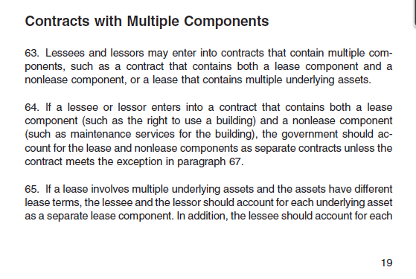
Multiple Components
May have to review contracts that aren’t labeled a “lease” to determine if there are items that would qualify as a lease under GASB 87 in the contracts
May have to break out portions:
Nonlease components such as maintenance costs versus lease costs (paragraph 64) or leases with different underlying assets (paragraph 65). See excerpt from GASB 87 below:

Slide 18
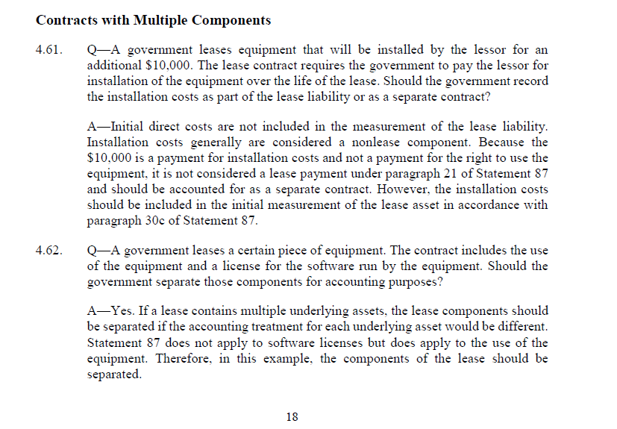
Multiple Components
Examples of leases with multiple components from the exposure draft:

Slide 19
Contract Combination
Criteria for treating as a single contract
Leases entered into at or near the same time with the same counterparty and one of the following:
Negotiated as a package with a single objective
Consideration paid in one contract depends on the price or performance of the other contract
Then, evaluate as a contract with multiple components

Slide 20
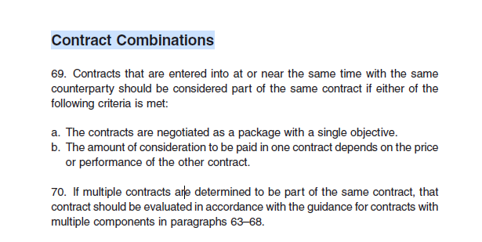
Contract Combination
Excerpt from GASB 87:

Slide 21
Renewal Options
Renewal Options - for financial reporting purposes intent of the lease term overrides the legal form of the lease term
A fiscal funding clause should only affect the lease term if it is reasonably certain that the clause will be exercised.
For example, a lease agreement with the option of renewing the lease on a year-to-year basis for 10 consecutive years SHOULD NOT be reported as a 1-year lease.
The intent of the lease term overrides the legal form of the lease term for financial reporting purposes. Even though the lease agreement is renewed every year, the lease term is 10 years and should be captured as such.

Slide 22
Renewal Options
The determination of the likelihood of a renewal or termination option being exercised applies only if that option pertains to the lessee alone.
If either the lessee or the lessor has the option to cancel a lease without permission from the other party (or if both parties have to agree to renew), an enforceable contract does not exist beyond that point.

Slide 23
Subleases
Treated as a separate transaction
Lessee now also the lessor
No offset of transactions
Original lessee
Right to use asset and liability (original lease)
Receivable and deferred inflow of resources (sublease)

Slide 24
Intergovernmental Agreements
If a State organization is part of the primary government for financial reporting purposes and enters into a lease agreement where the lessor entity (public authority, department, agency, division, etc.) is also part of the primary government, then the lease should not be reported as either an operating or capital lease.
The payments for these agreements should be considered ordinary operating expenditures/expenses by the lessee organization.
For example, agreements between Georgia Building Authority (GBA) and other organizations included in the State’s primary government should not be reported as leases in the statewide CAFR.
If any State organization enters into a lease agreement where the lessor is either a) a discretely presented component unit or b) a public organization that is not part of the governmental unit entity for financial reporting purposes, then the lease should be treated in the same manner as any other lease agreement of the State
Organization chart may be found on SAO’s website

Slide 25
Thresholds - TBD
SAO is currently determining thresholds for low dollar leases such as copiers & postage meters

Slide 26
Start thinking now about:
Leases with multiple components
Leases previously reported as Operating leases that will now be reported as Capital leases
Additional information may be required for these leases
Upcoming changes to the lease agreement data form for FY21
Lessor reporting changes
Future training considerations
Lease incentives
Leases with variable payments
Renewal periods
Lease form

Slide 27
Start thinking now about:
Factors to consider:
A significant economic incentive
A significant economic disincentive
A history of exercising options to extend or terminate
The extent to which the underlying asset is essential to the government services

Slide 28
Where to Find Information
SAO’s Website:
https://sao.georgia.gov/
Contact information:
Chelsea.bennett@sao.ga.gov
Amanda.brock@sao.ga.gov
GASB 87 can be found on GASB’s website at gasb.org and linked below:
https://www.gasb.org/jsp/GASB/Page/GASBSectionPage&cid=1176160042391
GASB 87 implementation guide can be found:
https://www.gasb.org/jsp/GASB/Page/GASBSectionPage&cid=1176160042391#gig

Slide 29
GASB 87 - Leases
Q&A

