Slide 1
GASB 87 Survey

Slide 2
Agenda
GASB 87 Implementation
Objective of Survey
Lease Scope Exclusions
GASB 87 Survey:
Instructions
Examples & definitions
Main Tab
Rent Tab
Other Agreements
Contract Combinations
Multiple Components
Variable Payments
Lease Incentives
Prepayments

Slide 3
GASB 87 Implementation
Process of Implementation:
GASB 87 Workshop (6/4/19)
FY19 Confirmation of Lease Reporting
FMC May 2020
GASB 87 Survey Workshop June 2020
Survey due back to SAO after fiscal year 2021 year- end close
May 2020 – GASB issues Statement No. 95 – Postponement of Effective Dates
Statement 87 and Implementation Guide 2019-3—fiscal years beginning after June 15, 2021, and all reporting periods thereafter
New Effective Date – July 1, 2021

Slide 4
Leases Scope Exclusions
Intangible assets (mineral rights, patents, software, copyrights)
Except for the sublease of an intangible right-to-use asset
Biological assets (including timber, living plants, and living animals)
Inventory
Service concession arrangements (GASB Statement 60)
Assets financed with outstanding conduit debt (unless both the asset and conduit debt are reported by lessor)
Supply contracts (such as typical power purchase agreements, which do not convey control of the right to use the underlying power generating facility)
Exceptions for lessors:
Leases of assets that are investments (under GASB 72 definition)
Certain regulated leases (e.g., airport-airline agreements)

Slide 5
Objectives of Survey
Assist agencies in analyzing lease population in order to meet compliance goal
To be in compliance with GASB 87, effective beginning July 1, 2021 (FY22)

Slide 6
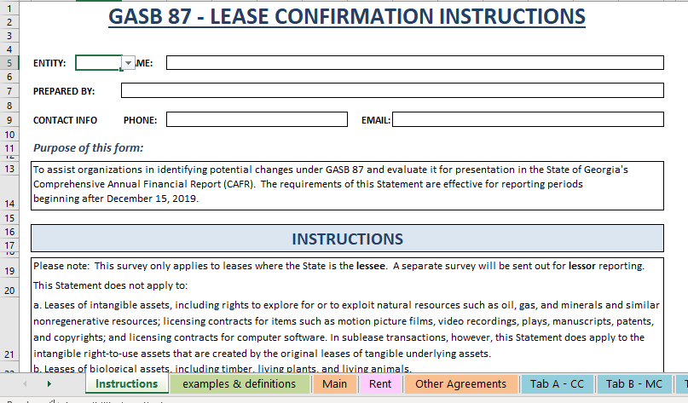
Instructions Tab
Complete top section of Instructions tab
SAO has a GASB implementation page
https://sao.georgia.gov/gasb-implementations

Slide 7
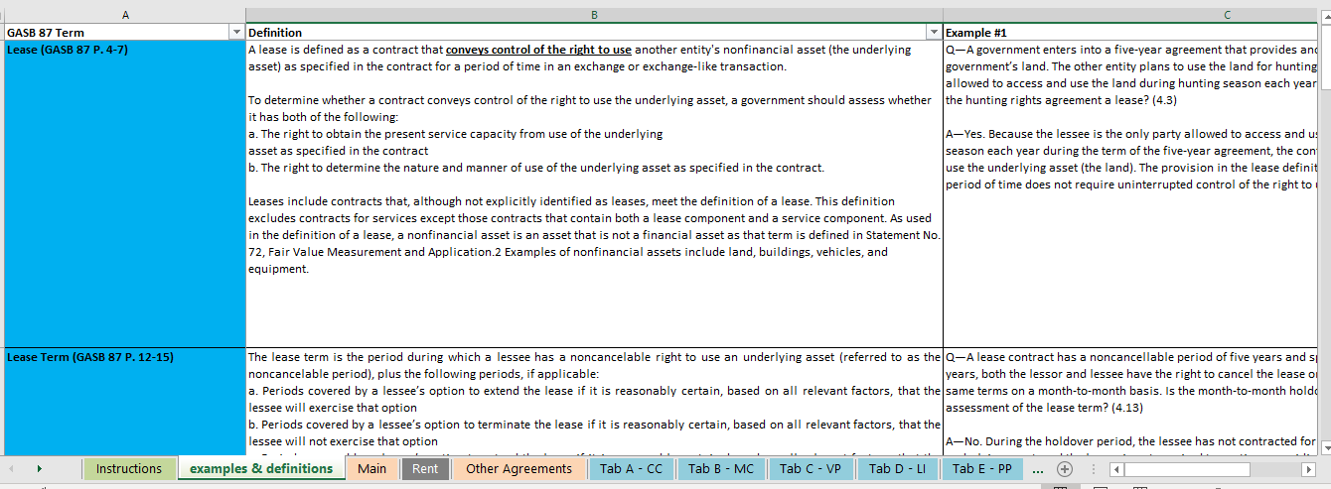
Examples & Definition Tab
Each GASB 87 term has:
paragraph reference
definition
examples given from Final Implementation Guide

Slide 8
Main Tab
Built around EZ Lease’s Lease List report in Excel Format
First few columns are linked to your agency’s lease data for easier viewing
Answer questions left to right
Color coded columns based on key elements of GASB 87:
Lease Term – orange columns
Lease Liability – green columns
Lease Asset – purple columns
Everything else – blue columns
Paragraph reference provided above each question
See Examples & Definitions tab for guidance

Slide 9
Main Tab

Slide 10
Lease Term
Lease term – Period during which a lessee has a noncancelable right to use an underlying asset
Plus the following periods if applicable:
Lessee’s option to extend if it is reasonably certain
Lessee’s option to terminate the lease if it is reasonably certain
Lessor’s option to extend the lease if it is reasonably certain
Lessor’s option to terminate the lease if it is reasonably certain
Reassess term only if:
the reasonably certain conclusion on options were wrong
An event that requires an extension or termination takes place
Fiscal Funding Clause - only affect the lease term if it is reasonably certain that the clause will be exercised
Most importantly - Is lease term in compliance with GASB 87?

Slide 11
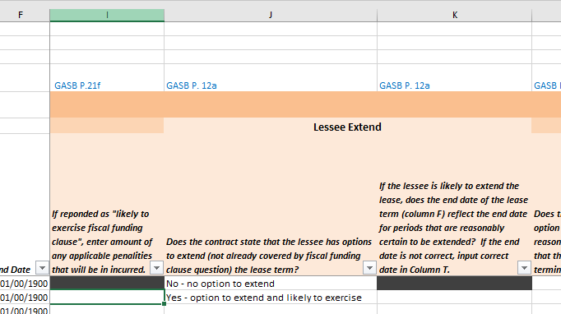
Lease Term
Lease term – Orange columns – 14 questions
Some questions will grey out depending on response to a previous question

Slide 12
Lease Liability
Remeasure Lease Liability if one or more of the following changes has occurred:
Change in lease term
Residual value guarantee being paid has changed in certainty
Assessment of likelihood of exercising option has changed
A change in estimated amounts of payments
Change in the interest rate the lessor charges the lessee
A change in the variable payments such that they now meet the criteria for measuring the lease liability.

Slide 13
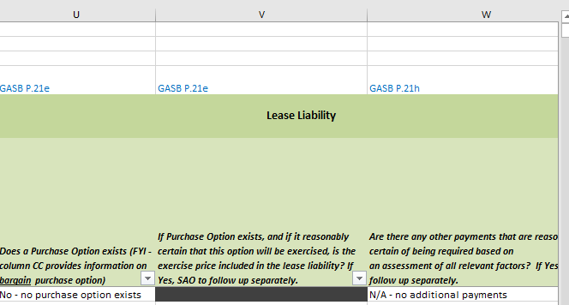
Lease Liability
Lease Liability – Green columns – 3 questions
Does purchase option exist? Column V will grey out depending on response in Column U

Slide 14
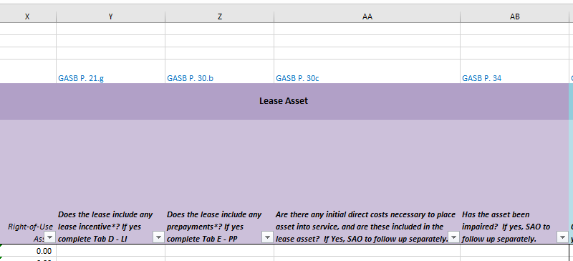
Lease Asset
Lease Asset – Purple columns – 4 questions
Right-of-Use-Asset prepopulates lease in column X (based on data from EZ)
If any Lease Incentives – complete Tab D – LI
If any Prepayments – complete Tab E - PP

Slide 15
Tab D – Lease Incentives
Lease incentives are:
(a) payments made to, or on behalf of, the lessee, for which the lessee has a right of offset with its obligation to the lessor, OR
(b) other concessions granted to the lessee. A lease incentive is equivalent to a rebate or discount and includes assumption of a lessee’s preexisting lease obligations to a third party, other reimbursements of lessee costs, rent holidays, and reductions of interest or principal charges by the lessor.

Slide 16
Tab D – Lease Incentives
If you answer “Yes” to the question in column Y then you must complete Tab D – LI
Only need to answer rows in yellow
If you answered “No” then row grays out
Columns A – C are linked to the Main tab
List amount of Lease Incentive in column D
Choose from dropdown list in column E
If lease incentive amount is included in the lease a change is needed
No change needed – lease asset already reduced by incentive amount

Slide 17
Tab E – Prepayments
Prepayments are:
Lease payments made to the lessor at or before the commencement of the lease term, less any lease incentives (as discussed in GASB 87 paragraphs 61 and 62) received from the lessor at or before the commencement of the lease term
Should NOT be included in the lease asset until you have the right to use the asset

Slide 18
Tab E – Prepayments
If you answer “Yes” to the question in column Z then you must complete Tab E – PP
Only need to answer rows in yellow
If you answered “No” then row grays out
Columns A – C are linked to Main tab
List amount of Prepayment in column D

Slide 19
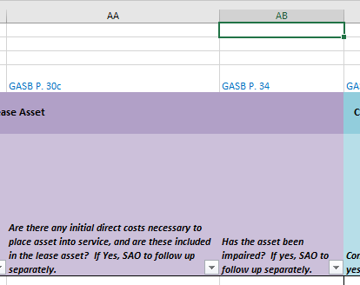
Lease Asset
Initial Direct Costs
Ancillary charges to place the asset into service
Impairment (GASB 87 P. 34)
If a lease asset is impaired, the amount reported for the lease asset should be reduced first for any change in the corresponding lease liability. Any remaining amount should be recognized as an impairment.

Slide 20
Everything Else
Columns AC – AE on Main tab require other tabs to be completed if answer is “Yes”
Tab A – Contract Combinations
Tab B – Multiple Components
Tab C – Variable Payments

Slide 21
Tab A - Contract Combination
Criteria for treating as a single contract:
Leases entered into at or near the same time with the same counterparty and one of the following:
Negotiated as a package with a single objective
Consideration paid in one contract depends on the price or performance of the other contract
If multiple contracts are determined to be part of the same contract, that contract should be evaluated in accordance with the guidance for contracts with multiple components in paragraphs 63–68.

Slide 22
Tab A - Contract Combination
If you answer “Yes” to the question in column AC then you must complete Tab A – CC
Enter lease number in column A
Select from drop down in column B
Contracts are negotiated as a package with a single objective
Dependence on the price or performance of the other contract

Slide 23
Tab B - Multiple Components
Contract with lease and nonlease components
• Separate lease component from nonlease component. Ex:
Allocate cost of toner vs copier
Allocate cost of vehicle vs oil changes or maintenance costs
• Treat as separate contracts
Multiple underlying assets in same lease and assets have different lease terms
• Each underlying asset treated as separate component (lessee and lessor)
Allocate contract price to each component using reasonableness and professional judgment
Prices for each component in the contract (if available)
Stand-alone prices for similar assets
If cannot determine allocation, treat as a single-lease unit

Slide 24
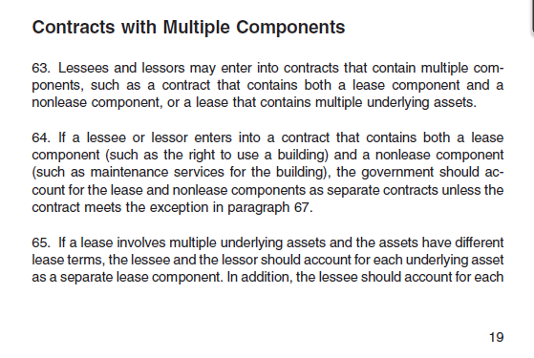
Tab B - Multiple Components
May have to review contracts that aren’t labeled a “lease” to determine if there are items that would qualify as a lease under GASB 87 in the contracts
May have to break out portions:
Nonlease components such as maintenance costs versus lease costs (paragraph 64) or leases with different underlying assets (paragraph 65). See excerpt from GASB 87 below:

Slide 25
Tab B – Multiple Components
If you answer “Yes” to the question in Column AD then you must complete Tab B – MC
If not able to break out components, explain why not practicable
Difference between practicable & hard
If MC exist, do they have different terms?
Remaining columns – provide breakout of components including component description and dollar amount

Slide 26
Tab C – Variable Payments
Payments that depend on an index or a rate (such as the Consumer Price Index or a market interest rate), initially measured using the index or rate as of the commencement of the lease term.
Variable payments based on future performance of the lessee or usage of the underlying asset should NOT be included in the measurement of the lease liability.
should be recognized as outflows of resources (for example, expense) in the period in which the obligation for those payments is incurred.
However, any component of those variable payments that is fixed in substance should be included in the measurement of the lease liability.
If you answer “Yes” to the question in Column AE then you must complete Tab C – VP

Slide 27
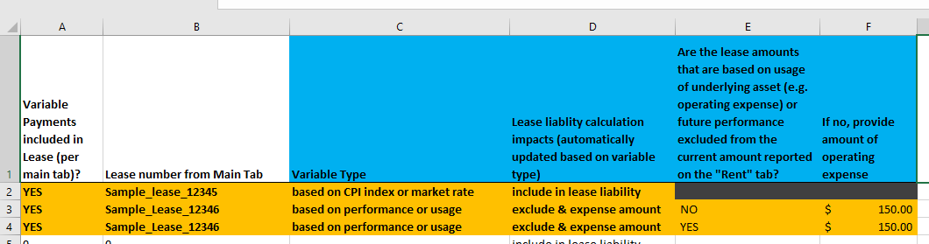
Tab C – Variable Payments
Columns A & B are linked from the Main tab
Select from drop down in column C
Based on CPI index or market rate
Based on performance or usage
Column D prepopulates based on answer chosen in column C
Column E - are lease amounts based on usage excluded from the amount on the “Rent” tab?
If no, provide amount of operating expense in column F
SAO to update rent amount that should be excluded

Slide 28
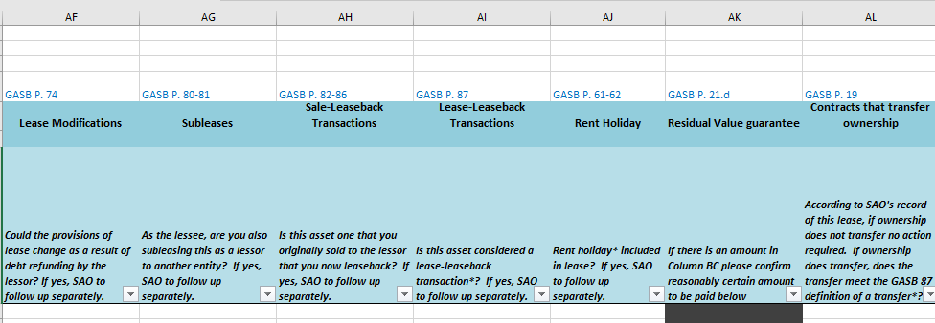
Everything Else
Remaining blue columns:
Lease Modifications – Debt refunding
Subleases
Sale-Leaseback Transactions/Lease-Leaseback Transactions
Rent Holiday
Residual Value Guarantee – greyed out depending on lease list
Contracts that Transfer Ownerships
Some answers will require SAO to follow up separately

Slide 29
Everything Else
Lease Modifications
The lessee and lessor should account for an amendment during the reporting period resulting in a modification to a lease contract as a separate lease (that is, separate from the most recent lease contract before the modification) if both of the following conditions are present:
The lease modification gives the lessee an additional lease asset by adding one or more underlying assets that were not included in the original lease contract.
The increase in lease payments for the additional lease asset does not appear to be unreasonable based on
(1) the terms of the amended lease contract and
(2) professional judgment, maximizing the use of observable information (for example, using readily available observable stand-alone prices).

Slide 30
Everything Else
Subleases - Treated as a separate transaction
Lessee now also the lessor
No offset of transactions
Original lessee
Right to use asset and liability (original lease)
Receivable and deferred inflow of resources (sublease)
Sale-Leaseback Transactions
Sale-leaseback transactions involve the sale of an underlying asset by the owner and a lease of the property back to the seller (original owner).
A sale-leaseback transaction that does not include a qualifying sale should be accounted for as a borrowing activity by the seller-lessee and a lending activity by the buyer-lessor.

Slide 31
Everything Else
Lease-Leaseback Transactions
In a lease-leaseback transaction, an asset is leased by one party (first party) to another party and then leased back to the first party.
May involve an additional asset (such as a building or only a portion of the original asset (such as leasing back only one floor of a building to the owner).
Should be accounted for as a net transaction. Both parties to a lease-leaseback transaction should disclose the amounts of the lease and the leaseback separately in the notes to financial statements.
Rent Holiday
One or more months free where in lessee does not pay rent

Slide 32
Everything Else
Residual Value Guarantee
Amounts that are reasonably certain of being required to be paid by the lessee
Contracts that Transfer Ownership
A contract that:
transfers ownership of the underlying asset to the lessee by the end of the contract AND
does not contain termination options (see paragraph 12), but that may contain a fiscal funding or cancellation clause that is not reasonably certain of being exercised (see paragraph 13), should be reported as a financed purchase of the underlying asset by the lessee or sale of the asset by the lessor.

Slide 33
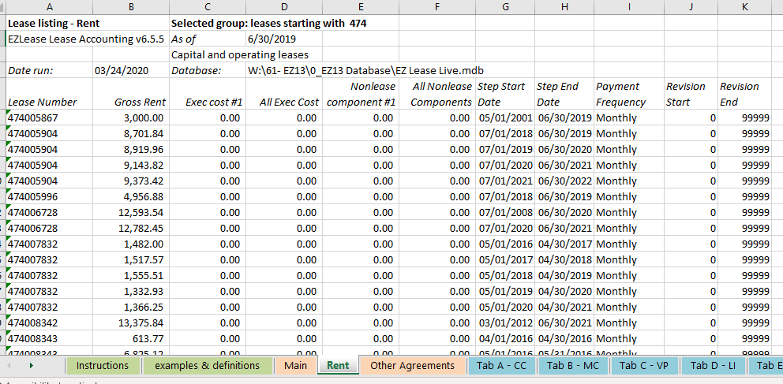
Rent Tab
Lease Listing – Rent report
This tab is linked to other tabs in survey
No action required

Slide 34
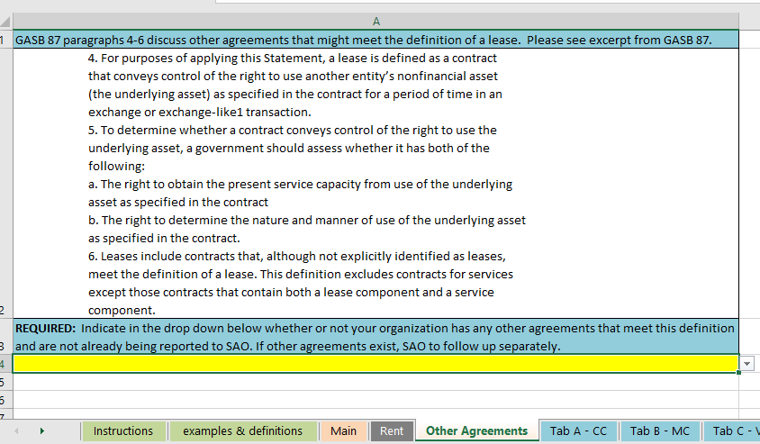
Other Agreements
Other Agreements that might meet the definition of a lease, which may be embedded in other agreements

Slide 35
Other Agreements
What is the challenge with embedded leases:
There may be leases embedded in existing contracts that were not previously identified
Many contracts will not use the terms “lease” or “rent” that allow for easier identification
Critical evaluation may be required to determine whether a right to control the use of an asset created by the contract
Where are embedded leases often found?
Advertising agreements
Service agreements
Transportation agreements
Construction agreements
Related party charges
IT Services
Supply contracts

Slide 36
Other Agreements
Example – Shuttle Service
Agency A has multiple buildings. Employees frequently must travel between buildings and parking lots that are far apart from each other.
Agency A engages Shuttle Service to provide shuttle bus service around its buildings to its employees and visitors.
3 buses used by Shuttle Service are dedicated to Agency A’s contract. Agency A can only use the buses on its buildings.
Agency A dictates the routes, frequency, and hours of operation for the shuttle service.
Shuttle Service operates and maintains the buses.
For what purpose & how the asset is used is not predetermined in the agreement
Agency has the right to direct how and for what purpose the asset is used
Contract contains a lease

Slide 37
Intergovernmental Agreements
Reminder - If a State organization is part of the primary government (PG) for financial reporting purposes and enters into a lease agreement where the lessor entity (public authority, department, agency, division, etc.) is also part of the PG, then the lease should not be reported as either an operating or capital lease.
The payments for these agreements should be considered ordinary operating expenditures/expenses by the lessee organization.
For example, agreements between Georgia Building Authority (GBA) and other organizations included in the State’s primary government should not be reported as leases in the statewide CAFR.
If any State organization enters into a lease agreement where the lessor is either a) a discretely presented component unit or b) a public organization that is not part of the governmental unit entity for financial reporting purposes, then the lease should be treated in the same manner as any other lease agreement of the State
Organization chart may be found on SAO’s website:
https://sao.georgia.gov/statewide-reporting/reporting-structure-chart-accounts

Slide 38
Start thinking now about:
Leases previously reported as Operating leases that will now be reported as Capital leases
Additional information may be required for these leases
Other Agreements
Contract Combinations
Multiple Components
Variable Payments
Lease Incentives
Prepayments
Upcoming changes to the lease agreement data form for FY22
Lessor reporting changes

Slide 39
Start thinking now about:
Subscription-Based Information Technology Arrangements (SBITAs):
The project will consider (1) potential accounting and financial reporting guidance for cloud computing arrangements (CCAs) that are not addressed in current guidance and (2) potential amendments to Statement No. 51, Accounting and Financial Reporting for Intangible Assets, and related questions and answers in the Comprehensive Implementation Guide.
CCAs typically allow end users to access software or hardware remotely from any location and to store data with the providers for a length of time typically longer than a year.
For more information on SBITAs, visit GASB’s website at:
https://www.gasb.org/jsp/GASB/GASBContent_C/ProjectPage&cid=1176170507484

Slide 40
Where to Find Information
SAO’s Website:
https://sao.georgia.gov/
Contact information:
Chelsea.Bennett@sao.ga.gov
Amanda.Weary@sao.ga.gov
GASB 87 can be found on GASB’s website at gasb.org and linked below:
https://www.gasb.org/jsp/GASB/Page/GASBSectionPage&cid=1176160042391
GASB 87 implementation guide can be found:
https://www.gasb.org/jsp/GASB/Page/GASBSectionPage&cid=1176160042391#gig

Slide 41
GASB 87 Survey
Q&A

