Slide 1
Multifactor Authentication (MFA) with Email Setup
DESCRIPTION
This guide will show employees how to set up Multi-Factor Authentication (MFA) with Email to access GA@WORK.
OVERVIEW
The key steps in the process are below:
Log in to GA@WORK with your username and password.
Click Sign In.
Click Email Set Up.
Retrieve Verification Code from email and enter code into GA@WORK.
Click Verify Code.
View your GA@WORK homepage.

Slide 2
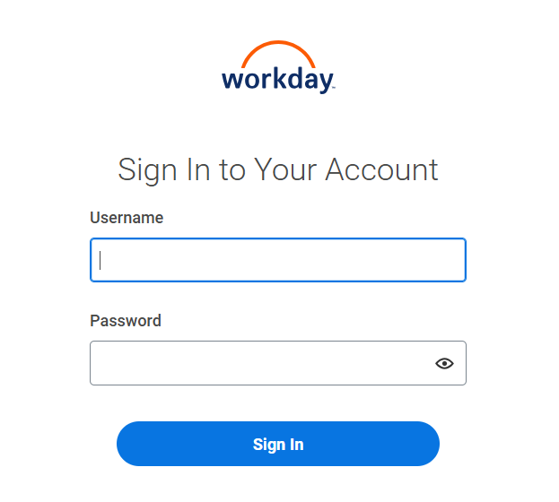
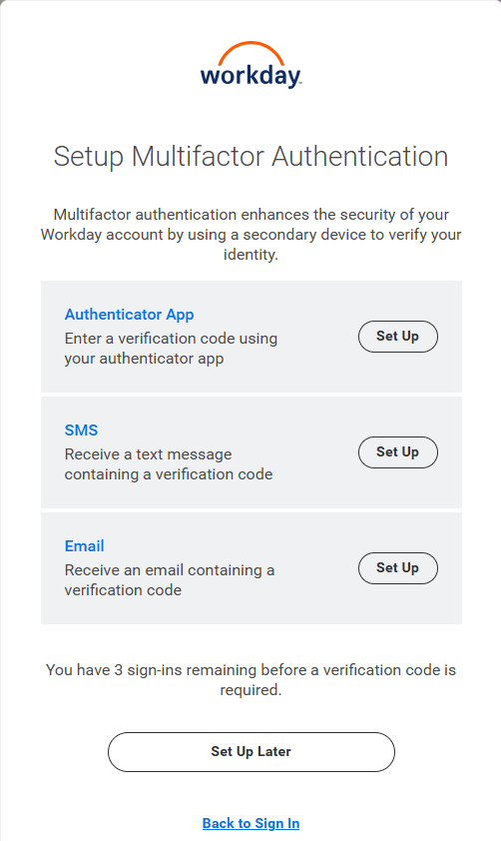
Multifactor Authentication (MFA) with Email Setup (Part 1 of 3)
INSTRUCTIONS
Enter your Username and Password.
Click Sign In.
1
2
Click Set Up in the Email block.
Note: Employees and External Learners may skip Multi-Factor Authentication up to 3 times when logging in.

Slide 3
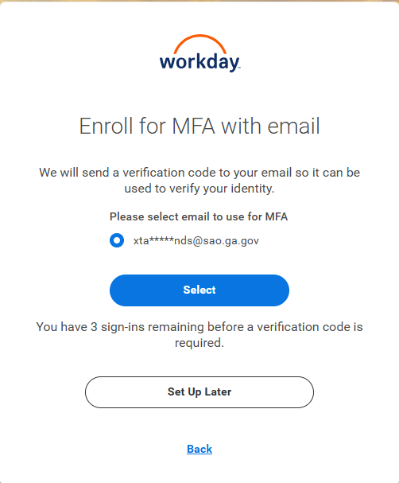
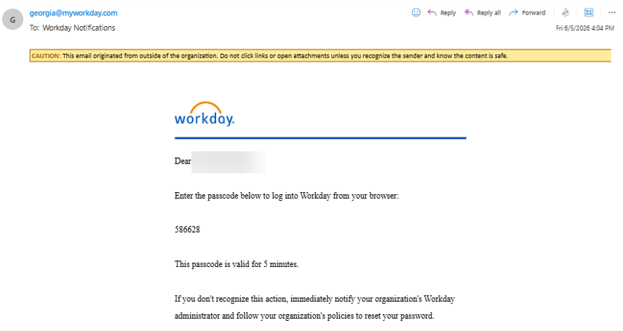
Multifactor Authentication (MFA) with Email Setup (Part 2 of 3)
INSTRUCTIONS
Click Select to Enroll for MFA with Email. A Verification Code will be sent to your email address noted in GA@WORK.
Locate the Verification Code sent to your email.

Slide 4
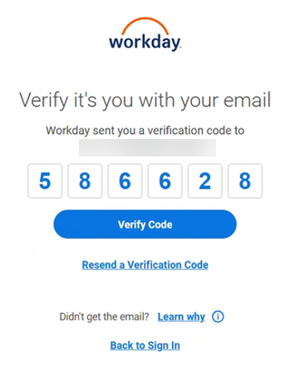
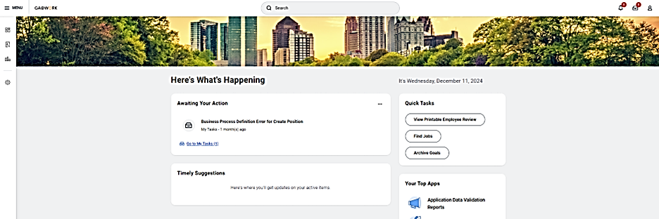
Multifactor Authentication (MFA) with Email Setup (Part 3 of 3)
INSTRUCTIONS
Enter the Verification Code from your email and click Verify Code.
You are now logged in to GA@WORK.
You have successfully setup a Multi-Factor Authentication (MFA) with Email.

