Slide 1
Log In to GA@WORK for Employees Using Azure Single Sign-On
This guide will assist Employees with the steps to Log In to GA@WORK using Azure Single sign-on.
Enter Username and Password.
Select Enter a code or Get a push notification.
Click GA@WORK.
Click Submit.

Slide 2

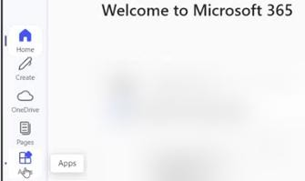
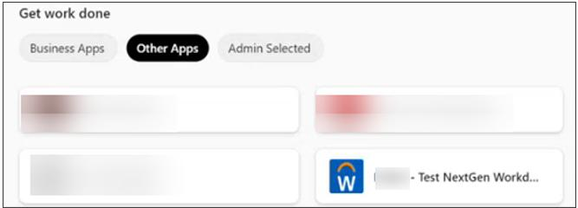
Log In to GA@WORK for Employees Using Azure Single Sign-On (Part 1 of 2)
Click Apps in Microsoft 365.
Select Other Apps.
Click the Workday app.
Note: The location of the Workday app will vary depending on your personal configurations.
2
3

Slide 3
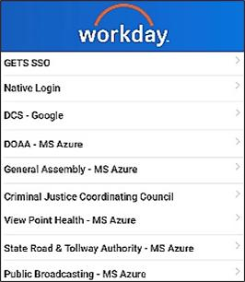
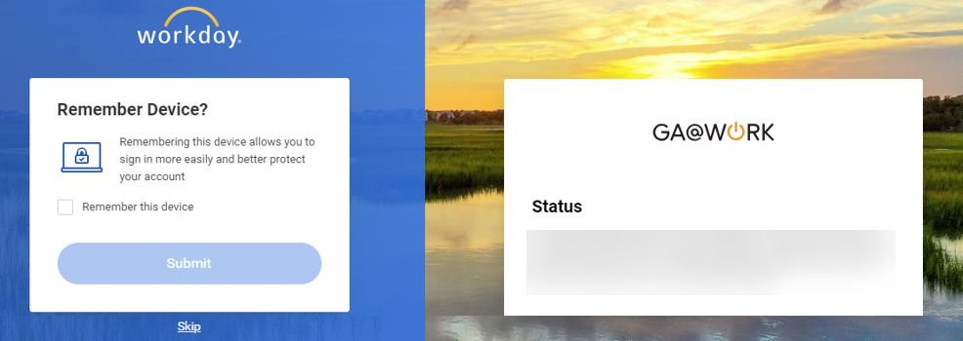
Log In to GA@WORK for Employees Using Azure Single Sign-On (Part 2 of 2)
Select the appropriate Identity Provider (IdP) provided for your agency, if applicable.
Note: If your agency is not in the list, select Native Login.
You may check Remember this device.
Click Submit.
Note: Click Skip to proceed without the device being remembered.
5
6
You have successfully logged in to GA@WORK using Azure Single Sign On.

