Slide 1
Log In to GA@WORK for Employees Using Okta Single Sign-On
This guide will assist employees with the steps to Log In to GA@WORK using Okta Single Sign-On.
Enter Username and Password.
Select Enter a code or Get a push notification.
Click GA@WORK.
Click Submit.

Slide 2
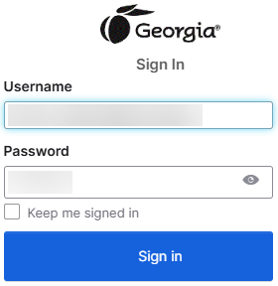
Log In to GA@WORK for Employees Using Okta Single Sign-On (Part 1 of 7)
Enter your Username and Password.
Click Sign In.
Note: You may click Keep me signed in to allow automatic sign in for future logins.
1
2

Slide 3
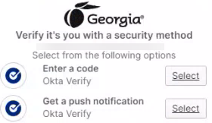
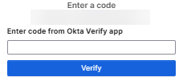
Log In to GA@WORK for Employees Using Okta Single Sign-On (Part 2 of 7)
If using a code, select Enter a Code.
You will be redirected to the Enter a code screen.

Slide 4

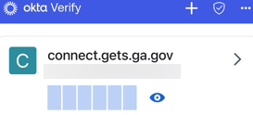
Log In to GA@WORK for Employees Using Okta Single Sign-On (Part 3 of 7)
On your device, select Okta Verify.
Note: Location and appearance may vary by device and personal configurations. This guide, uses an iPhone.
Click the masked code.

Slide 5
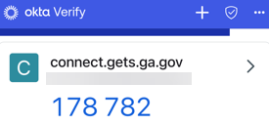
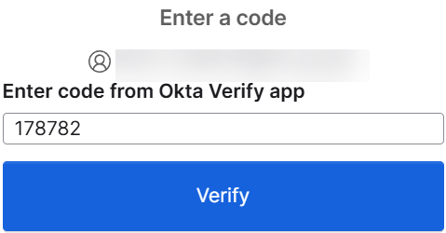
Log In to GA@WORK for Employees Using Okta Single Sign-On (Part 4 of 7)
The code will be revealed.
Note: This screen will reset code every thirty (30) seconds with a new code.
On your computer, enter code from the Okta Verify application.
Click Verify to access GA@WORK.
Note: If you would like to have the notification pushed to your phone, skip to Step 10.
8
9

Slide 6
Log In to GA@WORK for Employees Using Okta Single Sign-On (Part 5 of 7)
͏You may click Get a push notification as an alternative to entering a code.
On your device, select the Okta application.
Note: Location and appearance may vary by device and personal configurations. This guide, uses an iPhone.

Slide 7
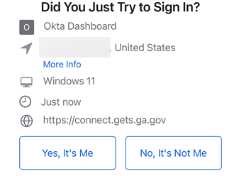
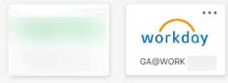
Log In to GA@WORK for Employees Using Okta Single Sign-On (Part 6 of 7)
͏On your device, click Yes, It’s Me.
Click GA@WORK.
Note: Location of GA@WORK tile will vary depending on personal configurations.

Slide 8
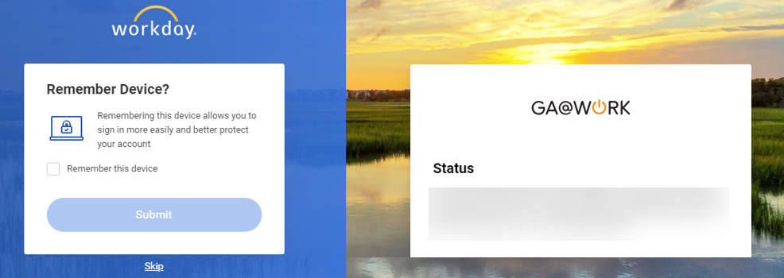
Log In to GA@WORK for Employees Using Okta Single Sign-On (Part 7 of 7)
You may check Remember this device.
Click Submit.
14
15
You have successfully logged in to GA@WORK using Okta (GETS) Single Sign-On.

