Slide 1
Log In to GA@WORK for Employees Using Native Login with MFA
DESCRIPTION
This guide will assist Employees with the steps for Native login to GA@WORK using Multifactor Authentication (MFA) with DUO, SafeNet, Okta, Google, or Microsoft authenticator applications.
OVERVIEW
The key steps in the process are below:
Download the applicable Authenticator Application on your phone (DUO, SafeNet, Okta, Google or Microsoft)
Login to GA@WORK and setup extra verification.
Scan QR Code.
Enter numerical code.
Business Process:
Install Duo Authenticator
Log In to GA@WORK
Scan QR Code
Enter Numerical Code

Slide 2
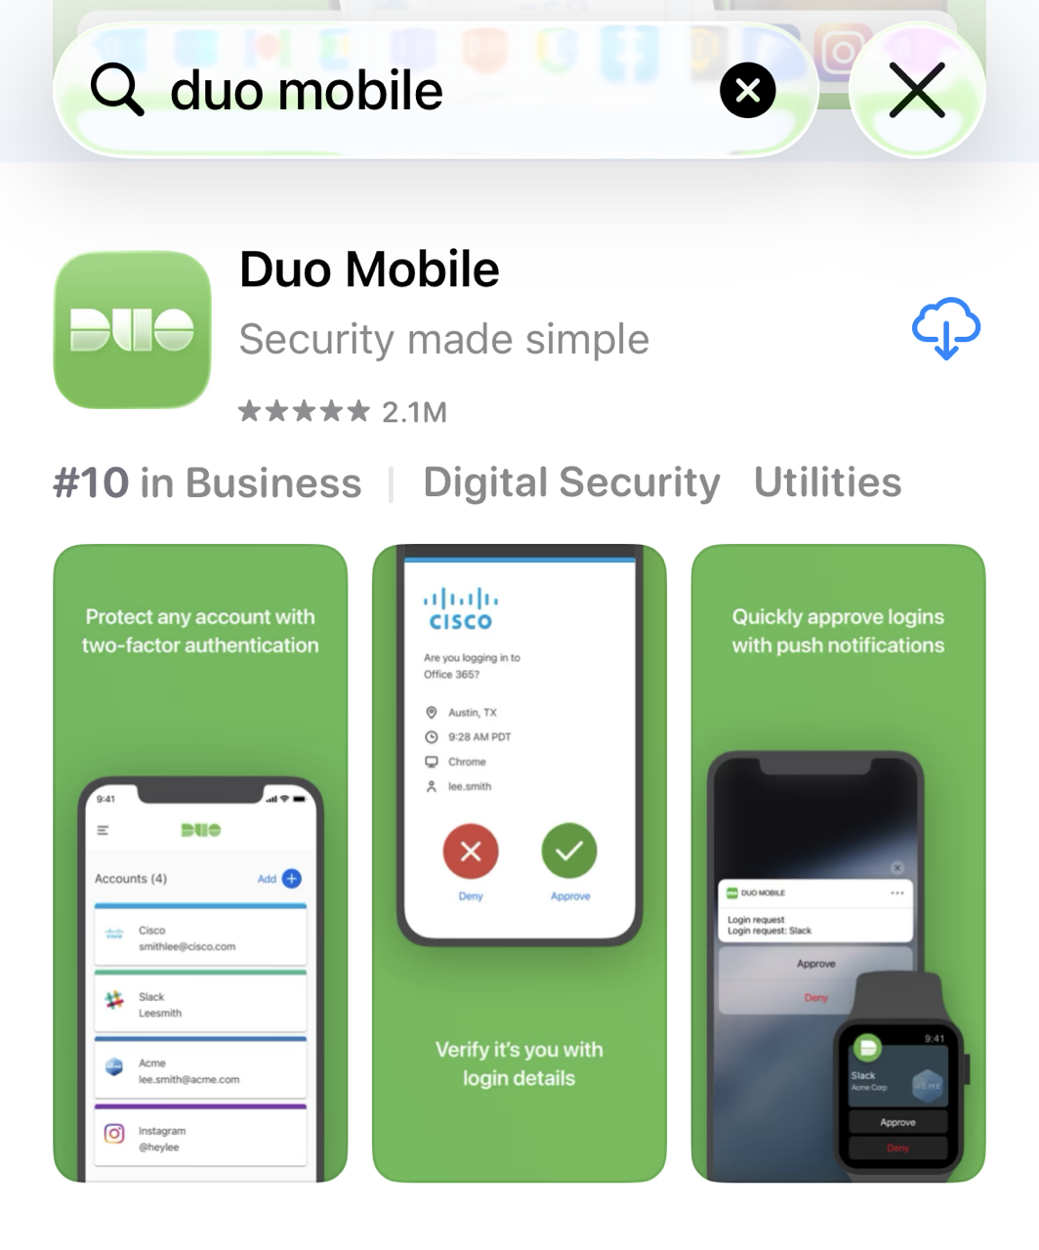
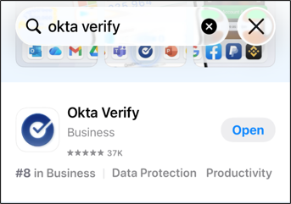
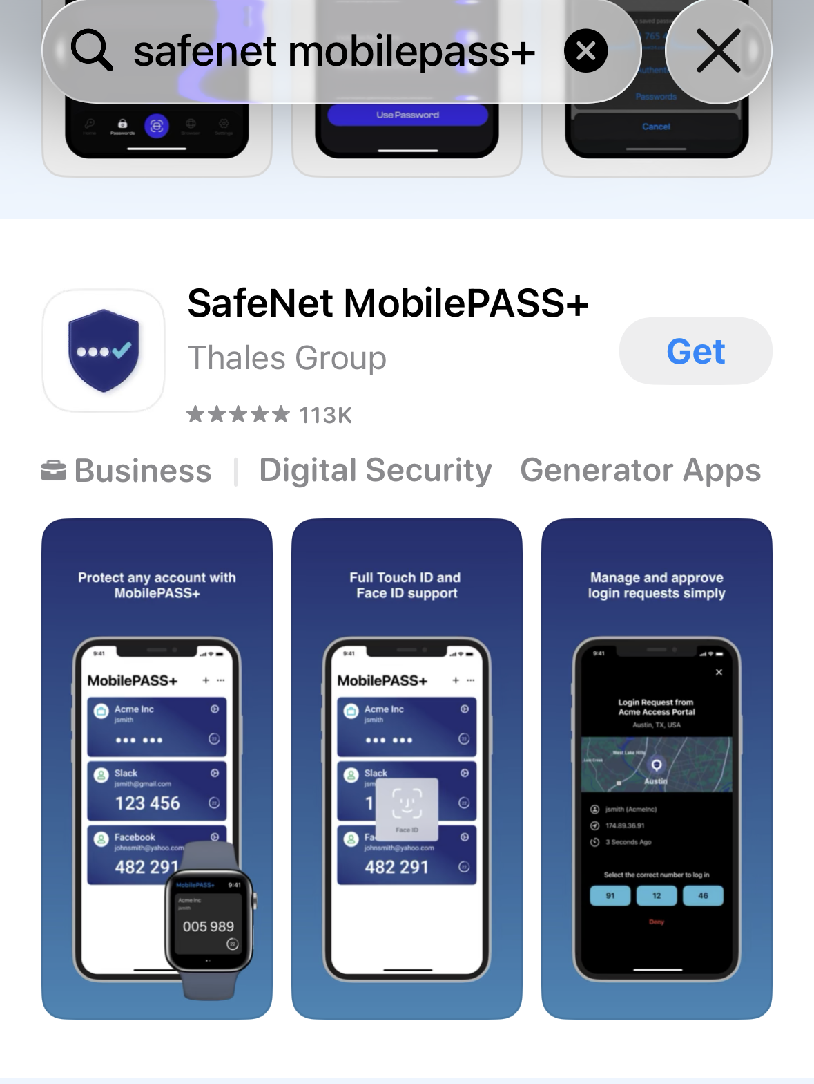
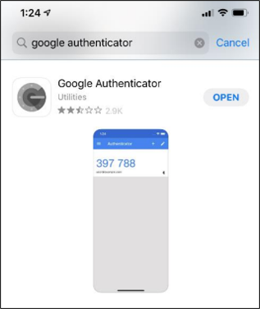
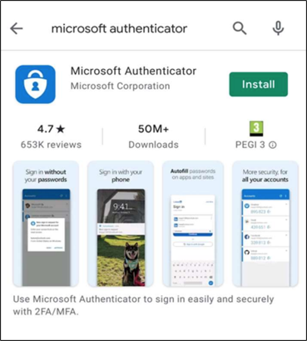
Log In to GA@WORK for Employees Using Native Login with MFA (Part 1 of 8)
On your phone, navigate to your phone’s app store and download the Authenticator Application used by your Agency.
Note: The images below show each of the Multifactor Authentication Applications (DUO, Okta, SafeNet MobilePass+, Google and Microsoft), please select the app designated by your agency.

Slide 3
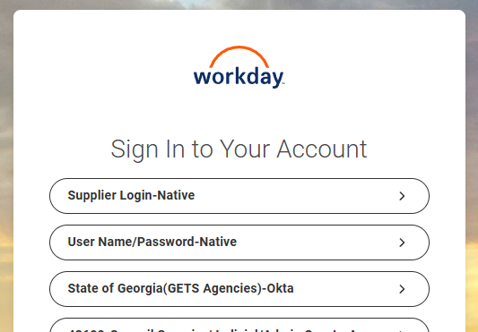
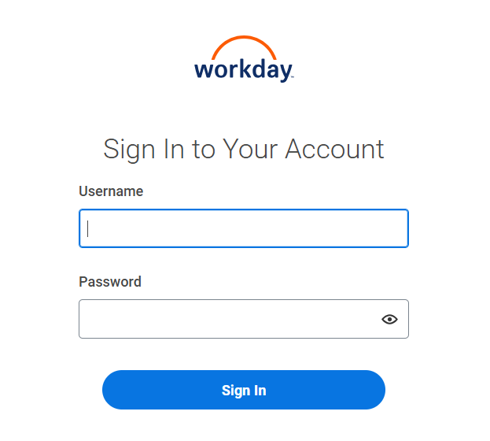
Log In to GA@WORK for Employees Using Native Login with MFA (Part 2 of 8)
INSTRUCTIONS
Navigate to the GA@WORK sign-in page, click User Name/Password-Native.
Enter your Username and Password.
Click Sign In.
3
4

Slide 4
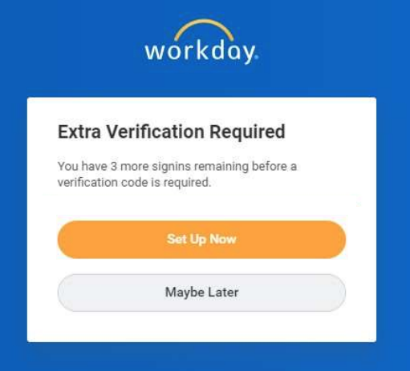
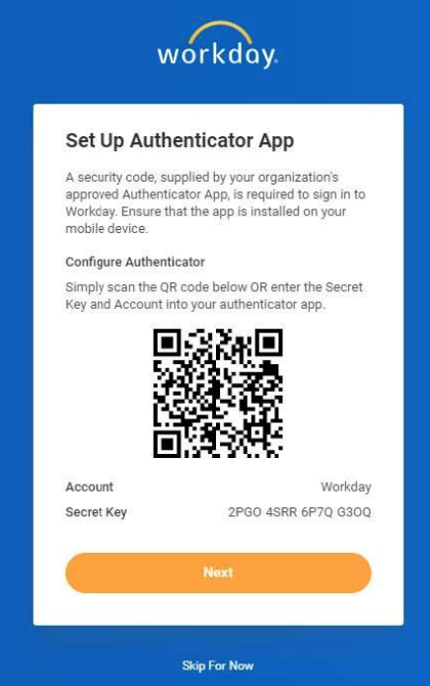
Log In to GA@WORK for Employees Using Native Login with MFA (Part 3 of 8)
INSTRUCTIONS
Click Set Up Now on the Extra Verification Required page.
Note: If you inadvertently skip the initial MFA setup, skip to Step 15 to access the QR Code from within the tenant.
View the QR Code and instructions on how to connect with the Authenticator App.

Slide 5
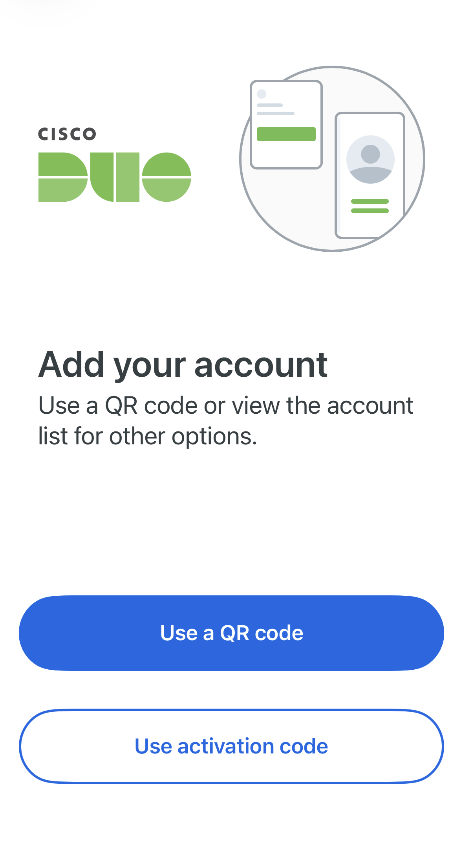
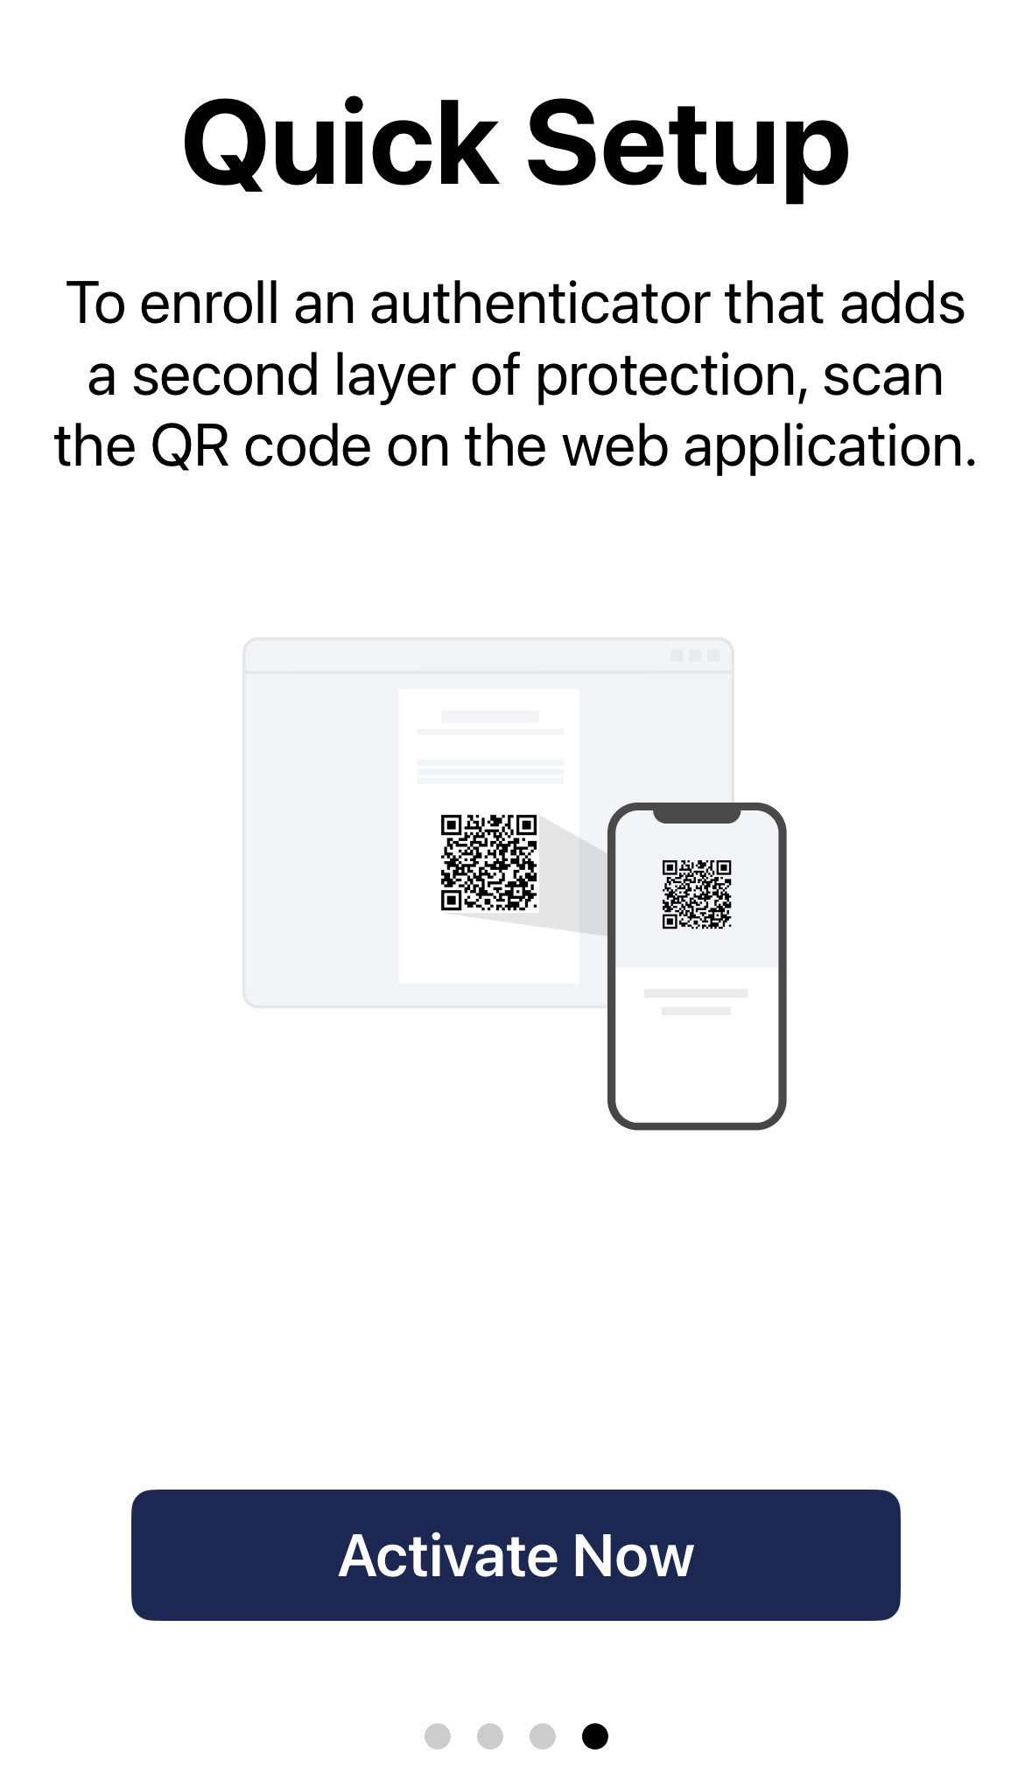
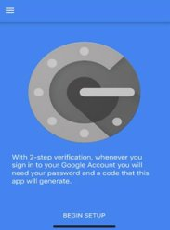
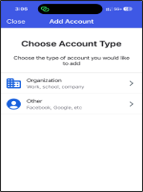
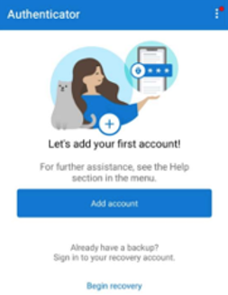
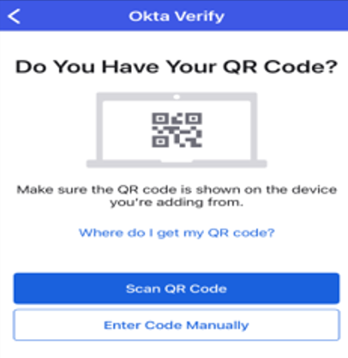
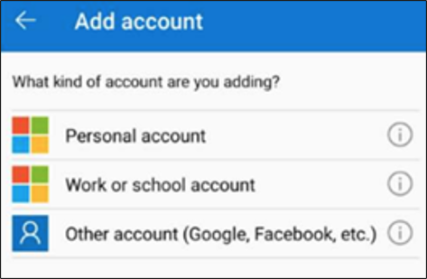
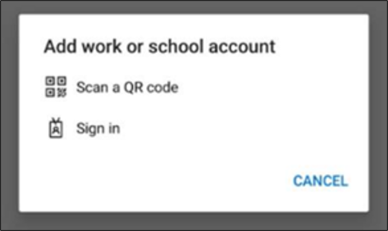
Log In to GA@WORK for Employees Using Native Login with MFA (Part 4 of 8)
INSTRUCTIONS
Open the Authenticator application on your phone and follow the setup guidance below:
DUO
Click Use activation code
SafeNet
Click Activate Now
Google
Click BEGIN SETUP
Okta
Click Organization > Scan QR Code
Microsoft
Click Add account > Work or school account >
Scan QR Code

Slide 6
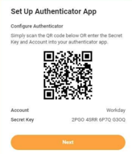
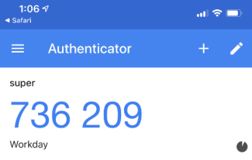
Log In to GA@WORK for Employees Using Native Login with MFA (Part 5 of 8)
INSTRUCTIONS
Scan the QR Code with your device.
Click Next.
8
9
View the code on your device.
Note: When the timer on the bottom right of the authenticator code times out, a new code is generated.

Slide 7
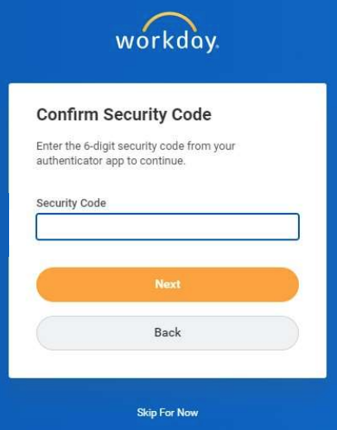
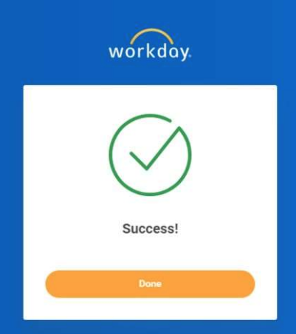
Log In to GA@WORK for Employees Using Native Login with MFA (Part 6 of 8)
INSTRUCTIONS
Enter the code (from your phone) into the Security Code field.
Click Next.
11
12
Click Done to continue to GA@WORK.

Slide 8
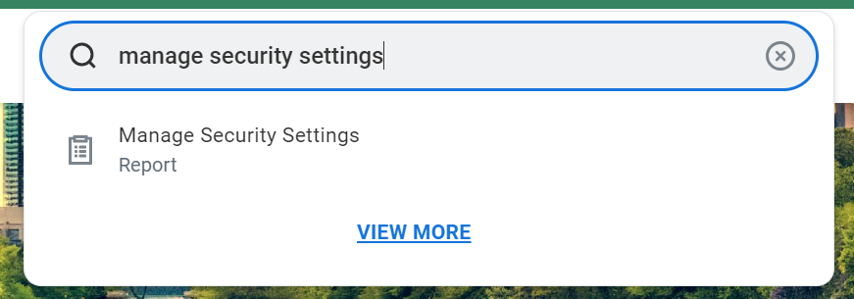
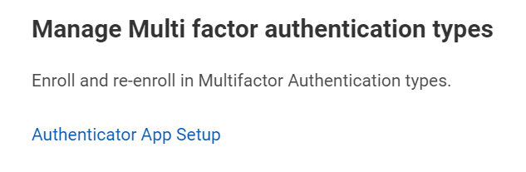
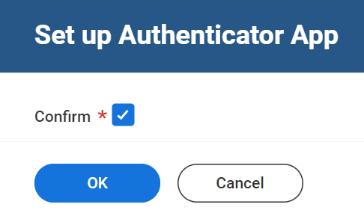
Log In to GA@WORK for Employees Using Native Login with MFA (Part 7 of 8)
INSTRUCTIONS
To locate the QR Code within the tenant, enter Manage Security Settings in the Search field.
Select Manage Security Settings Report.
15
16
Click Authenticator App Setup.
Check the Confirm* box.
Click OK.
18
19

Slide 9
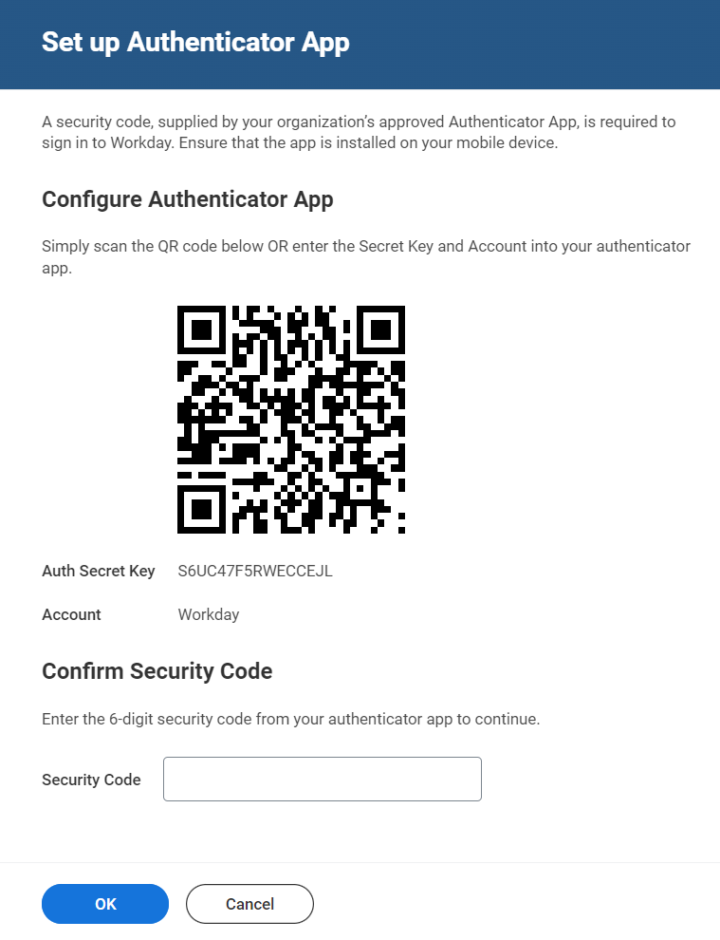
Log In to GA@WORK for Employees Using Native Login with MFA (Part 8 of 8)
INSTRUCTIONS
View the QR Code and instructions, then return to Step 7 to set up your Authenticator App.
You have successfully logged in to GA@WORK using Native Login with Multifactor Authentication.

