Slide 1
GASB 84 Training
Tuesday, June 11, 2019
Wednesday, June 19, 2019

Slide 2
GASB 84 Training
Purpose of this Training:
Discuss GASB 84 implementation steps, how it impacts your organization, and share answers to frequently asked questions.
PROCESS OF IMPLEMENTATION
DISCUSS SURVEY
FAQ - FOR THE SURVEY
NEW ACCOUNTING GUIDANCE – CUSTODIAL FUNDS
CAFR REPORTING CHANGES
QUESTIONS

Slide 3
GASB 84 Training
Process of Implementation:
Survey sent to identify organizations that will be impacted by changes
Two Training Classes (Tues. 6/11/19 and
Wed. 6/19/19)
July 1, 2019 – New accounting for custodial funds begins
CAFR FY2020 – New reporting requirement changes

Slide 4
GASB 84 Training
Survey:
Survey sent beginning of May 2019
Due May 15, 2019
A guide to help identify:
  If currently reported fiduciary activity is still appropriate given the GAAP changes
  If an activity not currently identified as fiduciary (reported as governmental or proprietary) should be identified as fiduciary or visa versa
  If an activity not currently accounted for on your GL should be identified as fiduciary
  Changes to PPTF, ITF, Pension & OPEB are minimal

Slide 5
GASB 84 Training

Slide 6
GASB 84 Training
The survey is the beginning of the process
Submissions can/will be revised if needed upon SAO review
You know your data (nuances, exceptions, etc.) therefore organizations must complete
SAO is available for guidance in the evaluation
SAO is still contacting those organizations from which we need clarification or confirmations

Slide 7
GASB 84 Training
FAQ - Survey:
Revenue Generated by Organization?
  What if I keep a portion of revenue collected?
    The portion of own-source revenue that is collected for your entity is recorded in your governmental fund (i.e. Budget Fund). The remaining activity will need to be evaluated for potential fiduciary activity inclusion.

Slide 8
GASB 84 Training
FAQ - Survey:
Revenue Generated by Organization? (Con’t)
  What if I charge a fee/retain a fee (i.e. Admin Fee)?
    Administrative fees charged for a service, such as collecting or processing funds, is an exchange or exchange-like transaction and should be booked separately in the organizations’ governmental fund (i.e. Budget Fund).

Slide 9
GASB 84 Training
FAQ - Survey:
2. Activity not on my GL
  What if I am/have attached agency?
    If an organization has a program that is administratively attached in the BCR include them in your evaluation.
    If you have a related organization that is NOT administratively attached in the BCR a separate survey will need to be completed. SAO will ensure these organizations respond accordingly.

Slide 10
GASB 84 Training
FAQ - Survey:
2. Activity not on my GL (Con’t)
  The form says I reported agency funds in PY, according to my GL I have no agency fund activity. Why does SAO say I have activity? How do I fill out the form?
    SAO used 2018 and 2019 GL activity and balances pull to identify those that had agency fund balances.
    If there was any data reported in the GL in an agency fund code it was included in the dropdown box. This included items such as; erroneous data entered then corrected, data where the account balances net to zero; however, data was reported in different programs, budget references, or etc.
    If the organization determines the activity is not a reportable activity, reasoning must be provided to SAO.

Slide 11
GASB 84 Training
FAQ - Survey:
Activity not on my GL (Con’t)
Erroneous data entered then corrected:

Slide 12
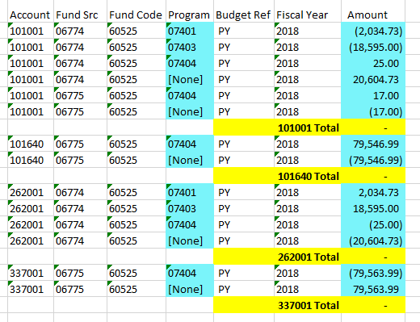
GASB 84 Training
FAQ - Survey:
Activity not on my GL (Con’t)
Data where the
account balances
net to zero; however,
data was reported in
different programs,
budget references,
or etc.

Slide 13
GASB 84 Training
FAQ - Survey:
2. Activity not on my GL (Con’t)
  The form says I reported agency funds in PY, according to my GL I have no agency fund activity. Why do you say I do? How do I fill out the form?
    If the activity nets to zero by account but not by other chart fields, SAO asks organizations to please investigate balances and correct ledger balances accordingly.
    If the activity is truly an error with a correction, the evaluation tab may be skipped if an explanation is given in the submission email and SAO is able to validate it.
    If SAO is unable to validate explanation, the evaluation tab must be completed for the activity.

Slide 14
GASB 84 Training
FAQ - Survey:
My survey indicates a reporting change either:
a) from one fiduciary type to another
(Example: from Agency to PPTF)
b) from a fiduciary activity to a
governmental activity
c) from a governmental activity to a
fiduciary activity
and SAO agrees with the change.
  Do I wait until July (FY2020) to make this change or do I make the change now in FY2019?
    NO, please wait to enter in FY2020

Slide 15
GASB 84 Training
FAQ - Survey:
My survey indicates a reporting change (Con’t)
    Please make no changes until SAO validates and agrees with the change in reporting.
    After SAO notifies confirmation of agreement with the change, starting FY2020 organizations are able to make the change in their accounting records.
    SAO will help those organizations that need additional guidance with moving balances as necessary.

Slide 16
GASB 84 Training
FAQ - Survey:
Changes take effect
July 1, 2019
FY2020

Slide 17
GASB 84 Training
FAQ - Survey:
My survey does not take into account GASB 84 business-type activity (BTA) exceptions.
What do I do?
    The business-type activity exception has very specific criteria which applies to few organizations.
    SAO is in the process of contacting these organizations to go over additional questions and provide guidance.

Slide 18
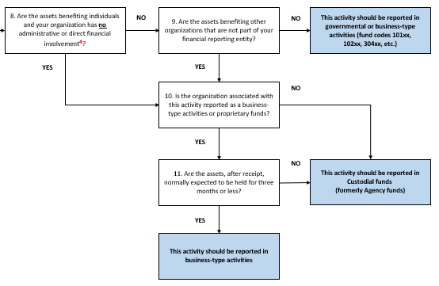
GASB 84 Training
FAQ - Survey:
My survey does not take into account GASB 84 BTA exceptions. What do I do? (Con’t)
Is the organization associated with this activity reported as a business-type activity or proprietary funds?
Are the assets, after receipt, normally expected to be held for three months or less?

Slide 19
GASB 84 Training
NEW Custodial Fund Accounting Guidance:
  Terminology Change
  PRE-GASB 84 (FY2019):
    Agency Funds
  POST-GASB 84 (FY2020):
    Custodial Funds

Slide 20
GASB 84 Training
NEW Custodial Fund Accounting Guidance:
  No more 262xxx accounts (Funds Held for Others) in 6xxxx fund type (excluding 69999)
  Funds held for others 262xxx CAN still be used in other fund types
  Custodial funds will report restricted net position instead of a funds held for others account
  SAO will monitor account 262xxx in custodial funds in TeamWorks at the beginning of FY2020 to ensure implementation at organization level

Slide 21
GASB 84 Training
NEW Custodial Fund Accounting Guidance:
  Pd 1 of FY2020 use account 390107 (adjustment to fund balance/net position) to record beginning net position and eliminate funds held for others balance (This is a one time conversion entry to create beginning net position.)
  Dr 262xxx Funds Held for Others
  Cr 390107 Adjustment to FB/NP

Slide 22
GASB 84 Training
NEW Custodial Fund Accounting Guidance:
  Use of the revenue and expense accounts are REQUIRED with the new custodial fund presentation
  All revenue and expense accounts are available for use beginning July 1, 2019 (FY2020)
    Revenue accounts 4xxxxx
    Expense accounts 5xxxxx-873xxx
  Select the accounts that best fit with
  organizational activity types

Slide 23
GASB 84 Training
NEW Custodial Fund Accounting Guidance:
  PRE-GASB 84 (FY2019):
  Additions
  Dr 101xxx Cash
  Cr 262xxx Funds Held for Others
  Deductions
  Dr 262xxx Funds Held for Others
  Cr 101xxx Cash

Slide 24
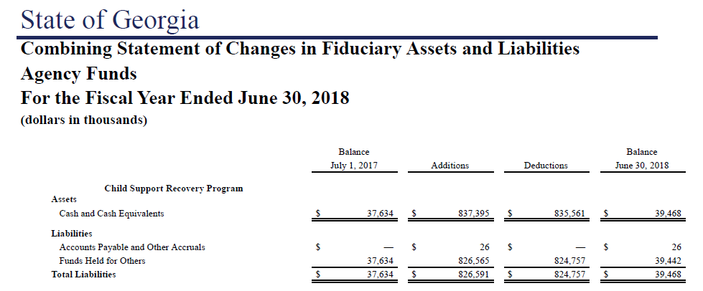
GASB 84 Training
NEW Custodial Fund Accounting Guidance:
  PRE-GASB 84:
  For reporting of this activity in the CAFR SAO has to analyze the debits and credits of the accounts to determine what to report as additions and deductions in the Combining Statement of Changes in Fiduciary Assets and Liabilities for Agency Funds.

Slide 25
GASB 84 Training
NEW Custodial Fund Accounting Guidance:
  POST-GASB 84 (FY2020): Charitable Contributions
  Additions
  Dr 101xxx Cash
  Cr 466001 Contributions & Donations
  Deductions
  Dr 696002 Distribution of Contributions
  Cr 101xxx Cash

Slide 26
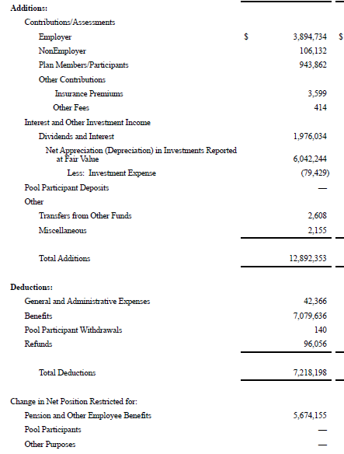
GASB 84 Training
  POST-GASB 84:
  New reporting presentation will be a Statement of Changes in Custodial Funds.
  The revenue and expense accounts will be mapped to appropriate CAFR line items in the same manner as other fiduciary funds.
NEW Custodial Fund Accounting Guidance:

Slide 27
GASB 84 Training
NEW Custodial Fund Accounting Guidance:
  Record amounts to the following accounts separately (if applicable):
    Investment earnings/Interest
    Investment costs
    Administrative costs
    (Note: Net investment earnings can be presented if investment costs and investment earnings are not separable)
    These three accounts are all related to investment activity
  These accounts will be presented separately in the CAFR

Slide 28
GASB 84 Training
NEW Custodial Fund Accounting Guidance:
  There is one EXCEPTION to the new custodial accounting presentation- the BTA exception
    This applies to Business-type Activities
    Includes Enterprise funds
    This allows activities that are identified as and normally reported in custodial funds to be reported on the Statement of Net Position and Statement of Cash Flows

Slide 29
GASB 84 Training
NEW Custodial Fund Accounting Guidance:
  Rules for BTA Exception:
      Can only present this way if assets, upon receipt, are NORMALLY expected to be held for three months or less
      Asset and corresponding liabilities presented on the BTA Statement of Net Position
      Additions and deductions reported separately as cash inflows and cash outflows on the Statement of Cash Flows in the operating activities category

Slide 30
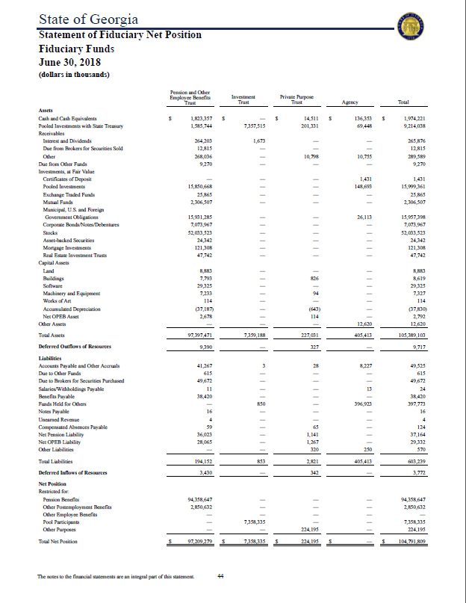
GASB 84 Training
PRE-GASB 84 Presentation
(FY2019)
Statement of Fiduciary Net Position
Agency Fund Presentation
  Funds Held for Others IS reported
Agency Fund Presentation
  Net Position is NOT reported
Funds Held for Others
Net Position

Slide 31
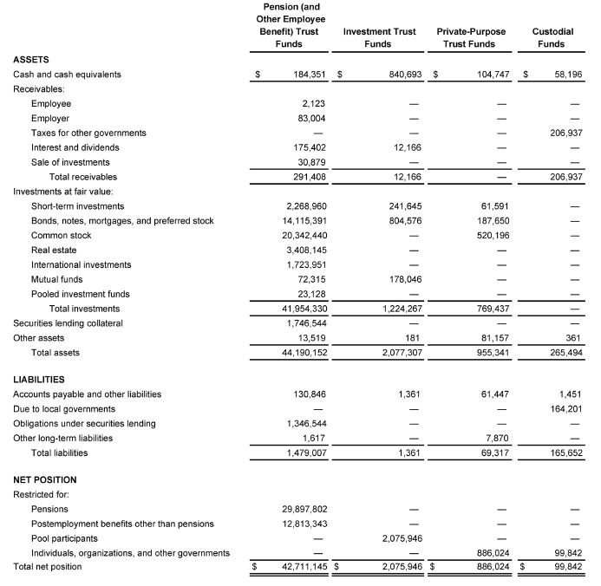
GASB No. 84 Con’t
POST-GASB 84 Presentation (FY2020)
Statement of Fiduciary Net Position
Custodial Fund Presentation
  Funds Held for Others is NOT reported.
  Liability not presented unless a
  disbursement is compelled.
Custodial Fund Presentation
  Net Position IS reported
  All Net Position is restricted

Slide 32
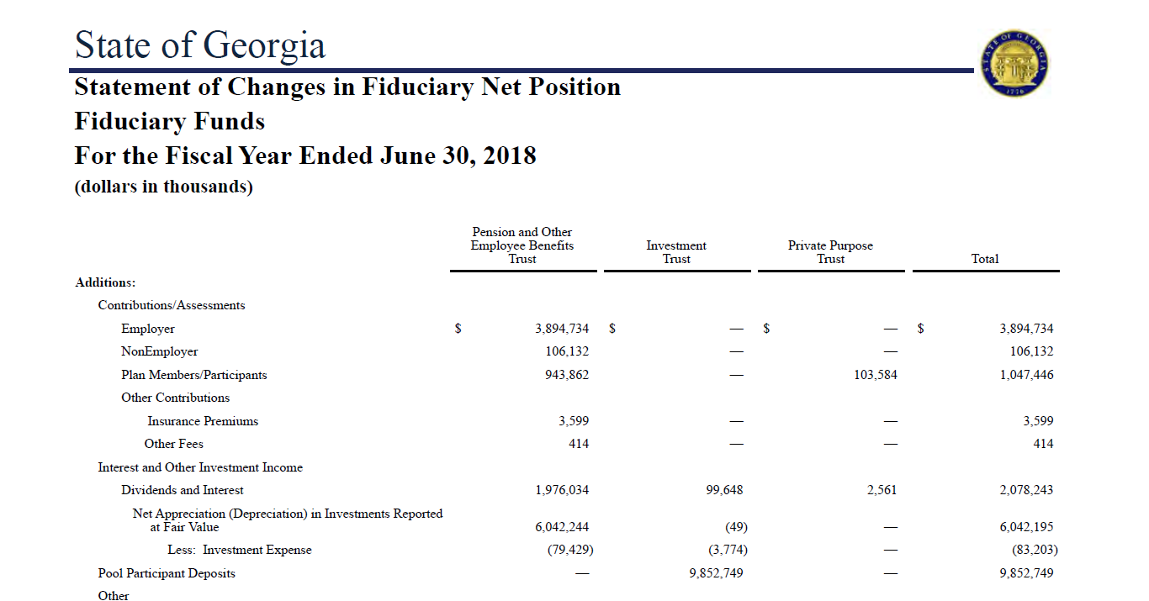
GASB 84 Training
PRE-GASB 84 Presentation (FY2019)
Statement of Changes in
Fiduciary Net Position
Now will
require
disclosure
similar to
other
fiduciary
funds for
custodial
funds (New)
No Agency Funds Reported

Slide 33
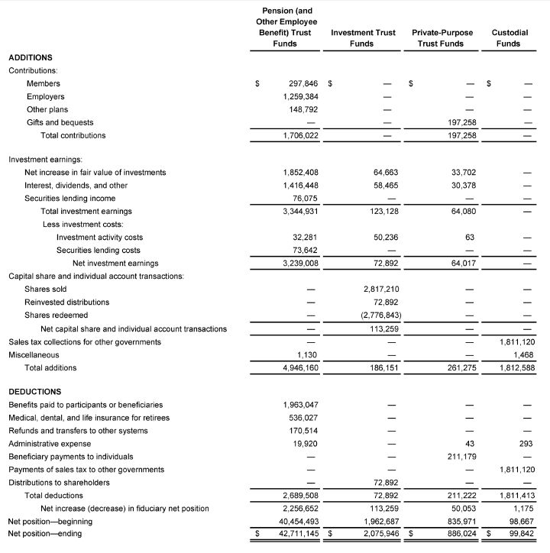
GASB 84 Training
POST-GASB 84 Presentation (FY2020)
Statement of Changes in
Fiduciary Net Position
Beginning July 1st, record
custodial funds using revenues
and expenditure accounts by
source and deduction type.
Administrative costs, investment costs,
and investment earnings must
be accounted for separately.
No longer posting to Funds
Held for Others account for
custodial funds only.
Funds Held for Others
account may still be used in
other fund types.

Slide 34
GASB 84 Training
Reference Links:
GASB Statement No. 84
GASB Fiduciary Activities Implementation Guide (Released 6/19)
Please contact SAO_Reporting@sao.ga.gov with questions

Slide 35
GASB 84 Training
Any questions, comments, concerns?

