Slide 1
Vendor Management Training
Kristi Johnson, Director Vendor Management
Lacara Adams, Supervisor of Vendor Managment
March 23, 2023

Slide 2
Why so many process changes?
#1 Reason MITIGATE FRAUD
The way we do business is constantly changing
Make internal changes frequently, including forms and processes
Vendor group focus is no longer data entry but has transitioned to “compliance auditors”
Notes:
By the end, you will be able to:
-Changes
-Provide-existing and new suppliers
-Train-tools provided by SAO. Recognizing that agencies have differing internal processes
-Reduce-Goal is to reduce errors/rejection which will speed up approval. Continue to protect State from fraud

Slide 3
Vendor Automation
Coming Soon
Agencies will be utilizing Supplier Change Request (SCR) functionality Teamworks
This automated tool will streamline vendor changes for EXISTING suppliers
Increased data protection of vendor information/eliminate potential fraud
All liaisons to electronically attach and submit documents in secure process
Expedite vendor processing time
Eliminate data entry errors by “requiring fields”
Vendor Liaisons always know the status of their requests
Notes:
By the end, you will be able to:
-Changes
-Provide-existing and new suppliers
-Train-tools provided by SAO. Recognizing that agencies have differing internal processes
-Reduce-Goal is to reduce errors/rejection which will speed up approval. Continue to protect State from fraud

Slide 4
Physical Address
NEW
Only “physical addresses” on VMF’s will be approved for new vendors and reactivations
Alternate addresses can be added as “additional address” on the VMF
Additional information may be required to validate the supplier’s address

Slide 5
Documents for Address Add/Changes
Individuals:
Invoice reflecting new address
Rental/lease agreement with owner/landlord signature
Mortgage
Deed of trust
Utility Bill (within last 30 days)
Business:
Invoice reflecting new address
Rental/lease agreement with owner/landlord signature
Government issued business document

Slide 6
Supplier Minority Requirements
NEW
Beginning April 3rd, the supplier diversity section of the VMF is a REQUIREMENT
Executive Order by Governor to begin capturing data on all Small Businesses in GA
SAO has been working with DOAS to define the parameters that should be included. This will be a requirement for all agencies using SCR and manual VMF form.

Slide 7
Vendor Liaison Role

Slide 8
Role of Vendor Liaison
Understand changes to Vendor Management Form
Provide clear instruction to vendors
Ensure all necessary documentation is attached
Train new agency liaisons and end-users
Review forms thoroughly to reduce errors and form rejection
Sign and be accountable for form submission
Notes:
By the end, you will be able to:
-Changes
-Provide-existing and new suppliers
-Train-tools provided by SAO. Recognizing that agencies have differing internal processes
-Reduce-Goal is to reduce errors/rejection which will speed up approval. Continue to protect State from fraud

Slide 9
Role of Vendor Liaison s
Email Vendor Mgmt. Group
psvendor@sao.ga.gov
Subject “Vendor Name, Vendor #”
Email body: List the “type” of requests
Train new agency liaisons and end-users
Inform CFO all vendor liaison contact info must be submitted on the vendor mangt. website
Notes:
By the end, you will be able to:
-Changes
-Provide-existing and new suppliers
-Train-tools provided by SAO. Recognizing that agencies have differing internal processes
-Reduce-Goal is to reduce errors/rejection which will speed up approval. Continue to protect State from fraud

Slide 10
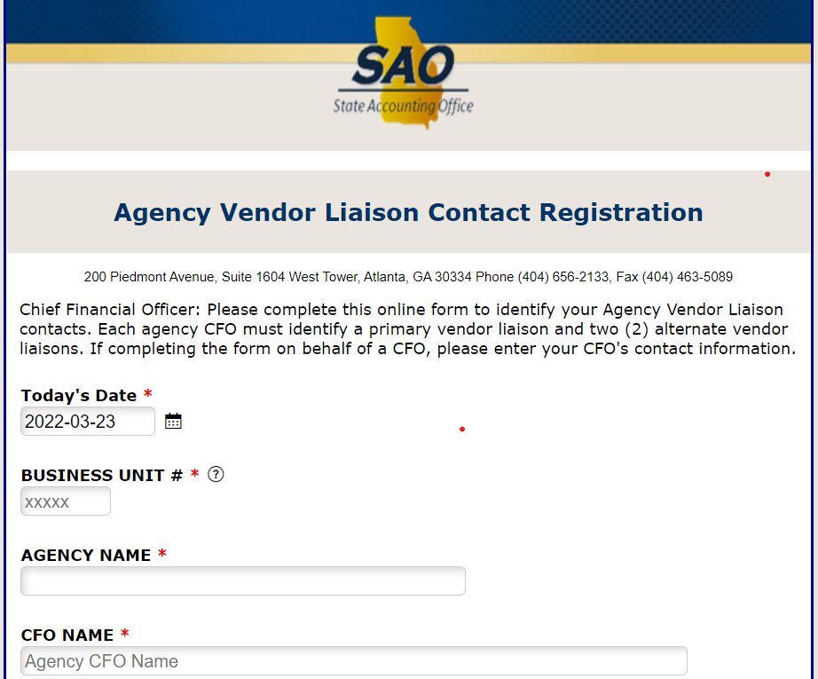
Vendor Liaison Online Registration
Liaison changes must be submitted by CFO
Agency Vendor Liaison Contact Registration
Notes:
By the end, you will be able to:
-Changes
-Provide-existing and new suppliers
-Train-tools provided by SAO. Recognizing that agencies have differing internal processes
-Reduce-Goal is to reduce errors/rejection which will speed up approval. Continue to protect State from fraud

Slide 11
Role of VMG
Responsible for maintaining the Statewide vendor database
Protect the State’s Asset
Exercise due diligence in obtaining and verifying vendor information
Only communicate with registered vendor liaisons
Provide limited information regarding rejections
Notes:
By the end, you will be able to:
-Changes
-Provide-existing and new suppliers
-Train-tools provided by SAO. Recognizing that agencies have differing internal processes
-Reduce-Goal is to reduce errors/rejection which will speed up approval. Continue to protect State from fraud

Slide 12
Banking Documentation

Slide 13
Documents for Bank Verification
Bank Verification Letter
Must be on Official Bank Letterhead
Dated (with current date)
Date Account Opened
Name(s) of Authorized Signer(s)
Business Name and DBA (must match supplier name)
Routing # and Account # for ACH debits/credits
Signed by Bank Officer
Phone number for Bank Officer

Slide 14
Documents for Bank Verification
Voided Check
Must be a physical check
Business Name and DBA name listed (if applicable)
Following are Not acceptable:
Starter checks
Deposit slips
Bank statements
Payment Instructions Notice
Direct Deposit Enrollment form

Slide 15
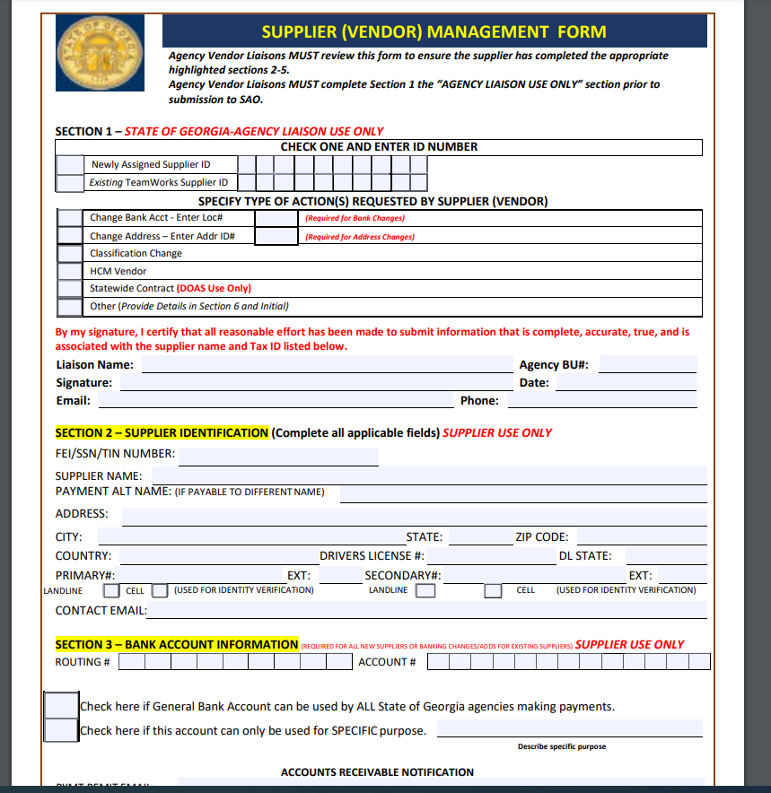
Vendor Management Form
Notes:
By the end, you will be able to:
-Changes
-Provide-existing and new suppliers
-Train-tools provided by SAO. Recognizing that agencies have differing internal processes
-Reduce-Goal is to reduce errors/rejection which will speed up approval. Continue to protect State from fraud

Slide 16
Communication with Suppliers
Suppliers should submit the Vendor Form directly to the vendor liaison
If a voided check/bank letter is requested, the Vendor management group will reach out directly to the vendor liaison
Supplier will have 7 business days to reply to the request. If we have not received a response in the allotted timeframe, the request is closed.
Please do not reach out directly to Vendor Group regarding status updates or questions regarding the process.

Slide 17
Review of Vendor Management Form

Slide 18
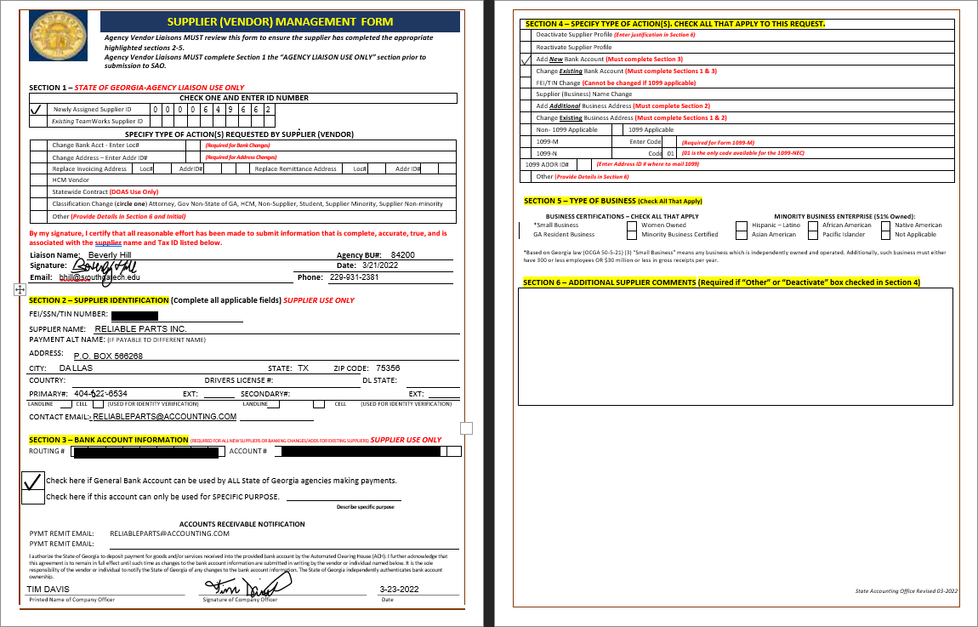
Vendor Management Form

Slide 19
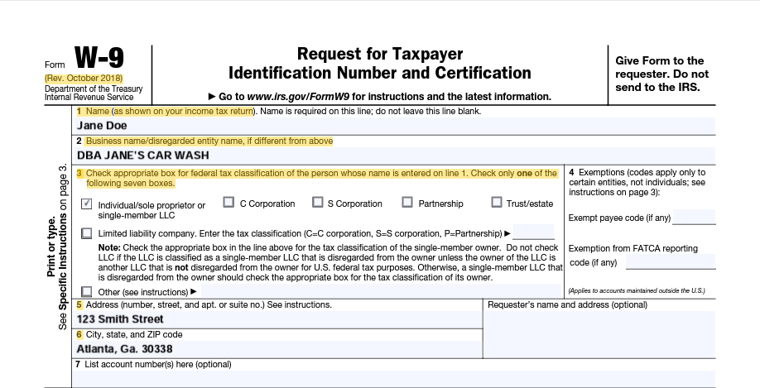
Steps to correctly complete a W-9
The name on line 1 must match with the name the IRS associates with the suppliers TIN
Line 2 is for Business name, trade name, doing business as name or disregarded entity name
All W9 information listed must match what is in Teamworks

Slide 20
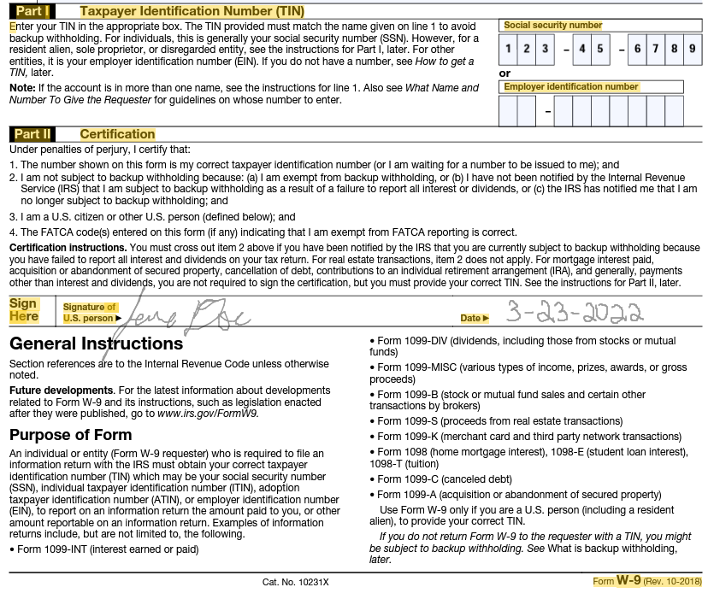
Continuation of steps to enter W9
Supplier should enter only ONE of either their SSN, EIN or individual taxpayer identification number. Depending on which one is appropriate.
By the supplier signing the W9 they attest that: The TIN given is correct.

Slide 21
Common Reason for Rejections

Slide 22
Common Reasons VMF’s are Rejected
EVERYTHING ON FORM IS REQUIRED
Duplicate Vendors
Incomplete form (Sections)
W-9 is not the current version
TIN# is not complete or does not match W-9
Account or routing number is not complete/correct
Not submitting “Page 2” of VMF
Contact information is not valid (phone #)
Notes:
By the end, you will be able to:
-Changes
-Provide-existing and new suppliers
-Train-tools provided by SAO. Recognizing that agencies have differing internal processes
-Reduce-Goal is to reduce errors/rejection which will speed up approval. Continue to protect State from fraud

Slide 23
FAQ’s
Why can’t the supplier provide SAO with the information directly?
The VMG is not aware of potentially whom they are speaking with. As a result, we rely on the vendor liaisons to submit information on their behalf.
Please do not have suppliers contact the VMG directly to resolve any issues or answer any questions.

Slide 24
FAQ’s
When VMF is incomplete or rejected, why can’t a full explanation be provided?
The VMG primary responsibility is prevented fraud. We only communicate limited information so that suppliers will not “learn” our verification process. We do communicate the “section” of the form to assist the vendor liaison in locating the error.

Slide 25
Reminders

Slide 26
Mini Sessions
VMG will conduct mini trainings during April:
Address Adds/Updates
1099 Requests
Banking
HR vendors/Customers
Notes:
By the end, you will be able to:
-Changes
-Provide-existing and new suppliers
-Train-tools provided by SAO. Recognizing that agencies have differing internal processes
-Reduce-Goal is to reduce errors/rejection which will speed up approval. Continue to protect State from fraud

Slide 27
Vendor Management Form
Reminders
Submission
Agency Vendor Liaisons only
Liaison changes must be submitted by CFO
Agency Vendor Liaison Contact Registration
Email Vendor Mgmt. Group
psvendor@sao.ga.gov
Subject “Vendor Name, Vendor #”
Voided check/bank letter not required
May be requested if needed
Notes:
Only registered liaisons can submit. Others will be rejected
Registration form on website
After reviewing and signing the VMF, submit to:
Check/letter no longer required with submission. Important that banking section 2 be completed in entirety

Slide 28
Additional Reminders
Reminders
New VMF only (as of 4/1/2022) | VMF is now required for “NEW” and “REACTIVATIONS” (not yet approved) vendors set-up. May be requested if needed.
Liaison should only sign/submit VMF after reviewing the suppliers’ entries | Forms must be received by SAO within 60 days of supplier and Liaison signatures
Approval Times Banking Estimated 5 weeks All Other Requests 5 days (not incl weekends/ holidays) | Liaisons should remind suppliers to respond in a timely matter when contacted by SAO
W-9 Required Approvals Reactivations TIN/FEIN changes Name changes If requested by VMG | VMG Communication Documentation Needed? Email to Liaison Bank Verification Issue? Call to Supplier Supplier has 7 days to respond
Notes:
Approval-
Adding/changing bank info within 5 business days (M-F, no holidays)
Other submissions 48hrs-no wknds/holidays. Ex: Friday submission =Tuesday approval
Liaison section moved to top. Don’t sign before sending to supplier and reviewing their entries
Recently VMG received email from supplier, responding to message sent in May!
Any missing, incorrect, incomplete submissions will result in delays.

Slide 29
Additional Reminders and Resources
Resources
SAO Website-Vendor Management Vendor Payment Management
Liaison Registration Form Agency Vendor Liaison Contact Registration
FAQ’s Vendor Management (Agency) FAQ’s Vendor Management (General) FAQ’s
List of Vendor Queries in TeamWorks Vendor Queries (Acct numbers partially masked)
0VN001 Vendor_ Search (Use this query to determine if the vendor is already set up in TW’s) 0VN011 Vendor ACH Locations (Use this query to determine if bank account is already set up) 0VN001 Vendor_SRCH_ID_NAME (Use this query to provide addresses)
Notes:
Approval-
Adding/changing bank info within 5 business days (M-F, no holidays)
Other submissions 48hrs-no wknds/holidays. Ex: Friday submission =Tuesday approval
Liaison section moved to top. Don’t sign before sending to supplier and reviewing their entries
Recently VMG received email from supplier, responding to message sent in May!
Any missing, incorrect, incomplete submissions will result in delays.

Slide 30
Questions?
SAO Vendor Management Group
PSVENDOR@SAO.GA.GOV

