Slide 1
SAO FMC Presentation
4/26/16

Slide 2
2016 Outlook
BCR issues noted during FY2015
CAFR Forms common issues
PCA tips
Unrecorded Payables and Receivable Form
Miscellaneous

Slide 3
BCR Issues Noted During FY2015

Slide 4
BCR Issues
Entries posted to fund balance accounts after tied in (especially during 998)
Post Closing Adjustments (PCA) form does not match BCR form (more on this later )
Budget variances prior to BudgetNet closing.

Slide 5
Tie in Beginning Fund Balance
Accounts are reviewed and reconciled by program and fund source
337xxx – Other Reserves
  Balance should be zero once carry-over for the next fiscal year has been moved to account 492xxx
390001 – Unreserved – Undesignated – Beginning Fund Balance
  Balance should equal surplus as reported in the prior year BCR by program and fund source
390104 – Adjustments to Fund Balance – Surplus Returned to OST
  Amount should equal (in opposite direction) the amount in beginning fund balance - surplus (A/C 390001) by program and fund source
492xxx – Carry-over/Transfers from Reserves
  Balance should equal reserves reported in the prior year BCR by program and fund source

Slide 6
Tie in Beginning Fund Balance
Other key accounts to note:
390109 – Adjustments to Fund Balance – Early Surplus Returned to OST
  This account should be used when surplus funds are lapsed and returned to Treasury within the same fiscal year (ex: surplus results from the cancelling of POs in the current fiscal year and is returned to OST in the current fiscal year)
493xxx – Carry-Over/Transfers From Fund Balance
  This account should be used to book the transfer of program fund balances from one agency to another agency or between programs if allowed (ex: other funds).

Slide 7
Entries Posted to Fund Balance Accounts After Being Tied In to the PY BCR
Once Beginning Fund Balance is tied in, NO entries should be posted to any of those accounts at any point during the year, except for account 337xxx, which establishes Current Fiscal Year reserves. Offset to reserve establishment is 390110.
Any entries posted to account 390001, 390104, or 492xxx will cause beginning fund balance to no longer tie to the prior year BCR.

Slide 8
Non-Compliance with Budget
Be certain to review final budget amounts in BudgetNet for Federal and Other funding sources to ensure budgetary compliance by funding source within program prior to BudgetNet closing (8/19/16).

Slide 9
CAFR Forms Common Issues

Slide 10
CAFR Forms
Lease Agreement Data
Capital Assets
Cash and Deposits
Inter-Organization Form (Due To/Due From)
Classification of Revenues
Fund Balance Non-Appropriated
Other Items Noted

Slide 11
Leases
Some of the issues we still continue to notice with the Lease Agreement Form
  Not all leases are reported on the form
    DOAA performs audit testing and notices that there are additional leases not reported within CAFR
  Incorrect payment frequency
    Lease payments are made monthly but on the form “annually” was chosen
  Duplication of lease numbers
    Each lease reported needs to have a unique identifying lease number
  Incorrect/Illogical Date Information
    Incorrect beginning and ending dates (ex: begin date 7/1/16, end date 6/30/15)
    End date not logical with payment frequency (ex: quarterly lease with begin date of 7/1/16 with end date of 5/31/16)
    End date of one year reported when lease has renewal options. End date should be the date at the end of the last renewal year.
  Illogical Economic life Information
    Ex: Building life reported as 48 months

Slide 12
Leases
Some of the issues we still continue to notice with the Lease Agreement Form
  Rent Steps Information not reported correctly
    Rent Steps are indicated on form, but no details are provided
    End date of rent steps is different than end date of lease
  Form is submitted without all required data filled in

Slide 13
Capital Assets
Some common things noted during the review of the capital asset forms
  Inadequate Descriptions of Adjustments
    Within the Capital Asset Form, there are columns that require additional information.
      Adjustments to Beginning Balances
      Adjustments to Current Additions/Deletions
      GSFIC Transfer to Agency
      Donations
      Transfers In/Out
  Transfers
    Transfers between agencies should be recorded at the same amounts at both agencies
      Including Accumulated Depreciation
    We have noted on various occasions where one agency reports $10,000 in capital assets and $3,000 in depreciation, while the second agency is reports $8,000 in capital assets and $2,000 in depreciation.
    Please refer to the Transfer of Capital Assets Policy at our website
      http://sao.georgia.gov/accounting-policy-manual

Slide 14
Cash and Deposits
The primary item noted within the Cash and Deposits Form is the collateralization:
  OST requires all bank fee program banks to pledge collateral in the name of the State of Georgia (Category 2) for accounts in the program
    This includes banks in the Georgia State Pledging Pool and those not (see Appendix sheet of form)
  Wells Fargo collateral for bank fee program accounts should be Category 2 – if collateralization inquiry comes back from Wells Fargo otherwise, it is up to the agency to contact the provider of the inquiry and ask for correction or explanation
    OST is reaching out to Wells Fargo to train their staff on how to prepare the forms correctly
Other Issues:
  Current year version of form is not used
    Current year version is always available on our website and there are usually changes to the form every year
  All bank accounts at agency are not included on form
    All bank accounts an agency has access to should be included on the form and on their general ledger
    Be sure to tie total Cash and Cash Equivalents back to the general ledger
    Be sure total deposits on the Cash Recon sheet are included on the Deposit Analysis sheet

Slide 15
Inter-Organization Form
Amounts reported on this form should match the amounts reported at the corresponding agency, ex: Agency A is showing a Due From Agency B equaling $50,000. There should be a Due To Agency A recorded at Agency B for $50,000
  To ensure completeness, reach out to the other agency and verify the amounts they are reporting
    If reported amounts between agencies do not match, a reconciliation of the differences (ex: timing) needs to be provided.

Slide 16
Classification of Revenues
Generally, with the potential exception of Revenue Collection funds, most agencies’ revenues should be classified as program revenues.

Slide 17
Fund Balance Non-Appropriated Form
The form should be used for any activity in the following funds:
  Capital Project Funds
    That are not included in the Budget Fund for BCR reporting!! (FYI – will not be allowed in FY17)
  Fiduciary Funds (excluding Agency Funds)
  Component Unit Activity
The form should NOT be used for any activity in fund balance/net position accounts that relate to the following fund types:
  Budget Fund
  State Revenue Collections Fund
  Agency Funds

Slide 18
Other Items Noted

Slide 19
Other Items Noted
Clearing Account
  Must be zero by fund type by end of year (ex: BCR,CPF, Agency, etc). Refer to accounting policy: Control/Clearing Accounts-Balancing Requirements for travel related account exceptions
Revenue Collections
  Should be on Cash Basis
    Cash, Revenues, Transfers, possibly Fund Balance
    NOT Accounts Receivables
    NOT Accounts Payables
    NOT Deferred Revenues
    Transfers out should tie to amounts confirmed with OST prior to year-end close

Slide 20
Other Items Noted
Governance List
  Account Payable – Encumbrances Payable 200011 should be zero in General Ledger until year end when PO module closes to GL
  In Period 1 Manual JVs should be reversed and adjustments should be made through PO module
Inappropriate balances on Capital Projects Fund (CPF) trial balances & Reconciliation to GSFIC Transfers
  Due To/Due From accounts should only include activity pertaining to capital projects, not general fund
  Transfers to/from GSFIC do not match
    SAO understands there are instances for timing differences for transfers
    Transfers should only be with GSFIC

Slide 21
Tips for Post Closing Adjustments (PCAs)

Slide 22
PCA Form does not match BCR Form
SAO has noticed that at times agencies have submitted a PCA Form that is not in sync with the Fund Balance Appropriated Form (FBAF).
Examples: PCA increases revenues and an offsetting A/R account, but the FBAF shows no effect on ending fund balance; budget ref per PCA submitted not the same as what is reported on FBAF (CY vs. PPA).

Slide 23
For PCA Revenue Adjustments
If there is an increase in revenue/fund balance (credit entry to revenue on PCA form):
  Amount is entered on FBAF form as a POSITIVE amount
If there is a decrease in revenue/fund balance (debit entry to revenue on PCA form):
  Amount is entered on FBAF form as a NEGATIVE amount

Slide 24
For PCA Expenditure Adjustments
If there is an increase in expenditures/decrease in fund balance (debit entry to expenditures on PCA form):
  Amount is entered on FBAF form as a POSITIVE amount
If there is a decrease in expenditures/increase in fund balance (credit entry to expenditures on PCA form):
  Amount is entered on FBAF form as a NEGATIVE amount

Slide 25
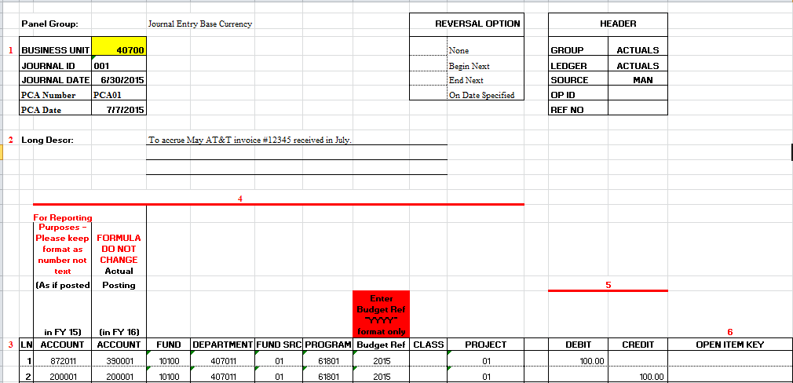
PCA Example
The PCA below represents a scenario where expenditures needs to be increased:

Slide 26
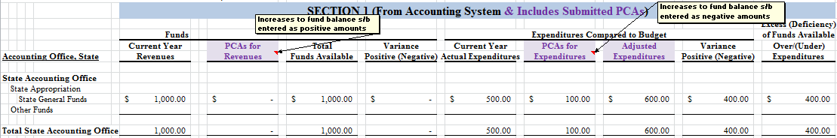
PCA Example Recorded on FBAF
The FBAF below reflects the PCA example properly recorded on FBAF:

Slide 27
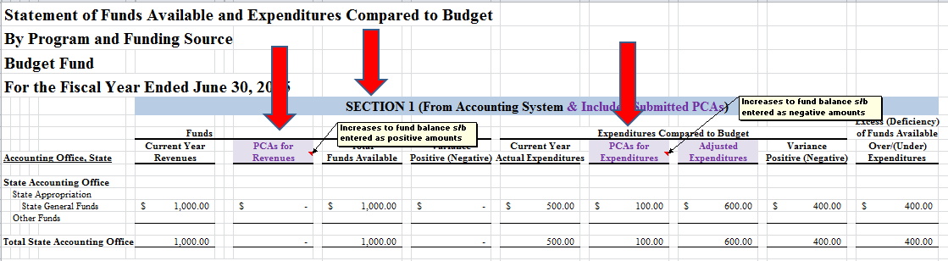
PCA Budget Year Reported Properly on FBAF Form
If the PCA submitted is to adjust Current Year revenue and/or expenditures, it goes in Section 1 of FBAF in corresponding column:

Slide 28
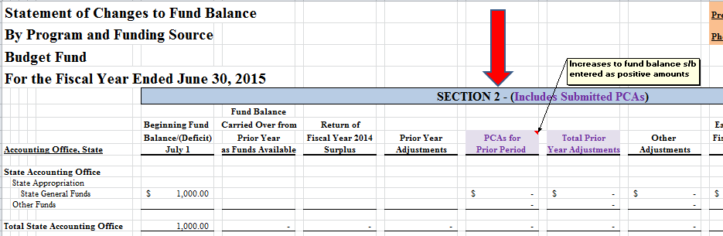
PCA Budget Year Reported Properly on FBAF Form
If the PCA submitted is to adjust Prior Year revenue and/or expenditures, it goes in Section 2 of FBAF in the PCA prior period adjustment column (enter increases in fund balance as a positive amount, decreases as a negative amount):

Slide 29
Other PCA Tips
PCA entry form is filled out completely and correctly and entry is balanced. Make sure correct account, program, fund source and budget year data is provided.
Program and fund source data on PCA form is reported properly on FBAF form (ex: PCA adjusts state funds but federal funds are adjusted on FBAF).
Use one PCA form per entry, do not combine multiple PCAs onto one form.
Do not add lines to PCA short form. If additional lines are needed, use PCA long form.
PCAs are processed in Teamworks timely in subsequent fiscal year (do not wait for SAO’s beginning fund balance recon exercise, PCAs should be posted prior).

Slide 30
Unrecorded Payables/Receivables (UR&P)

Slide 31
FY16 Updates
In response to feedback from agencies, UR&P form due date will coincide with FY16 BCR FBAF/PCA form due dates (Tier A, B, & C).
P.O. number field will be added to form data.

Slide 32
Unrecorded Payables
For BCR reporting
  Budget Fund substantially GAAP modified accrual with the following exceptions:
    Expenditures and Payables:
      Liabilities and expenditures are recorded when purchase orders or other contractual obligations to procure goods or services have been executed.
      Expenditures for items not requiring purchase orders are recorded when the goods or services are received.
      Agencies may record these expenditures when presented for payment as long as the application of this method is applied consistently and the appropriate number of occurrences is reflected each year.

Slide 33
Unrecorded Payables
For CAFR reporting
  Encumbrances payable do NOT meet recognition requirements of expenditures/liabilities for GAAP modified and full accrual bases
    These expenditures are reversed by SAO for CAFR reporting.
  Accounts payable must be recorded for any goods and/or services received as of year-end
    Note: Recording expenditures based on purchase orders, while valid for BCR purposes, is not valid for CAFR and should be reported on form.

Slide 34
Unrecorded Payables
When SAO converts BCR financial statements to CAFR financial statements it is necessary to:
  Identify and accrue for goods & services received as of year-end but for which there is no corresponding expenditure and payable already recorded in CAFR (Note: encumbrances are not included in CAFR balances).

Slide 35
Unrecorded Payables
For goods and services that have been received prior to fiscal year end, the transaction could be:
  On GL in encumbrances payable
    Must be reclassified to accounts payable through use of new form
  On GL in accounts payable
    Stay where they are, that is, do nothing
  Not recorded on GL
    May or may not be required to be reported on statutory basis, e.g., recurring payments. Regardless of whether or not reported on statutory basis (through BCR PCA), all goods and services received, but not on GL, must be included on form
    Example: June 16 item received, while possibly booked in FY17 in BCR, needs to be reported in FY16 CAFR

Slide 36
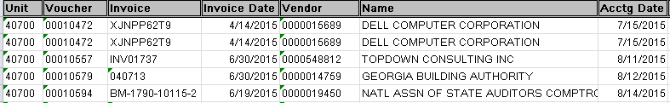
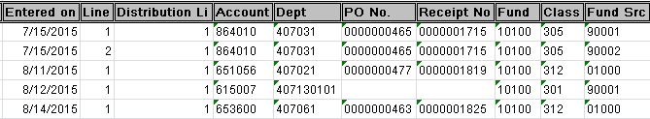
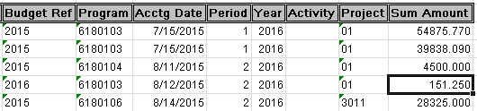
Query 1
Invoice Date current reporting year (e.g., 2016) vouchered subsequent year (e.g., 2017) or not at all

Slide 37
Query 2
P.O. Receipt Date current reporting year or prior (e.g., < or = 2016) vouchered subsequent year (e.g., 2017) or not at all

Slide 38
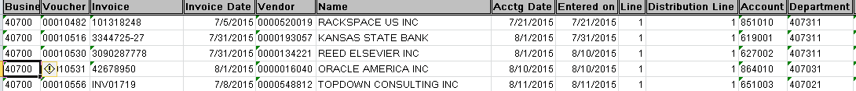
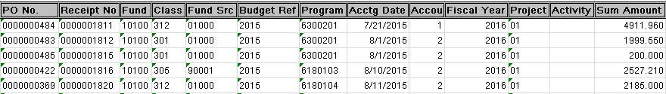
Query 3
Budget Reference of current reporting year or prior (e.g., < or = 2016), invoice date and vouchered subsequent year (e.g., 2017)

Slide 39
Note on Queries
The same item may show on multiple queries, so the results of the queries need to be analyzed to ensure that they are only reported on the form once.

Slide 40
Encumbered vs. Not Encumbered
Encumbered:
  Agency generates a PO on 6/1/16 for a computer to be purchased. The computer is received on 6/15/16. The invoice for the computer is dated 7/1/16 and the agency posts it in A/P on 07/13/16 in period 1 FY2017.
    BCR effect: no action necessary, encumbrance will be recognized as an FY 16 expenditure for statutory reporting
    GAAP effect: statutory encumbrance payable/ expenditure has been removed for CAFR reporting, so GAAP accounts payable/expenditure are required to be recorded
      Must be reported on form!

Slide 41
Encumbered vs. Not Encumbered
Not Encumbered:
  Agency orders a computer on 6/1/16 but does not issue a PO for it. The computer is received on 6/15/16. The invoice for the computer is dated 7/1/16 and agency posts it in A/P during period 1 FY17.
    BCR effect: This is an FY 16 BCR expenditure since the computer was received in the current reporting year
      BCR PCA must be submitted unless a recurring payment
    GAAP effect: GAAP accounts payable/expenditure are required to be recorded
      Must be reported on form!

Slide 42
Recurring Payment Example
Agency A processes utility invoices on a 1 month lag (January invoice posted in February). Agency has posted 12 months of utility invoices in FY16 (June 2015 through May 2016 invoices). The June 16 invoice, representing services provided during the month of June, is received in July.
For BCR: no action is required. 12 months (June – May) of annualized costs are reported.
For CAFR: June 2016 invoice amount must be reported on UP&R form, but no PCA needs to be submitted. SAO will do a reporting adjustment to book the accrual. All goods and services received within the fiscal year need to be reported in accordance with full accrual GAAP financial statements, regardless if there are 12 months worth of expenses already recorded.

Slide 43
Unrecorded Receivables
Revenue Recognition Criteria are different between statutory, modified and full accrual
  Statutory Basis – Generally, for funds other than State and Federal Funds, revenue and receivables are recognized on cash basis.
  GAAP Bases – Key concepts are:
    Earned – a matrix has been included in the Revenues, Receivables, Unearned Revenue and Unavailable Revenues – General policy on SAO’s website to assist in determining earning criteria for various types of revenue
    Available – once it has been determined a revenue has been earned, it has to be determined if modified accrual availability criteria (defined on form) have been met

Slide 44
Unrecorded Receivables
This grid is included within the form’s instructions to assist in determining what transactions need to be included on form

Slide 45
Unrecorded Receivables
When SAO converts BCR financial statements to CAFR financial statements it is necessary to:
  Identify and accrue for revenues that are earned on either the GAAP modified or full accrual basis, along with any related allowance for doubtful accounts, for such receivables

Slide 46
Communication Is Key!!
Validate query results are legitimate expenses for accrual with purchasing or applicable agency personnel
Meet with management/department heads
  Confirm all current FY expenditures have been reported (no non-PO A/P surprises)
  Confirm all current FY revenue has been reported

Slide 47
Deadlines
Form Due = BCR FBAF/PCA Tier A,B,C Due Dates
If BCR adjustments are necessary, related BCR PCAs must be submitted in accordance with Tier A, B, & C BCR PCA deadlines.
  BCR adjustments requested subsequent to BCR PCA deadlines could result in audit adjustments/ findings
  Be sure to retain documentation for auditor review

Slide 48
Miscellaneous
All Capital Projects Funds must be included in BCR in FY17
FY16 year-end timeline will be similar to FY15 timeline
There will be some minor changes to the year end forms which will be communicated when forms package is sent out, however there are NO NEW CAFR FORMS THIS YEAR!!
Revised/new policies issued on SAO’s website:
  Control/Clearing Accounts – Balancing Requirements (revised)
  Revenues, Receivables, Unearned Revenue and Unavailable Revenues – General (new)
  Revenues – Grants and Other Financial Assistance (new)
  Equity (new)
Send notification re: accounting staff changes to SAO_Reporting@sao.ga.gov

Slide 49
Questions?

