Slide 1
FMC Presentation May 19, 2020

Slide 2
Agenda
Upcoming GASBs
BCR Reminders
Capital Projects Funds
CAFR Forms
Single Audit
Post-Closing Adjustments (PCA) Tips
Other Items Noted from CAFR Process
Chartfield Maintance Form
Miscellaneous Items
Note – items in the purple font are new items added to the FY20 training
2

Slide 3
Upcoming GASBs
3

Slide 4
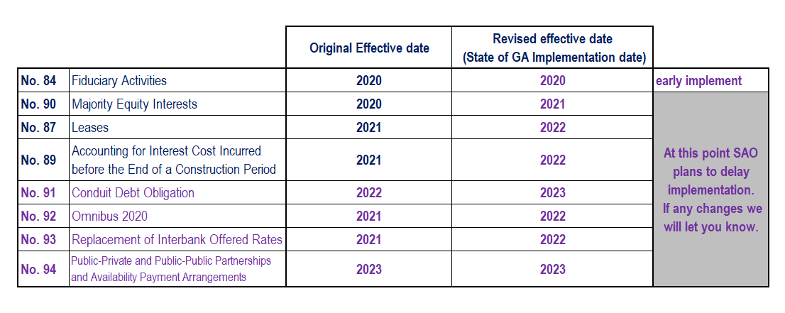
Upcoming GASB’s
GASB 95 was announced on May 7th 2020. This statement postpones the effective date of certain upcoming GASB standards.
4

Slide 5
GASB No. 84 – Fiduciary Activities
KEY AREAS TO REMEMBER
Funds Held for Others should NOT be used for fiduciary funds
Many agencies are still using this account
Revenue and Expenditure accounts MUST be used
New account requests can be submitted as needed
Net Position will be reported
Presentation in the CAFR FY20 could change based upon surveys submitted and approved
5

Slide 6
GASB No. 84 – Fiduciary Activities
NEXT STEPS:
SAO:
Based upon activities noted from surveys recommend journal entries based upon activity (arriving this month)
Prepare CAFR presentation for agency changes
AGENCIES:
Provide clarifications or supporting documentation when requested
Make journal entries, as needed, to correctly present activity
Restate beginning balances
Create expense and revenue accounts based upon activity noted
Move activity to other funds, as necessary
6

Slide 7
GASB No. 84 – Fiduciary Activities
NEW PROCESS:
When requesting new fund sources for custodial (formerly agency funds) activity. You must either:
Update a former survey to include new fund source
Or provide new evaluation for the new activity
This must be submitted with the tree maintenance form.
Fund source will not be approved until this is completed and reviewed.
If an agency needs previous surveys to resubmit please contact SAO_Reporting@sao.ga.gov and enter in the subject line “(Agency number) XXX-Fiduciary Survey Request for Resubmission”.
New evaluation located on GASB 84 Implementation page Fiduciary Activities Evaluation
7

Slide 8
GASB No. 84 – Fiduciary Activities
SAO GASB Implementation Page:
GASB 84 Fiduciary Activities
Links to GASB Information
Training resources given by SAO
Evaluation for new potential fiduciary activity
8

Slide 9
GASB 87 - Leases
Process of Implementation:
May 2020 – GASB issues Statement No. 95 – Postponement of Effective Dates
Statement 87 and Implementation Guide 2019-3—fiscal years beginning after June 15, 2021, and all reporting periods thereafter
New Effective Date – July 1, 2021
Training and Implementation activities
Last year held GASB 87 Workshop (6/6/19)
FY19 Confirmation of Lease Reporting
Upcoming GASB 87 Survey Workshop June 2020 (6/16/20)
Survey due back to SAO after fiscal year 2021 year- end close
9

Slide 10
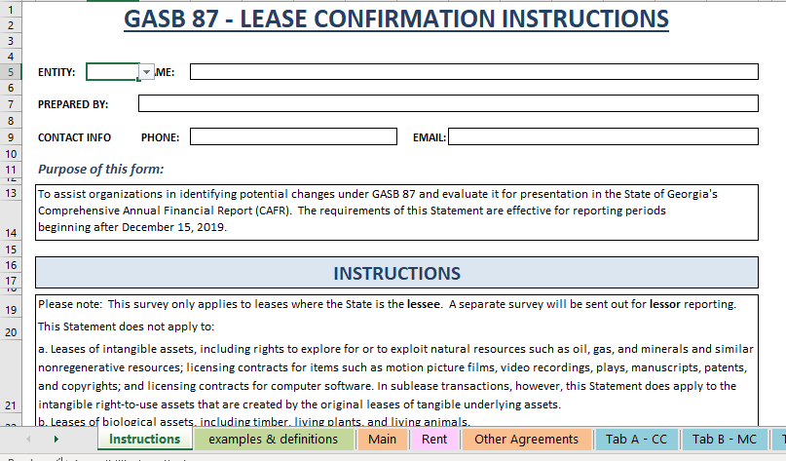
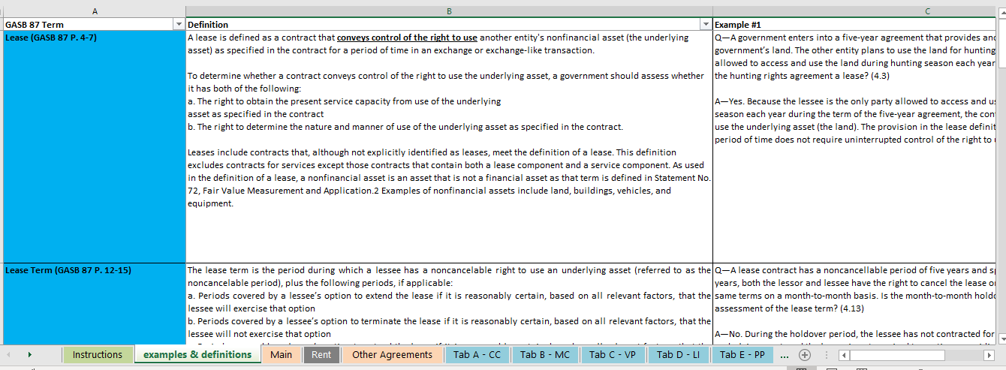
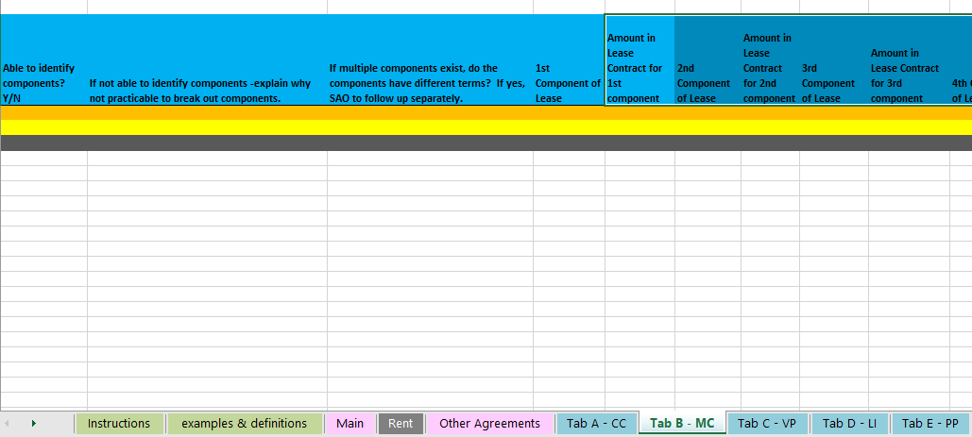
GASB 87 - Leases
GASB 87 Survey:
Instructions Tab
Main Tab
Examples & definitions
Tabs A – E
10

Slide 11
GASB 87 - Leases
Lease term –
Period during which a lessee has a noncancelable right to use an underlying asset
Plus the following periods if applicable:
Lessee’s option to extend if it is reasonably certain
Lessee’s option to terminate the lease if it is reasonably certain
Lessor’s option to extend the lease if it is reasonably certain
Lessor’s option to terminate the lease if it is reasonably certain
Reassess term only if:
the reasonably certain conclusion on options were wrong
An event that requires an extension or termination takes place
Fiscal Funding Clause - only affect the lease term if it is reasonably certain that the clause will be exercised
Most importantly - Is lease term in compliance with GASB 87?
11

Slide 12
GASB 87 - Leases
Tab B - Multiple Components:
Contract with lease and nonlease components
• Separate lease component from nonlease component. Ex:
Allocate cost of toner vs copier
Allocate cost of vehicle vs oil changes or maintenance costs
• Treat as separate contracts
Multiple underlying assets in same lease and assets have different lease terms
• Each underlying asset treated as separate component (lessee and lessor)
Allocate contract price to each component using reasonableness and professional judgment
Prices for each component in the contract (if available)
Stand-alone prices for similar assets
If cannot determine allocation, treat as a single-lease unit
12

Slide 13
GASB 87 - Leases
Tab C – Variable Payments
Payments that depend on an index or a rate (such as the Consumer Price Index or a market interest rate), initially measured using the index or rate as of the commencement of the lease term.
Variable payments based on future performance of the lessee or usage of the underlying asset should NOT be included in the measurement of the lease liability.
Should be recognized as outflows of resources (for example, expense) in the period in which the obligation for those payments is incurred.
However, any component of those variable payments that is fixed in substance should be included in the measurement of the lease liability.
If you answer “Yes” to the question in Column AE then you must complete Tab C – VP
13

Slide 14
GASB 87 - Leases
Subleases - Treated as a separate transaction
Lessee now also the lessor
No offset of transactions
Original lessee
Right to use asset and liability (original lease)
Receivable and deferred inflow of resources (sublease)
Contracts that Transfer Ownership
A contract that:
transfers ownership of the underlying asset to the lessee by the end of the contract AND
does not contain termination options (see paragraph 12), but that may contain a fiscal funding or cancellation clause that is not reasonably certain of being exercised (see paragraph 13), should be reported as a financed purchase of the underlying asset by the lessee or sale of the asset by the lessor.
14

Slide 15
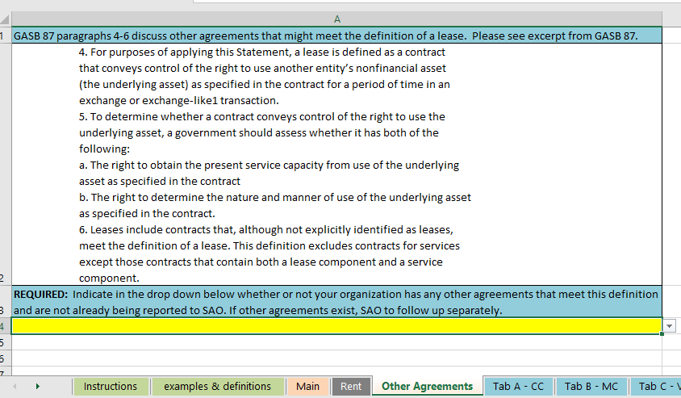
GASB 87 - Leases
Other Agreements that might meet the definition of a lease
15

Slide 16
GASB 87 - Leases
Reminders:
Intergovernmental Agreements
PG to PG leases should NOT be reported
Ex: agreements between Georgia Building Authority (GBA) and other organizations included in the State’s primary government should not be reported as leases in the statewide CAFR.
PG to CU should be reported
If any State organization enters into a lease agreement where the lessor is either a) a discretely presented component unit or b) a public organization that is not part of the governmental unit entity for financial reporting purposes, then the lease should be treated in the same manner as any other lease agreement of the State
Organization chart may be found on SAO’s website
Upcoming changes to the lease agreement data form for FY22
Lessor reporting changes
16

Slide 17
BCR Reminders
17

Slide 18
Common BCR Issues
PCA’s may need to be submitted to tie in Appropriations Receivable, Appropriations Revenue, Return of Surplus and/or Early Return of Surplus to OST.
Agencies should ensure that any further PCA’s to change certain BCR line items do not impact these four line items once tied in.
18

Slide 19
Common BCR Issues
Entries aren’t being posted to tie in fund balance until files are received from SAO
Entries posted to fund balance accounts after tied in (especially during 998)
Post Closing Adjustments (PCA) form does not match BCR form
Budget variances not corrected prior to OPB budget system closing
Reserve requests to OPB not matching what agencies provided as reserved fund balance on the BCR
19

Slide 20
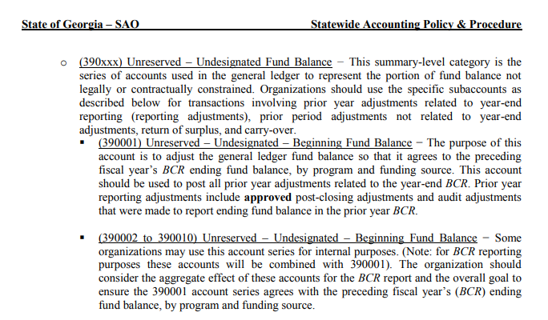
Tie in Beginning Fund Balance
Accounts are reviewed and reconciled by program and fund source
Please refer to the Equity Policy on SAO’s website: https://sao.georgia.gov/accounting-policy-manual
20

Slide 21
Entries Posted to Fund Balance Accounts After Being Tied In to the PY BCR
Once Beginning Fund Balance is tied in, NO entries should be posted to any of those accounts at any point during the year, except for account 337xxx, which establishes Current Fiscal Year reserves. Offset to reserve establishment is always 390110.
Any entries posted to account 390001, 390104, or 492xxx will cause beginning fund balance to no longer tie to the prior year BCR.
21

Slide 22
Non-Compliance with Budget
Be certain to review final budget amounts and enter final budget amendments in OPB budget system for Federal and Other funding sources to ensure budgetary compliance by funding source within program prior to OPB PBCS budget system closing (mid-August).
Note: Budget amounts in SAO’s Final BCR come from OPB’s PBCS budget system, not TeamWorks.
22
22

Slide 23
Non-Compliance with Budget
SAO will be sending draft BCRs on the Monday and Thursday of the 998 close week to assist agencies in reviewing their BCR prior to year end close
Goal of this exercise:
(A) To avoid agencies having more expenditures than revenue and to give agencies a chance to review data in SAO format and make necessary adjustments in TeamWorks before 998 close
(B) Reduce the number of PCAs
23

Slide 24
Purchase Order Reminders
When organizations cancel a PY PO with State funding sources, these funds are to lapse to OST and not be respent
As a reminder, organizations should be reviewing all PO’s regularly and closing any old PO’s or those with no future activity anticipated
24

Slide 25
Capital Projects Funds
25

Slide 26
Capital Projects Funds
It is ok to post matching federal funds for GO projects as long as a federal fund source is used for the funds (and not the 9xxxx fund source used for the GO Bond funds from GSFIC).
Capital Projects Fund accounting policy went into effect 7/1/2017 which requires use of a 5xxxx fund to be included in budget fund.
https://sao.georgia.gov/business-process-policies
Account 474002-OFS-Proceeds of General Obligation Bonds
Must be used to post GO bond proceeds from GSFIC and only GO bond proceeds can be posted here
Agencies should be able to reconcile their transfers (revenue) from GSFIC and identify timing differences. Be sure to review transfers in from GSFIC posted to the CPF fund for accuracy.
26

Slide 27
CAFR Forms
27

Slide 28
CAFR Forms (not an all inclusive list of forms)
Lease Agreement Data
Capital Assets
Inter-Organization Form (Due To/Due From)
Pollution Remediation Obligations (Form in Wdesk)
New form for Asset Retirement Obligation (ARO) (Form in Wdesk)
Unrecorded Receivables and Payables (URP)
Cash Form Reminders
Classification of Revenue
Year-end forms collected via Wdesk
SEFA Reconciliation Form
Training Videos
28

Slide 29
Lease Form
Lease Agreement Form tips to ensure completeness and accuracy:
Ensure all leases are reported on the form
Ensure payment frequency is correct
No duplication of lease numbers
Ensure correct and logical date information is reported
Ensure correct and logical economic life information is reported
Ensure rent steps information is reported correctly
Do not report information for leases with GBA and SPC – only lease agreements outside the Primary Government in the reporting entity are included in the CAFR
Ensure form is submitted with all required data filled in
29

Slide 30
Lease Form
Lease Agreement Form tips to ensure completeness and accuracy:
One-year lease with renewal periods need to be included as these are leases and not one-year contracts.
Report all one-year leases for office space with renewal options including those that may have been signed by the State Properties Commission (SPC) on behalf of your organization. SPC will only report true multi-year leases therefore, one year leases with renewal options are to be reported by each organization regardless of who signed the lease. If you have questions about these SPC leases, please contact SPC directly.
Intent of the lease term overrides the legal form of the lease term for financial reporting purposes.
Please refer to the Lease Policy on SAO’s website: https://sao.georgia.gov/accounting-policy-manual
30

Slide 31
Capital Assets
Some common things noted during the review of the capital asset forms
Inadequate Descriptions of Adjustments
Within the Capital Asset Form, there are columns that require additional information.
Adjustments to Beginning Balances
Adjustments to Current Additions/Deletions
GSFIC Transfer to Agency
Donations
Transfers In/Out
Transfers
Transfers between agencies should be recorded at the same amounts at both agencies
Including Accumulated Depreciation
Review of Executive Order’s will occur in FY20 for asset moves
Please refer to the Transfer of Capital Assets Policy at our website
http://sao.georgia.gov/accounting-policy-manual
31

Slide 32
Capital Assets
Some common things noted during the review of the capital asset forms
Construction In Progress
Ensure CIP amounts are reviewed for accuracy and all “ins and outs” have been recorded appropriately.
Ensure all completed assets that have been put into service have been moved out of CIP and into their proper asset g/l account on the books.
We have come across instances where CIP balances do not change from year to year…this is not normal! Please review CIP balances to make sure proper amounts are being reported.
Do not write off asset if fully depreciated and still using
32

Slide 33
Inter-Organization Form
Amounts reported on this form should match the amounts reported at the corresponding agency, ex: Agency A is showing a Due From Agency B equaling $50,000. There should be a Due To Agency A recorded at Agency B for $50,000
To ensure completeness, reach out to the other agency and verify the amounts they are reporting
Pick up the phone and call each other
If identified differences between agencies are do to timing, a CAFR adjustment is required. An adjustment should be sent to SAO on the Unrecorded Receivables and Payables form for these timing differences. It is NOT ok for agencies to have A/R and A/P balances between each other that are not in sync.
33

Slide 34
Pollution Remediation Obligations
Obligating Events
When a government knows or reasonably believes that a site is polluted, the government should determine whether one or more components of a pollution remediation obligation are recognizable as a liability when any of the following events occurs:
a. The government is compelled to take remediation action because pollution creates an imminent endangerment to public health or welfare or the environment, leaving it little or no discretion to avoid remediation action.
b. The government is in violation of a pollution prevention–related permit or license, such as a Resource Conservation and Recovery Act (RCRA) permit or similar permits under state law.
34

Slide 35
Pollution Remediation Obligations
Obligating Events (continued)
c. The government is named, or evidence indicates that it will be named, by a regulator as a responsible party or potentially responsible party (PRP) for remediation, or as a government responsible for sharing costs.
d. The government is named, or evidence indicates that it will be named, in a lawsuit to compel the government to participate in remediation.
e. The government commences, or legally obligates itself to commence, cleanup activities or monitoring or operation and maintenance of the remediation effort. If these activities are voluntarily commenced and none of the other obligating events have occurred relative to the entire site, the amount recognized should be based on the portion of the remediation project that the government has initiated and is legally required to complete.
35

Slide 36
Pollution Remediation Obligations
Agencies should be sure to report remediation of asbestos and lead based paint along with other forms of potential exposure.
Purchase order line details can be searched for “asbestos” as a starting point to for identification.
Contracts opened and closed within the same year must be reported!
GSFIC will report on any pollution remediation for GSFIC managed projects!
2019 Performance audit report found there are still cases of pollution remediation, especially asbestos, that are not being reported to SAO.
36

Slide 37
Pollution Remediation Obligations
Agencies need to ensure any and all potential exposure for pollution remediation is reported on the form!
Be sure to follow up with program managers/field staff, agency council, and leadership to ensure any potential litigation settlements are included on the form.
For existing litigation that has been reported in prior years, please provide as much update and the most current known status as possible.
37

Slide 38
Asset Retirement Obligation (ARO)
ARO – legally enforceable liability associated with the retirement of a tangible capital asset.
A government that has legal obligations to perform future asset retirement activities related to its tangible capital assets should recognize a liability based on the guidance in this statement.
Link to Standard:
http://www.gasb.org/jsp/GASB/Document_C/DocumentPage?cid=1176168670369&acceptedDisclaimer=true
38

Slide 39
Asset Retirement Obligation (ARO)
Obligation arises from law, regulation, contract, court judgement, and occurrence of an internal or external event.
An agency has an ARO if at the time of the asset being put into service, the agency knows with certainty that they will incur some cost to retire the asset in the future.
ARO is different than Pollution Remediation (GASB 49). With PRO, it is not known at the beginning of the assets life that there is something to do upon retirement. It is only when something becomes polluted that the obligation arises.
39

Slide 40
Asset Retirement Obligation (ARO)
Agencies using a vendor to dispose of assets must have a contract stating that the agency is not responsible for remediating the asset to be exempt from ARO.
Agencies using DOAS state surplus or GEFA to dispose of assets need to reach out to those agencies for information regarding cost of disposal.
40

Slide 41
Asset Retirement Obligation (ARO)
FY 20 WDesk Form
41

Slide 42
Asset Retirement Obligation (ARO)
FY 20 WDesk Form
42

Slide 43
Asset Retirement Obligation (ARO)
If “Yes” response to Wdesk form questions 5 or 6, then this excel spreadsheet is required
43

Slide 44
Unrecorded Payables
For BCR reporting
Budget Fund substantially GAAP modified accrual with the following exceptions:
Expenditures and Payables:
Liabilities and expenditures are recorded when purchase orders or other contractual obligations to procure goods or services have been executed.
Expenditures for items not requiring purchase orders are recorded when the goods or services are received.
Agencies may record these expenditures when presented for payment as long as the application of this method is applied consistently and the appropriate number of occurrences is reflected each year.
44

Slide 45
Unrecorded Payables
For CAFR reporting
Encumbrances payable do NOT meet recognition requirements of expenditures/liabilities for GAAP modified and full accrual bases
These expenditures are reversed by SAO for CAFR reporting.
Accounts payable must be recorded for any goods and/or services received as of year-end
Note: Recording expenditures based on purchase orders, while valid for BCR purposes, is not valid for CAFR and should be reported on form.
45

Slide 46
Unrecorded Payables
When SAO converts BCR financial statements to CAFR financial statements it is necessary to:
Identify and accrue for goods & services received as of year-end but for which there is no corresponding expenditure and payable already recorded in CAFR (Note: encumbrances are not included in CAFR balances).
46

Slide 47
Unrecorded Payables
For goods and services that have been received prior to fiscal year end, the transaction could be:
On GL in encumbrances payable
Must be reclassified to accounts payable through use of the form
On GL in accounts payable
Stay where they are, that is, do nothing
Not recorded on GL
May or may not be required to be reported on statutory basis, e.g., recurring payments. Regardless of whether or not reported on statutory basis (through BCR PCA), all goods and services received, but not on GL, must be included on form
Example: June 20 item received, while possibly booked in FY21 in BCR, needs to be reported in FY20 CAFR
47

Slide 48
Unrecorded Payables
Note on Queries:
The same item may show on multiple queries, so the results of the queries need to be analyzed to ensure that they are only reported on the form once.
48

Slide 49
Unrecorded Receivables
Revenue Recognition Criteria are different between statutory, modified and full accrual
Statutory Basis (e.g. BCR) – Generally, for funds other than State and Federal Funds, revenue and receivables are recognized on cash basis.
GAAP Bases – Key concepts are:
Earned – a matrix has been included in the Revenues, Receivables, Unearned Revenue and Unavailable Revenues – General policy on SAO’s website to assist in determining earning criteria for various types of revenue
Available – once it has been determined a revenue has been earned, it has to be determined if modified accrual availability criteria (defined on form) have been met
49

Slide 50
Unrecorded Receivables
This grid is included within the form’s instructions to assist in determining what transactions need to be included on form
50

Slide 51
Unrecorded Receivables
When SAO converts BCR financial statements to CAFR financial statements it is necessary to:
Identify and accrue for revenues that are earned on either the GAAP modified or full accrual basis, along with any related allowance for doubtful accounts, for such receivables
51

Slide 52
Unrecorded Receivables
Validate query results are legitimate expenses for accrual with purchasing or applicable agency personnel
Meet with management/department heads
Confirm all current FY expenditures have been reported (no non-PO A/P surprises)
Confirm all current FY revenue has been reported
Communication Is Key!!
52

Slide 53
Cash Form Reminders
Do not include PCAs affecting cash accounts – it will not reconcile to what SAO loads from TeamWorks
SAO will account for PCAs affecting cash accounts
No need to submit multiple cash forms (i.e. a separate form for each fund type)
53

Slide 54
Classification of Revenue Form
SAO’s long-term goal is to eliminate Classification of Revenue form
Capital Grant and Contributions Revenue Accounts – accounts have been set up in TeamWorks for organizations to use to record any capital contribution (e.g. Grants and contributions revenues that are primarily restricted for the purchase, construction or renovation of capital assets. Also, any investment income related to these funds.) Please either use these accounts or reclass capital contribution revenue at year-end into these accounts.
496010 – Capital Contributions-FED
496020 – Capital Contributions-OTH
Until SAO can confirm all organizations are properly using these accounts the Classification of Revenues form will still be required
54

Slide 55
Wdesk for year-end form collection
SAO uses a software, called Wdesk, to issue the CAFR.
Agency CFOs will be provided a login and will submit the following year end CAFR forms via a Wdesk reporting portal on the web for FY20:
Year-end Reporting Package Confirmation
Service Concession Arrangements
Deferred Outflows, Inflows of Resources and Nonexchange Financial Guarantees
Pollution Remediation
Asset Retirement Obligation (ARO)
Year-end Questionnaire
Subsequent Events
Subsequent Events – Single Audit
Note: CFOs will be able to forward forms to delegate to complete. Forms will be available closer to the applicable deadlines on SAO’s website.
55

Slide 56
SEFA Reconciliation Form
Recap:
Reconciles Federal expenditures reported in SEFA webportal back to federal revenues reported in the CAFR, after considering GAAP adjustments
Do not use “plug” numbers to reconcile
All differences must be fully explained
If changes made to accounting records, year-end forms or SEFA data then must submit new Recon forms
Remember RBE and SEFA Recon need to be in sync
Remember URP and SEFA Recon need to be in sync
If passing from/to another entity then need to communicate amongst yourselves
This ensures that both are using same CFDA number, same amount, same designation of research & development, etc.
This data is part of the single audit report which is filed with the Fed Govt, so accuracy of information is important
56
Notes:
In other words, the amounts on both the Revenue Based on Encumbrance form and the SEFA form need to agree
and the amounts on both the Unearned Revenue and Payables form and the SEFA form need to agree

Slide 57
Training Videos
Training videos for the year end forms can be on SAO’s website under “Training and Calendars”
Videos may be a little outdated but still provide helpful and relative information
https://sao.georgia.gov/year-end-training-videos-presentations
57

Slide 58
SAO Forms Open House
SAO Forms Open House #1 – August 5th, Room 1514C 2 p.m.- 4 p.m.
SAO Forms Open House #2 – August 25th Room 1514C 2 p.m.- 4 p.m.
There is no agenda for these sessions. Please bring your forms and specific questions! ☺
Note – at this time we are planning on these being held in person, but once we are closer to the date we may change to be a web-based format
58

Slide 59
Single Audit
59

Slide 60
Single Audit
Carefully read instructions every year – there is a lot of important information in there (and changes are made to them)
SEFA webportal has many sets of instructions built into as denoted by
https://sao.georgia.gov/federal-compliance-reporting
Remember: all Federal money must be reported (in current Covid some Agencies may receive Federal amounts and may not have reported anything in past years)
60

Slide 61
Single Audit
SEFA webportal submission:
Properly identify if monetary vs. non-monetary
System limits monetary or non-monetary options by CFDA, but if needed reach out to SAO if you need to use a CFDA and the option is not available
Properly identify research & development
Should find notation somewhere in grant award documents
Use listing on SAO’s website to identify proper State Organization
Use especially when receiving money from an Attached Organization as the System only allows for selection of the lead/parent organizations
If passed-through make sure amount and ALL other information (CFDA number, R&D answer, etc.) agrees to organization who initially received the money.
61

Slide 62
Single Audit
SEFA webportal submission:
Use CFDA number per grant award documents
Do not just use same CFDA number that was used in past years
System will be updated to only allow active CFDA numbers to be used, but reach out to SAO if there is one needed to be used that is not valid in the System
Do not just pick a different CFDA
Interagency pass thru:
There are still issues with agencies not matching. Please remember “timing” is not an acceptable as both sides should match (may require URP adjustment).
62

Slide 63
PCA Tips
Post-Closing Adjustments
63

Slide 64
PCA Tips
PCA entry form is filled out completely and correctly and entry is balanced. Make sure correct account, program, fund source and budget year data is provided.
Program and fund source data on PCA form is reported properly on Fund Balance Appropriations form (FBAF) (e.g. PCA adjusts state funds but federal funds are adjusted on FBAF).
Use one PCA form per entry, do not combine multiple PCAs onto one form.
Do not add lines to PCA short form. If additional lines are needed, use PCA long form, or request assistance from SAO to add additional lines
64

Slide 65
PCA Tips
PCAs are processed in TeamWorks timely in subsequent fiscal year (do not wait for SAO’s beginning fund balance recon exercise, PCAs should be posted prior).
Use accounts indicated in the FY21 column of the form when posting FY20 PCAs to Teamworks in FY21 (as items recorded to a revenue/expense account on the FY20 PCA need to be posted to account 390001 in Teamworks in FY21).
Limit the number of PCAs submitted
Non-recurring each year as recurring ones should be adjusted in the next year before 998 closes (e.g. PCAs should be non-routine and non-recurring)
65

Slide 66
Other Items Noted from CAFR Process
66

Slide 67
Other Items Noted
Common Statewide Findings
These are repeat findings across multiple agencies:
IT controls
Periodic review of user access
Segregation of duties (user access rights)
Financial Reporting
Strengthen control over accuracy of information in financial statements and required disclosures
Errors in year-end forms
67

Slide 68
Other Items Noted
Clearing Account
Must be zero by fund type by end of year (ex: BCR,CPF, Agency, etc). Refer to accounting policy: Control/Clearing Accounts-Balancing Requirements for travel related account exceptions
Balances in accounts 196xxx should offset to zero at year end
Excludes Travel Clearing accounts:
196040
196041
196060
196061
Balances in accounts 296xxx should also offset to zero at year end
68

Slide 69
Other Items Noted
Governance List
Accounts Payable – Encumbrances Payable 200011 should be zero in General Ledger until year end when PO module closes to GL
Should only have balances from period 998 of CY
It is ok to post current year manual JVs for accrual of encumbrances to account 200011 in periods 12 and 998
In period 1 of the following year, manual JVs to account 200011 should be reversed and related adjustments should be made through the PO module
It is not ok to carry balances in account 200011 that resulted from prior year manual JVs
69

Slide 70
Other Items Noted
Transfers
Interfund transfers (accounts 471001/750001) are flows of assets without equivalent flows of assets in return and without a requirement for repayment (subsidies).
An example of a transfer would be where the Governor’s office transfers emergency funds to an agency, however the agency does not need to provide goods and/or services back to the Governor’s office. In this case, the Governor’s office is spending funds without receiving a benefit in return; the benefit is received by the public who is being served by the agency who received the transfer in of funds.
70

Slide 71
A/R Accounts for Revenue Based on Encumbrances
In 2017 specific account numbers were established to record Accounts Receivable balances resulting from Revenue Based on Encumbrances accruals.
122003 – Fed Receivables-Direct-3-RBE
122004 – Fed Receivables-Direct-4-RBE
122502 – Fed Receivables-Indirect-2-RBE
133010 – Other Receivables – RBE
143073 – Inter Rec-RBE
143075 – Inter Rec-DOT-GPDuefrGSFIC-RBE
143078 – Interfund Rec – SRTA – RBE
143080 – Interfund Rec –DOT-TIA Enc-RBE
SAO encourages all Agencies to use these accounts for FY20 to record their Revenues Based on Encumbrances. Using these accounts should assist in completing the Revenues Based on Encumbrances and SEFA forms.
71

Slide 72
Reminder of Federal Revenue Accounts
As noted above in the CAFR forms section, new specific account numbers have been established to record Capital Grants and Contributions – Federal and Other.
496010 - Cap Grants & Contrib - Capital Contributions - Federal
496020 - Cap Grants & Contrib - Capital Contributions - Other
72

Slide 73
Chartfield Maintenance form
Funding Source Requests
73

Slide 74
Fund Source Tree Request Form
There have been many changes made to the Fund Source Tree Request form:
Form format enhancement:
• Dropdown boxes for selection convenience.
• Conditional formatting to prompt data entry for required fields.
• Fund Balance Instructions tab has been updated to provide clarity.
It is recommended to download the form template from the SAO website for every new Fund Source request to ensure the integrity of the form. In case of a mistake while inputting the data, delete erroneous row(s). Begin again on the next row to allow all dropdown boxes, conditional formatting, and formulas to work properly.
74

Slide 75
Fund Source Tree Request Form
COVID Relief Act - Memo from OPB issued April 30, 2020
A Column has been added regarding the COVID Relief Act: “Is this a fund source for COVID relief acts?
Select from dropdown.
Yes – Coronavirus Preparedness and Response Supplemental Appropriations Act 2020 (CPRSA),
Yes - The Families First Coronavirus Response Act (FFCRA) and
Yes - The Coronavirus Aid, Relief, and Economic Security (CARES) Act
No - if not related.
New parents: YCCDB, YCSBG, YLIHE, YMAP and YFED2
Organizations need to add the following values to their BCM_FUND_SRC tree, in Design Chartfields :
COVD1 (FS_CAT level)
Yxxxx (FS_Type level)
Organizations receving Coronovirus Relief Fund money from OPB need to establish funding source 3Y999
75

Slide 76
Fund Source Tree Request Form
Custodial Funds (Formerly Agency Funds) requests:
For approval you must update or submit a Fiduciary Survey with your Tree maintenance form.
Reminder
"To expedite the approval process, please COMPLETE ALL COLUMNS of the form and verify that values to be added are entered into TeamWorks - Design Chart fields. For fund source requests, please include supporting documentation for restricted, committed, nonspendable and assigned fund balance categories. The form should not be submitted with any red cells. Old versions of this form are not being accepted and WILL be sent back for incompleteness or inaccuracies.“
76

Slide 77
Miscellaneous
Miscellaneous Items
77

Slide 78
Covid Considerations for CAFR
Organizations may need to review their calculations on allowance for doubtful accounts if they are aware that their uncollectible amounts may increase.
For CAFR reporting we know we will need to discuss COVID in MD&A, and that we can access the data in Teamworks on the COVID Funding sources. At this time we are unsure of what additional information we may need to collect.
78

Slide 79
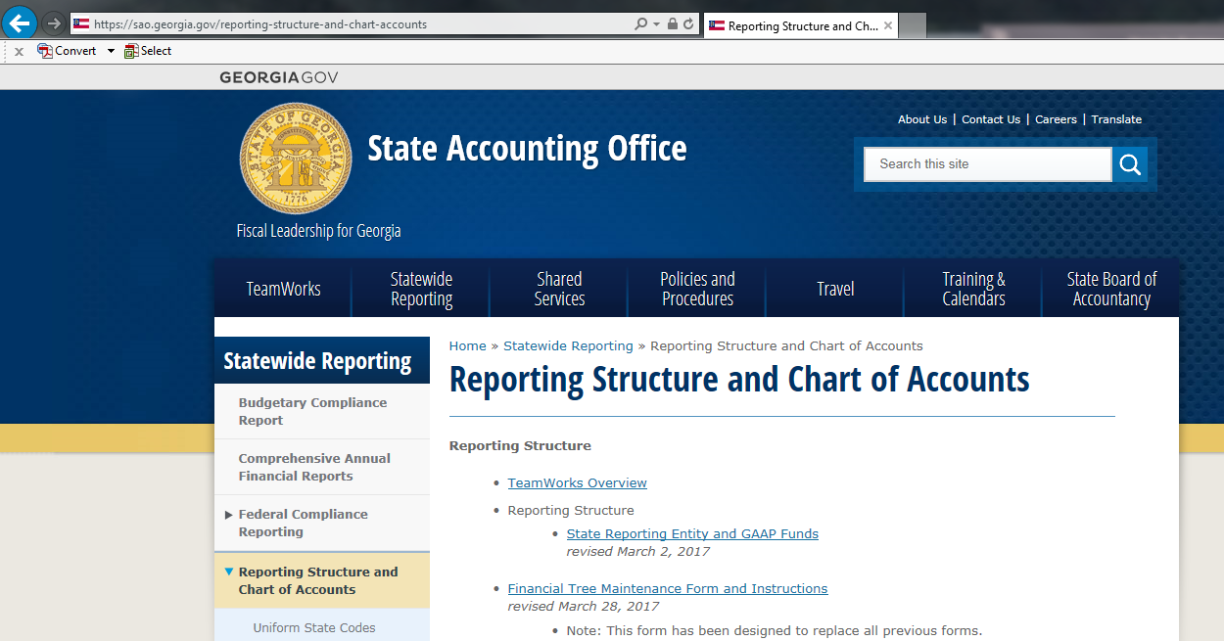
Entity Listings
Listings of other state agencies can be found on SAO’s website here:
79

Slide 80
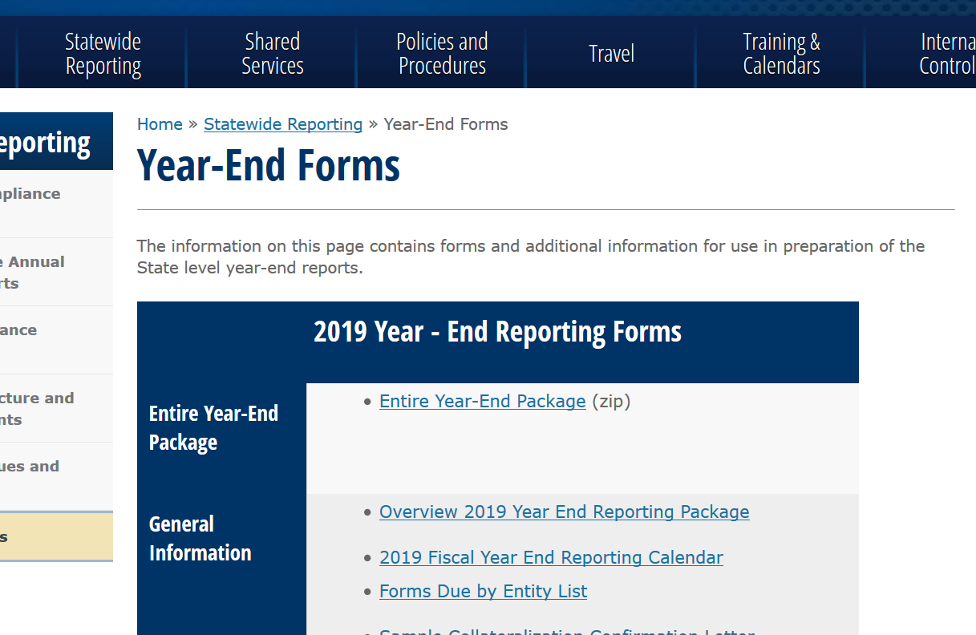
Entity Listings
Be sure to find the current forms for the applicable fiscal year on SAO’s website. Do not copy and paste or use forms from prior years.
FY20 year-end forms should be posted to SAO’s website by the end of May. An email will be sent out once they are available.
80

Slide 81
AR Write-Off Form
Slight improvements were made last year to the AR Write-Off template to prevent errors and expedite the approval process.
Information such as obligator’s ID is a required field on all submissions.
Conditional formatting added to verify compliance with write-off limits.
The form is located on SAO website:
Home >> Policies and Procedures >> Business Process Policies >> Accounts Receivable
81

Slide 82
AR Write-Off template
82

Slide 83
Other
Reminder: May 2020 FMC training presentation is out on SAO’s website
FY20 year-end timeline is net yet available, but will be similar to the FY19 timeline
FY20 forms will be posted by May 29, 2020
Onspring Internal Controls RA/CA submission is due on June 30, 2020
83

Slide 84
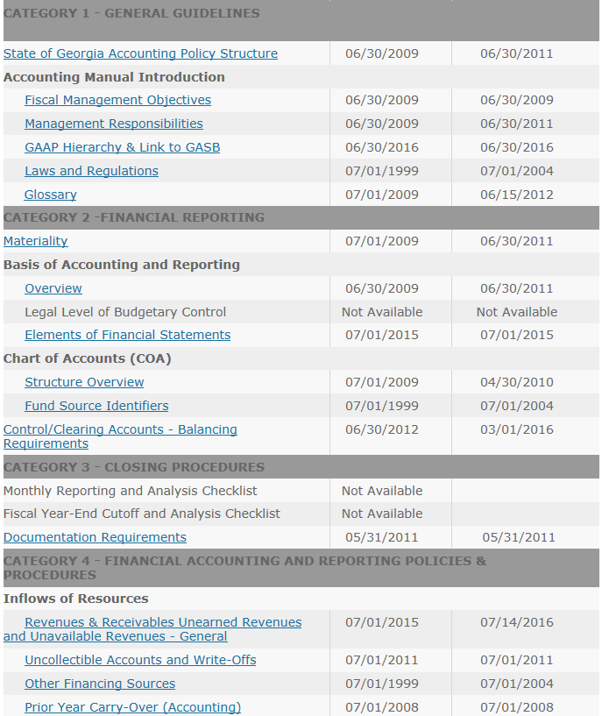
SAO Policies on Web
SAO accounting policies can be found here:
https://sao.georgia.gov/accounting-policy-manual
84

Slide 85
SAO Policies on Web
The Accounting Policy Manual includes high-level policies and procedures to ensure that financial activity is recorded accurately and consistently across organizations within the state reporting entity (e.g. reported in the CAFR), so that government-wide financial statements will comply with authoritative GASB and legislative standards.
The following slide is a snapshot of the revenue recognition matrix where guidance is given regarding when to recognize revenue and is included in the “Revenues & Receivables Unearned Revenues and Unavailable Revenues – General” policy.
85

Slide 86
SAO Policies on Web
86

Slide 87
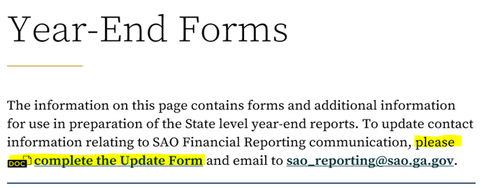
Communications list
SAO has a form for agencies to complete for updated agency contacts.
SAO will also be contacting agencies to validate contact information.
Note – this communication list is different that the Financial News sign up available in TeamWorks.
87

Slide 88
Questions?
88

