Slide 1
State of Georgia
Affordable Care Act (ACA) Marketplace Training
  January 2016

Slide 2
Agenda
ACA Overview
EY’s Services for Employers
  Marketplace Services
  Key Takeaways
  Contacts
EY Services for Employees
  Inquiry services
  Key Takeaways
Communications

Slide 3
In-scope Agencies/Populations
Who’s included in these services?
Agencies/entities that utilize both TeamWorks(PeopleSoft) for payroll and participate in the State Health Benefits Plan (SHBP)
DFACS

Slide 4
The Affordable Care Act
The ACA provides that if large employers fail to offer healthcare coverage (or offer "unaffordable" healthcare coverage) to its full-time employees, the employer may be liable for an excise tax.
Employees have the opportunity to go to a State or Federal Healthcare Marketplace to receive coverage, and may qualify for a Premium Tax Credit (PTC).
Large employers may be subject to a substantial penalty if even one full time employee receives a Premium Tax Credit from the Healthcare Marketplace.
It is important that a Healthcare Marketplace is aware of any employee that was offered affordable coverage through State of Georgia, both for the protection of State of Georgia and so that the employee does not inadvertently receive a Premium Tax Credit that they may have to pay back.
EY is working with State of Georgia to help stay in compliance with the Affordable Care Act (ACA).

Slide 5
Federal vs. State Marketplace
Each state had an option to create and manage their own marketplace or collaborate with the Federal Marketplace for some or all of their marketplace management.
The State of Georgia has opted to allow the Federal Marketplace to manage their program.

Slide 6
EY Services for Employers for 2015 Reporting
Inquiry Support Services for your employees
Marketplace Support Services - Premium Tax Credit Notice processing
Printing and distribution of employee forms (1095-C)
Preparation of employer forms (1094-C)
Electronic filing of employer/employee forms
Reporting

Slide 7
ACA Filing extension
The IRS has announced extensions to the deadlines for 1095-C and 1094-C forms.
The State of Georgia plans to complete 1095-C & 1094-C processing by the original deadlines.

Slide 8

Marketplace Services for State of Georgia
Employers
  EY will serve as the third party administrator on behalf of State of Georgia
  EY will collect, process and track all notices sent by the Marketplace
  EY will analyze notices to determine if appealable
  If applicable, EY will prepare and submit appeal with any required evidentiary documentation within the allotted time frame (90 days from notice date)

Slide 9
Notice & Appeals Process
Notices issued by the Exchange should come to EY to process and track
If State of Georgia receives any notices, send to EY as soon as possible.
There is a limited amount of time to appeal a Premium Tax Credit Notice.
    Email: MarketplaceSupport@ey.com OR
    Fax: (305) 328-9719 OR
    Mail: State of Georgia C/O EY ACA Services
    P.O. Box 227017
    Dallas, TX 75222-7017
Receive notices
Document and input information
Make Appeal determination within 90 days
Appeal notice and provide evidentiary information

Slide 10
What if the Marketplace contacts me directly?
EY will field any requests for information from the Healthcare Marketplaces in regards to PTC notices or appeals.
Forward any request for information:
MarketplaceSupport@ey.com

Slide 11
Process Flow - Marketplace premium tax credit notices
EY ops team Reviews Notice to determine if follow-up is required with Marketplace
Analyze and determine if the notice is appealable
No
Client Receives Marketplace Notices and transmit to EY
Yes
Yes
Enter notices in ACA COMPASSSM
No
Contact Marketplace to confirm identity of employee (as needed)
Identify any evidentiary documentation needed and compile appeal package for Client review
Included in reporting are status reports based on analysis of notices and results received
Report back to Client
EY supports Client throughout appeals process
Close case
EY Follow-up with Marketplace until Client receives appeal decision
Submit appeal

Slide 12
Defined Appeal Processes
The Federally Facilitated Marketplace (FFM) issued a statement on September 18, 2015 addressing the FFM notice and appeals process.
Although the process is not defined at this time, the FFM made the following statements:
  Notices will be sent in large batches
  If an employer chooses to appeal, they may attest the employee listed on the notice has been offered ACA compliant coverage
  Appeals may require additional supporting documentation
  Appeals may be submitted via fax or mail

Slide 13
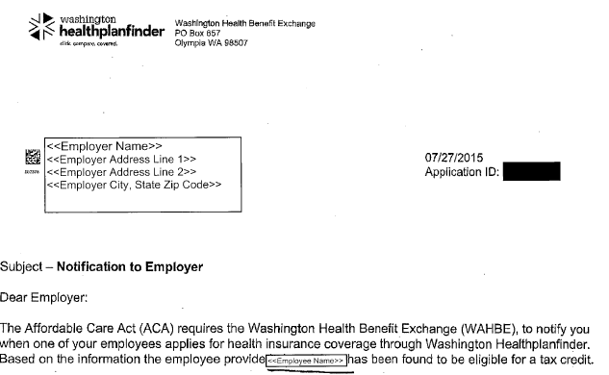
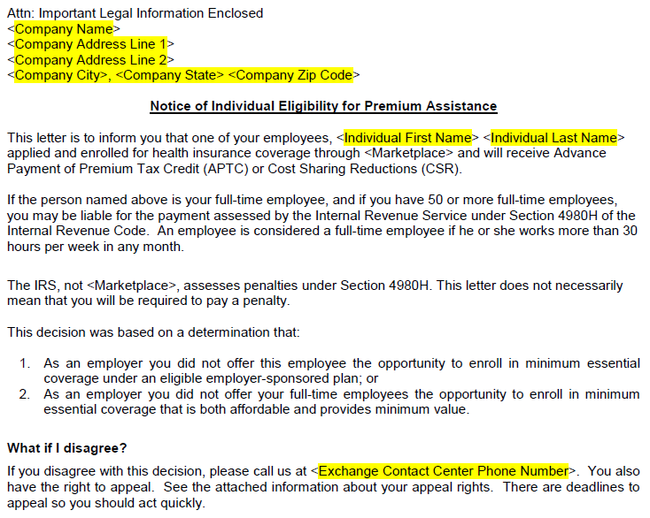
What does a Premium Tax Credit employer notice look like?
Be aware that notices could look different by state
Examples of notices are below
Connecticut
Washington

Slide 14

Key Takeaways for Employers
Immediately send EY any notices from the Healthcare Marketplaces
MarketplaceSupport@ey.com
  Fax Number: 305-328-9719
  Mail: State of Georgia C/O EY ACA Services
  P.O. Box 227017
  Dallas, TX 75222-7017
If notices are not received by EY, and processed in time, substantial penalties may exist for State of Georgia.
EY completes electronic employer filing

Slide 15
1095-C Forms
EY will print and mail all forms
Forms are scheduled to be printed and mailed by January 31, 2016 by EY
1095-C distribution is different than W-2 distribution
Data Corrections
  All data corrections will be applied through the file process
  Employee corrections should be reported to the agencies and/or SHBP
  Data corrections need to be completed before early-February

Slide 16
ACA Inquiry Services for Employees
EY is providing ACA Inquiry Services for all in-scope agencies/entities
Employees should call 1-855-314-4222 (M-F 8 AM – 8PM) with questions about their 1095-C
Go-Live date for Inquiry Services is January 25, 2016.
Employees who call the SAO Customer Support will be directed to ACA Inquiry Services

Slide 17

Key Takeaway for Your Employees
1095-C Forms will be mailed to employees by EY
Only employees under an offer of coverage or coverage during 2015 will receive a 1095-C
Forms should be mailed by January 31, 2016
W-2 and 1095-C distributions are different
Employee data corrections must first go to employers and/or SHBP
ACA Inquiry Services phone number:
1-855-314-4222 M-F 8 AM – 8PM

Slide 18
Communications
Affordable Care Act (ACA) Information for Employees
1095-C FAQs for employees
ACA Marketplace Training PowerPoint
ACA Resource page on SAO website

Slide 19
Who should agencies contact?
Contact the SAO Customer Support Center
Email: hcm@sao.ga.gov
Phone Number:
404-657-3956 or
888-896-7771

Slide 20
Resources
DOAS ACA Questions and Answers Bulletin:
  http://doas.ga.gov/human-resources-administration
  Newsletters and Advisories
  ACA Questions and Answers Bulletin
ACA Resource page on SAO website
  http://sao.georgia.gov/affordable-care-act

Slide 21
Resources
IRS Link for ACA:
https://www.irs.gov/Affordable-Care-Act
IRS Link to 1094-C & 1095-C Instructions: https://www.irs.gov/pub/irs-pdf/i109495c.pdf
IRS Link to 1095-C
https://www.irs.gov/pub/irs-pdf/f1095c.pdf
IRS Link to 1094-C form:
https://www.irs.gov/pub/irs-pdf/f1094c.pdf

Slide 22
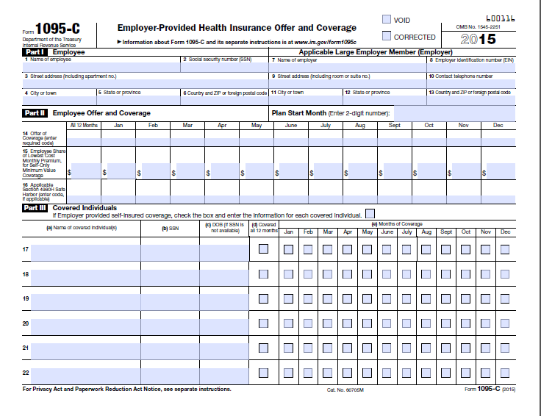
1095-C Form

Slide 23
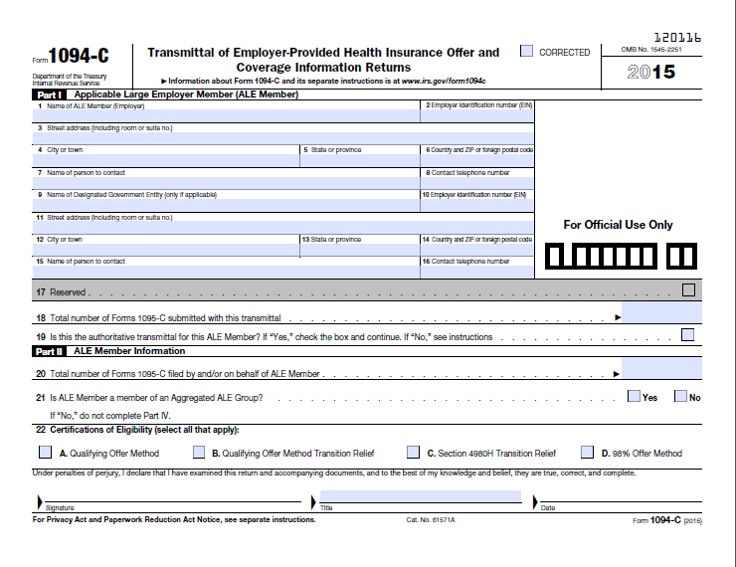
1094-C

Slide 24
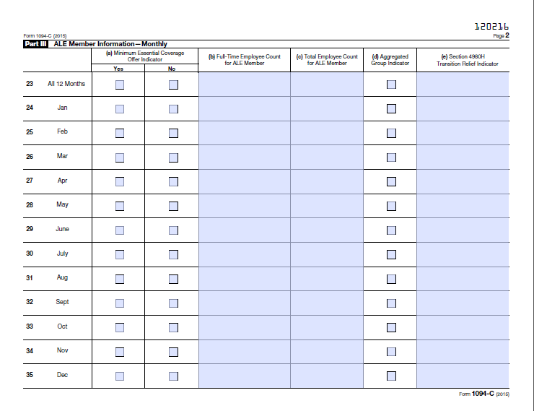
1094-C

Slide 25
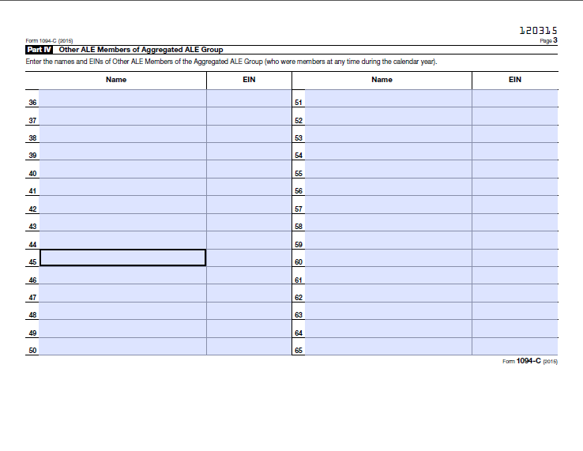
1094-C

Slide 26
Affordable Care Act
Questions?

