Slide 1
FMC Presentation
May 21, 2019

Slide 2
Agenda
Upcoming GASBs
BCR Reminders
Capital Projects Funds
CAFR Forms
Single Audit
Post-Closing Adjustments (PCA) Tips
Other Items Noted from CAFR Process
Miscellaneous Items
  Note – items in the purple font are new items added to the FY19 training

Slide 3
Upcoming GASBs

Slide 4
Upcoming GASBs
FY2019:
  No. 83: Certain Asset Retirement Obligations
  No. 88: Certain Disclosures Related to Debt, including Direct Borrowings and Direct Placements
FY2020:
  No. 84: Fiduciary Activities
  No. 90: Majority Equity Interests
FY2021
  No. 87: Leases
  No. 89: Accounting for Interest Cost Incurred before the End of a Construction Period

Slide 5
GASB No. 83 (ARO)
Asset Retirement Obligations (ARO)
ARO – legally enforceable liability associated with the retirement of a tangible capital asset
A government that has legal obligations to perform future asset retirement activities related to its tangible capital assets should recognize a liability based on the guidance in this statement
Link to Standard:
  http://www.gasb.org/jsp/GASB/Document_C/DocumentPage?cid=1176168670369&acceptedDisclaimer=true

Slide 6
GASB No. 83 (ARO)
Obligation arises from law, regulation, contract, court judgement, and occurrence of an internal or external event.
An agency has an ARO if at the time of the asset being put into service, the agency knows with certainty that they will incur some cost to retire the asset in the future.
ARO is different than Pollution Remediation (GASB 49). With PRO, it is not known at the beginning of the assets life that there is something to do upon retirement. It is only when something becomes polluted that the obligation arises.

Slide 7
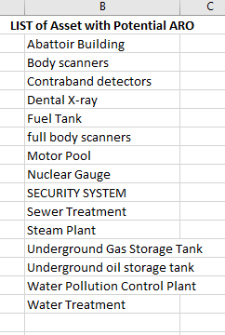
GASB No. 83 (ARO)
First survey was sent out in May of 2018
Based on responses, we reached out and worked with agencies with potential ARO. See example of potential ARO from the survey.
Second survey sent 4/12/219 and responses are expected 5/31/2019

Slide 8
GASB No. 83 (ARO)
Agencies using a vendor to dispose of assets must have a contract stating that the agency is not responsible for remediating the asset to be exempt from ARO.
Agencies using DOAS state surplus or GEFA to dispose of assets need to reach out to those agencies for information regarding cost of disposal.

Slide 9
GASB No. 84 – Fiduciary Activities
Survey was sent to CFOs on May 1; due by May 15
  Already late if not submitted yet
  Some items currently being reported as fiduciary activity may change due to survey assessment
GASB 84 training invitations for June
  Dates reserved June 11th and June 19th 1pm – 3pm

Slide 10
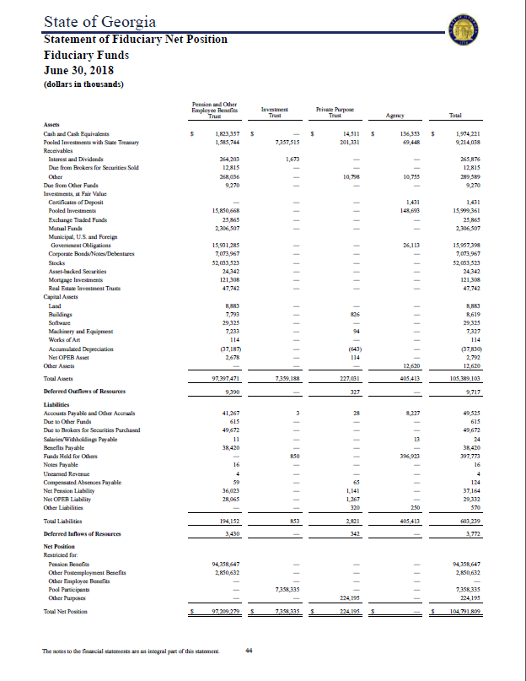
GASB No. 84 – Fiduciary Activities
2018 CAFR
Statement of Fiduciary Net Position
Agency Fund Presentation (Current)
  Funds Held for Others IS reported
Agency Fund Presentation (Current)
  Net Position is NOT reported
Funds Held for Others
Net Position

Slide 11
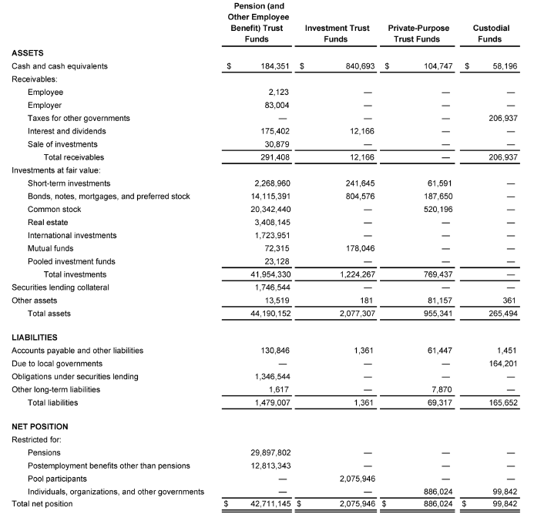
GASB No. 84 – Fiduciary Activities
Beginning FY2020 CAFR Presentation
Statement of Fiduciary Net Position
Custodial Fund Presentation
  Funds Held for Others is NOT reported.
  Liability not presented unless a
  disbursement is compelled.
Custodial Fund Presentation
  Net Position IS reported

Slide 12
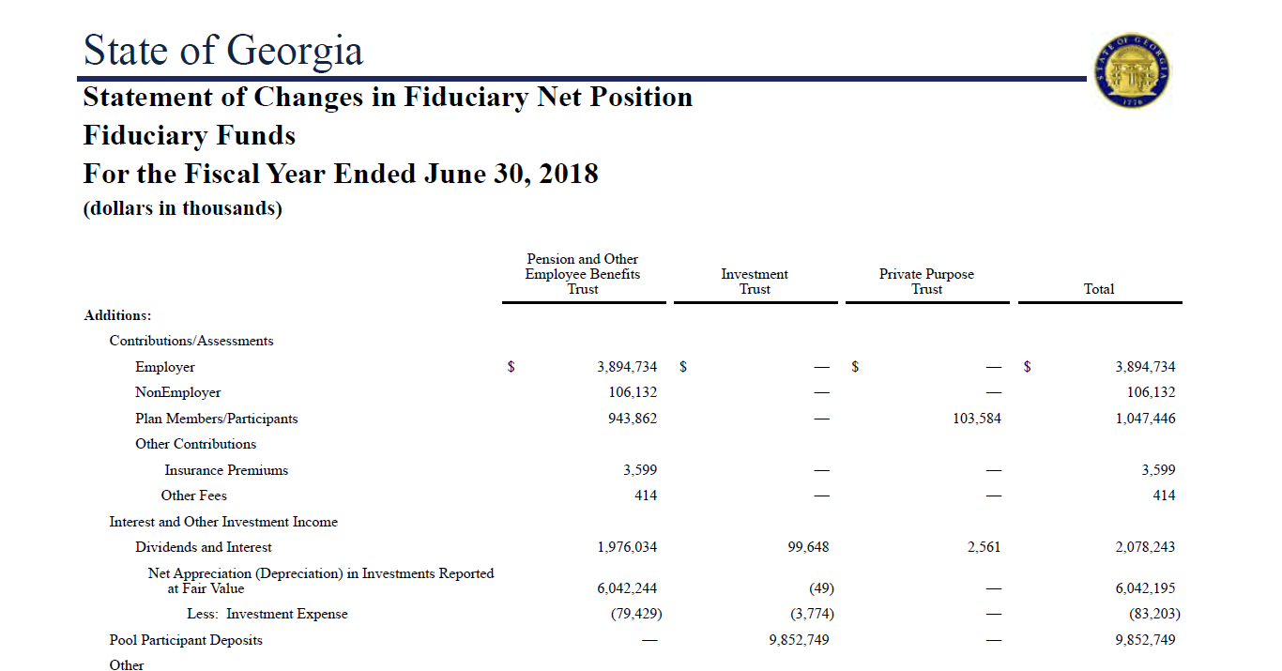
GASB No. 84 – Fiduciary Activities
2018 CAFR Presentation
Statement of Changes in
Fiduciary Net Position
Now will
require
disclosure
like other
fiduciary
funds for
custodial
funds (New)
No Agency Funds Reported (Currently)

Slide 13
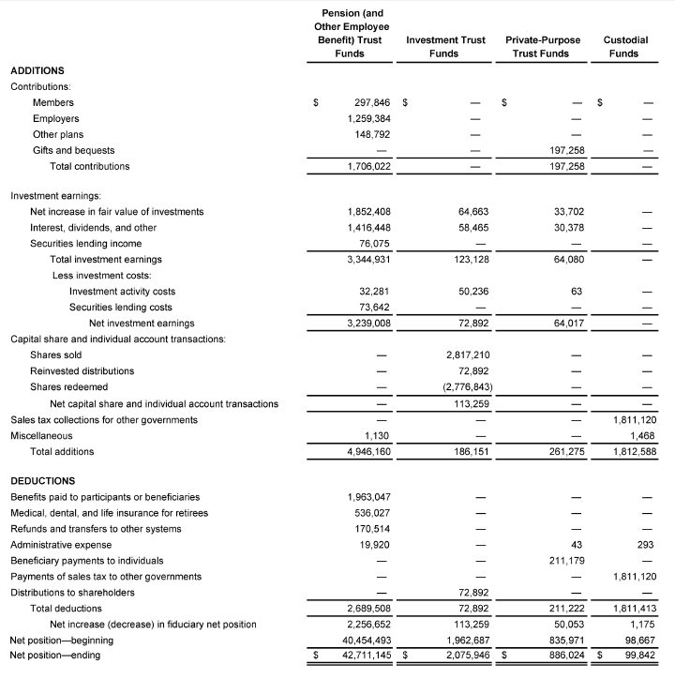
GASB No. 84 – Fiduciary Activities
Beginning FY2020 CAFR Presentation
Statement of Changes in
Fiduciary Net Position
Beginning July 1st, record
custodial funds using revenues
and expenditure accounts by
source and deduction type.
Administrative costs must
be accounted for separately.
No longer posting to Funds
Held for Others account for
custodial funds only.
Funds Held for Others
account may still be used in
other fund types (i.e. budget fund).

Slide 14
GASB No. 87 - Leases
Effective date is December 15, 2019 (fiscal year 2021)
Changes definition of a lease:
  A contract that conveys control of the right to use another entity’s nonfinancial asset (underlying asset) as specified in the contract for a period in an exchange or exchange-like transaction
    Conveying control requires both of the following:
      the right to obtain the present service capacity from use of the underlying asset, and
      the right to determine the nature and manner of use of the underlying asset
Substantially all leases are treated as Capital Leases
Short-term Leases are excluded from this standard
  Short-term is defined as a lease that, at the commencement of the lease, has a maximum possible lease term of 12 months, including any options to extend regardless of their probability of being exercised.
Other Exceptions (lessors and lessees)
  Leases that transfer ownership and do not contain termination options
Exceptions for lessors
  Leases of assets that are investments (under GASB 72 definition)
  Certain regulated leases (e.g., airport-airline agreements)

Slide 15
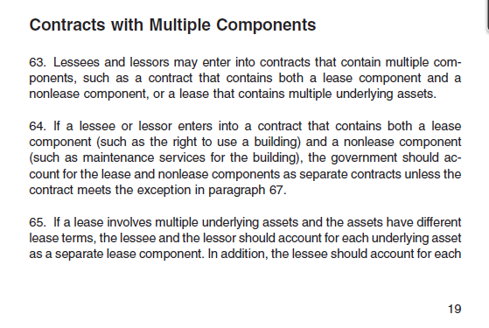
GASB No. 87 - Leases
  May have to review contracts that aren’t labeled a “lease” to determine if there are items that would qualify as a lease under GASB 87 in the contracts
  May have to break out maintenance costs versus lease costs (paragraph 64) or leases with different underlying assets (paragraph 65). See excerpt from GASB 87 below:

Slide 16
GASB No. 87 - Leases
GASB 87 Workshop
  Thursday, June 6, 2019 from 1-3 pm.
  Rooms 1514A & 1514B located on the 15th floor of the West tower
Some of the topics to be discussed at this workshop include:
  Lease population – all leases will be reported as capital
  Upcoming high-level changes to lease agreement data form
  Review of leases for items to be expensed and not capitalized (ex: maintenance)
  Exposure Draft and Implementation Guide
Please send an email to SAO_reporting@sao.ga.gov with any additional questions or topics you would like to discuss during this workshop.

Slide 17
BCR Reminders

Slide 18
Common BCR Issues
Entries aren’t being posted to tie in fund balance until files are received from SAO
Entries posted to fund balance accounts after tied in (especially during 998)
Post Closing Adjustments (PCA) form does not match BCR form
Budget variances not corrected prior to OPB budget system closing
Reserve requests to OPB not matching what agencies provided as reserved fund balance on the BCR

Slide 19
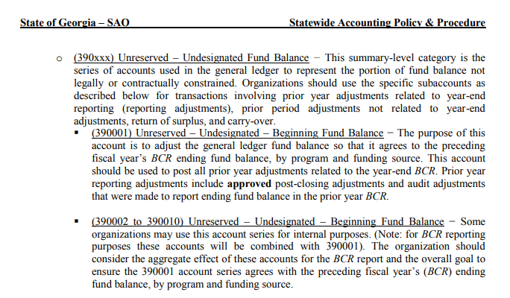
Tie in Beginning Fund Balance
Accounts are reviewed and reconciled by program and fund source
Please refer to the Equity Policy on SAO’s website: https://sao.georgia.gov/accounting-policy-manual

Slide 20
Entries Posted to Fund Balance Accounts After Being Tied In to the PY BCR
Once Beginning Fund Balance is tied in, NO entries should be posted to any of those accounts at any point during the year, except for account 337xxx, which establishes Current Fiscal Year reserves. Offset to reserve establishment is always 390110.
Any entries posted to account 390001, 390104, or 492xxx will cause beginning fund balance to no longer tie to the prior year BCR.

Slide 21
Non-Compliance with Budget
Be certain to review final budget amounts and enter final budget amendments in OPB budget system for Federal and Other funding sources to ensure budgetary compliance by funding source within program prior to OPB budget system closing (8/16/19).
  Note: Budget amounts in SAO’s Final BCR come from OPB’s budget system, not TeamWorks.

Slide 22
Non-Compliance with Budget
SAO will be sending draft BCRs on the Monday and Thursday of the 998 close week to assist agencies in reviewing their BCR prior to year end close
Goal of this exercise:
  (A) To avoid agencies having more expenditures than revenue and to give agencies a chance to review data in SAO format and make necessary adjustments in TeamWorks before 998 close
  (B) Reduce the number of PCAs

Slide 23
Purchase Order Reminders
When organizations cancel a PY PO with State funding sources, these funds are to lapse to OST and not be respent
As a reminder, organizations should be reviewing all PO’s regularly and closing any old PO’s or those with no future activity anticipated

Slide 24
Capital Projects Funds

Slide 25
Capital Projects Funds
It is ok to post matching federal funds for GO projects as long as a federal fund source is used for the funds (and not the 9xxxx fund source used for the GO Bond funds from GSFIC).
Capital Projects Fund accounting policy went into effect 7/1/2017 which requires use of a 5xxxx fund to be included in budget fund.
  https://sao.georgia.gov/business-process-policies
Account 474002-OFS-Proceeds of General Obligation Bonds
  Must be used to post GO bond proceeds from GSFIC and only GO bond proceeds can be posted here
Agencies should be able to reconcile their transfers (revenue) from GSFIC and identify timing differences. Be sure to review transfers in from GSFIC posted to the CPF fund for accuracy.

Slide 26
CAFR Forms

Slide 27
CAFR Forms
Lease Agreement Data
Capital Assets
Inter-Organization Form (Due To/Due From)
Pollution Remediation Obligations
Unrecorded Receivables and Payables (URP)
Revenue Based on Encumbrances (RBE)
Cash Form Reminders
Classification of Revenue
Wdesk
Year-end Questionnaire
SEFA Reconciliation Form
Training Videos

Slide 28
Leases
Lease Agreement Form tips to ensure completeness and accuracy:
  Ensure all leases are reported on the form
  Ensure payment frequency is correct
  No duplication of lease numbers
  Ensure correct and logical date information is reported
  Ensure correct and logical economic life information is reported
  Ensure rent steps information is reported correctly
  Do not report information for leases with GBA and SPC – only lease agreements outside the reporting entity are included in the CAFR
  Ensure form is submitted with all required data filled in

Slide 29
Leases
Lease Agreement Form tips to ensure completeness and accuracy:
  One-year lease with renewal periods need to be included as these are leases and not one-year contracts.
  Report all one-year leases for office space with renewal options including those that may have been signed by the State Properties Commission (SPC) on behalf of your organization. SPC will only report true multi-year leases therefore, one year leases with renewal options are to be reported by each organization regardless of who signed the lease. If you have questions about these SPC leases, please contact SPC directly.
  Intent of the lease term overrides the legal form of the lease term for financial reporting purposes.
  Please refer to the Lease Policy on SAO’s website: https://sao.georgia.gov/accounting-policy-manual

Slide 30
Capital Assets
Some common things noted during the review of the capital asset forms
  Inadequate Descriptions of Adjustments
    Within the Capital Asset Form, there are columns that require additional information.
      Adjustments to Beginning Balances
      Adjustments to Current Additions/Deletions
      GSFIC Transfer to Agency
      Donations
      Transfers In/Out
  Transfers
    Transfers between agencies should be recorded at the same amounts at both agencies
      Including Accumulated Depreciation
    Review of Executive Order’s will occur in FY19 for asset moves
    Please refer to the Transfer of Capital Assets Policy at our website
      http://sao.georgia.gov/accounting-policy-manual

Slide 31
Capital Assets
Some common things noted during the review of the capital asset forms
  Construction In Progress
    Ensure CIP amounts are reviewed for accuracy and all “ins and outs” have been recorded appropriately.
    Ensure all completed assets that have been put into service have been moved out of CIP and into their proper asset g/l account on the books.
    We have come across instances where CIP balances do not change from year to year…this is not normal! Please review CIP balances to make sure proper amounts are being reported.
  Do not write off asset if fully depreciated if still using

Slide 32
Inter-Organization Form
Amounts reported on this form should match the amounts reported at the corresponding agency, ex: Agency A is showing a Due From Agency B equaling $50,000. There should be a Due To Agency A recorded at Agency B for $50,000
  To ensure completeness, reach out to the other agency and verify the amounts they are reporting
  Pick up the phone and call each other
  If identified differences between agencies are do to timing, a CAFR adjustment is required. An adjustment should be sent to SAO on the Unrecorded Receivables and Payables form for these timing differences. It is NOT ok for agencies to have A/R and A/P balances between each other that are not in sync.

Slide 33
Pollution Remediation Obligating Events
When a government knows or reasonably believes that a site is polluted, the government should determine whether one or more components of a pollution remediation obligation are recognizable as a liability when any of the following events occurs:
a. The government is compelled to take remediation action because pollution creates an imminent endangerment to public health or welfare or the environment, leaving it little or no discretion to avoid remediation action.
b. The government is in violation of a pollution prevention–related permit or license, such as a Resource Conservation and Recovery Act (RCRA) permit or similar permits under state law.

Slide 34
Pollution Remediation Obligating Events
c. The government is named, or evidence indicates that it will be named, by a regulator as a responsible party or potentially responsible party (PRP) for remediation, or as a government responsible for sharing costs.
d. The government is named, or evidence indicates that it will be named, in a lawsuit to compel the government to participate in remediation.
e. The government commences, or legally obligates itself to commence, cleanup activities or monitoring or operation and maintenance of the remediation effort. If these activities are voluntarily commenced and none of the other obligating events have occurred relative to the entire site, the amount recognized should be based on the portion of the remediation project that the government has initiated and is legally required to complete.

Slide 35
Pollution Remediation Obligations
Agencies should be sure to report remediation of asbestos and lead based paint along with other forms of potential exposure.
Purchase order line details can be searched for “asbestos” as a starting point to for identification.
Contracts opened and closed within the same year must be reported!
GSFIC will report on any pollution remediation for GSFIC managed projects!

Slide 36
Pollution Remediation Obligations
Agencies need to ensure any and all potential exposure for pollution remediation is reported on the form!
  Be sure to follow up with program managers/field staff, agency council, and leadership to ensure any potential litigation settlements are included on the form.
  For existing litigation that has been reported in prior years, please provide as much update and the most current known status as possible.

Slide 37
Unrecorded Payables
For BCR reporting
  Budget Fund substantially GAAP modified accrual with the following exceptions:
    Expenditures and Payables:
      Liabilities and expenditures are recorded when purchase orders or other contractual obligations to procure goods or services have been executed.
      Expenditures for items not requiring purchase orders are recorded when the goods or services are received.
      Agencies may record these expenditures when presented for payment as long as the application of this method is applied consistently and the appropriate number of occurrences is reflected each year.

Slide 38
Unrecorded Payables
For CAFR reporting
  Encumbrances payable do NOT meet recognition requirements of expenditures/liabilities for GAAP modified and full accrual bases
    These expenditures are reversed by SAO for CAFR reporting.
  Accounts payable must be recorded for any goods and/or services received as of year-end
    Note: Recording expenditures based on purchase orders, while valid for BCR purposes, is not valid for CAFR and should be reported on form.

Slide 39
Unrecorded Payables
When SAO converts BCR financial statements to CAFR financial statements it is necessary to:
  Identify and accrue for goods & services received as of year-end but for which there is no corresponding expenditure and payable already recorded in CAFR (Note: encumbrances are not included in CAFR balances).

Slide 40
Unrecorded Payables
For goods and services that have been received prior to fiscal year end, the transaction could be:
  On GL in encumbrances payable
    Must be reclassified to accounts payable through use of the form
  On GL in accounts payable
    Stay where they are, that is, do nothing
  Not recorded on GL
    May or may not be required to be reported on statutory basis, e.g., recurring payments. Regardless of whether or not reported on statutory basis (through BCR PCA), all goods and services received, but not on GL, must be included on form
    Example: June 16 item received, while possibly booked in FY17 in BCR, needs to be reported in FY16 CAFR

Slide 41
Unrecorded Payables
Note on Queries:
The same item may show on multiple queries, so the results of the queries need to be analyzed to ensure that they are only reported on the form once.

Slide 42
Unrecorded Receivables
Revenue Recognition Criteria are different between statutory, modified and full accrual
  Statutory Basis (e.g. BCR) – Generally, for funds other than State and Federal Funds, revenue and receivables are recognized on cash basis.
  GAAP Bases – Key concepts are:
    Earned – a matrix has been included in the Revenues, Receivables, Unearned Revenue and Unavailable Revenues – General policy on SAO’s website to assist in determining earning criteria for various types of revenue
    Available – once it has been determined a revenue has been earned, it has to be determined if modified accrual availability criteria (defined on form) have been met

Slide 43
Unrecorded Receivables
This grid is included within the form’s instructions to assist in determining what transactions need to be included on form

Slide 44
Unrecorded Receivables
When SAO converts BCR financial statements to CAFR financial statements it is necessary to:
  Identify and accrue for revenues that are earned on either the GAAP modified or full accrual basis, along with any related allowance for doubtful accounts, for such receivables

Slide 45
Unrecorded Receivables
Validate query results are legitimate expenses for accrual with purchasing or applicable agency personnel
Meet with management/department heads
  Confirm all current FY expenditures have been reported (no non-PO A/P surprises)
  Confirm all current FY revenue has been reported
Communication Is Key!!

Slide 46
Cash Form Reminders
Do not include PCAs affecting cash accounts – it will not reconcile to what SAO loads from TeamWorks
SAO will account for PCAs affecting cash accounts
No need to submit multiple cash forms (i.e. a separate form for each fund type)

Slide 47
Classification of Revenue Form
SAO’s long-term goal is to eliminate Classification of Revenue form
Capital Grant and Contributions Revenue Accounts – accounts have been set up in TeamWorks for organizations to use to record any capital contribution (e.g. Grants and contributions revenues that are primarily restricted for the purchase, construction or renovation of capital assets. Also, any investment income related to these funds.) Please either use these accounts or reclass capital contribution revenue at year-end into these accounts.
  496010 – Capital Contributions-FED
  496020 – Capital Contributions-OTH
Until SAO can confirm all organizations are properly using these accounts the Classification of Revenues form will still be required

Slide 48
Wdesk for year-end form collection
SAO implemented a new reporting software, called Wdesk, to issue the FY2017 CAFR.
Agency CFOs will be provided a login and will submit the following year end CAFR forms via a Wdesk reporting portal on the web for FY2019:
  Subsequent Events
  Year-end Questionnaire
  Service Concession Arrangements
  Deferred Outflows, Inflows of Resources and Nonexchange Financial Guarantees
  Pollution Remediation
  Year-end Reporting Package Confirmation
  Subsequent Events – Single Audit
Note: CFOs will be able to forward forms to delegate to complete. Forms will be available closer to the applicable deadlines on SAO’s website.
More details and instructions to come!

Slide 49
Year-end Questionnaire
  New for FY19:
    GASB Statement No. 88, Certain Disclosures Related to Debt, including Direct Borrowings and Direct Placements requires that governments should separate information in debt disclosures for direct borrowings and direct placements of debt separately from other debt.
      The policy underlying this requirement is that direct borrowings and direct placements may expose a government to risks that are different from or additional to risks related to other types of debt. This statement also requires governments to disclose additional essential debt-related information for all types of debt, including amounts of unused lines of credit; assets pledged as collateral for debt; and terms specified in debt agreements related to significant: (a) events of default with finance-related consequences, (b) termination events with finance-related consequences, and (c) significant subjective acceleration clauses to improve financial reporting.
    Lessor reporting - The State leases certain facilities and land for use by others for terms varying from 1 to 40 years. Is your organization involved in an agreement where your organization is the lessor?

Slide 50
SEFA Reconciliation Form
Federal revenues reported for SEFA should tie back to federal revenues reported in the CAFR after considering GAAP adjustments.
  SEFA Reconciliation Form supports amounts being in agreement
Common errors found when reconciling SEFA data to CAFR data:
  Revenues in GL accounts that are not federal revenue accounts
  Not including all federal revenue in SEFA
  Revenue Based on Encumbrances form amounts not tying to SEFA recon (current and prior year)
  Unrecorded Receivables/Payables form amounts not tying to SEFA recon (current and prior year)
  Consider impact of PCA’s on SEFA data and amounts reported on SEFA recon
  Not recording non-monetary or loan activity on SEFA recon

Slide 51
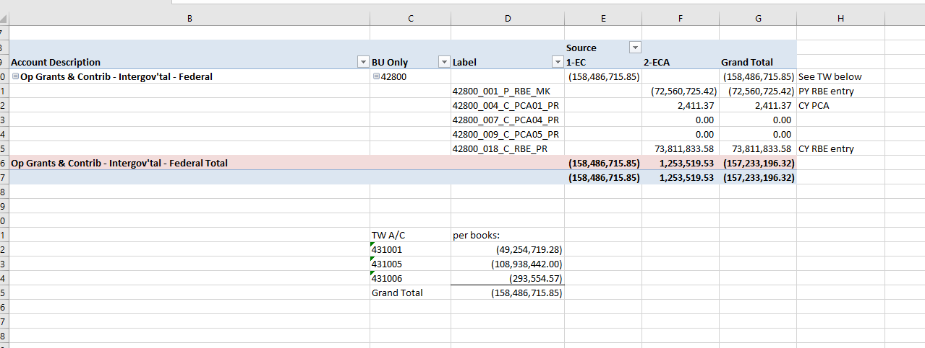
SEFA Reconciliation Form
Detail for Federal revenues reported in the CAFR after considering CAFR adjustments - RBE and URP Year End forms and other reconciling items

Slide 52
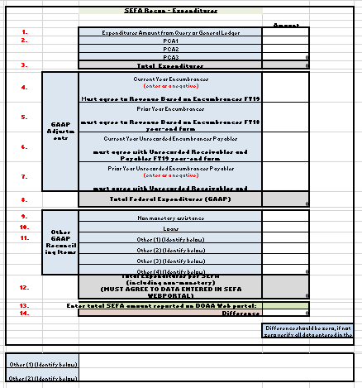
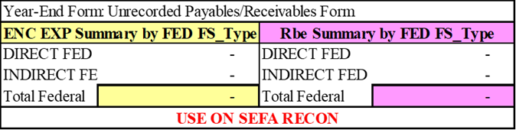
SEFA Reconciliation Form
SEFA reconciliation form is redesigned to simplify process and reduce potential errors
SEFA Recon - Expenditures
There should be no red in “Difference” cell.
Notes:
Note: Use of the other adjustments columns on the SEFA Reconciliation form are rare!
There is additional table for you to provide explanations for reconciling items specific to your agency
Also, there is additional space to tell us any additional information you think is helpful

Slide 53
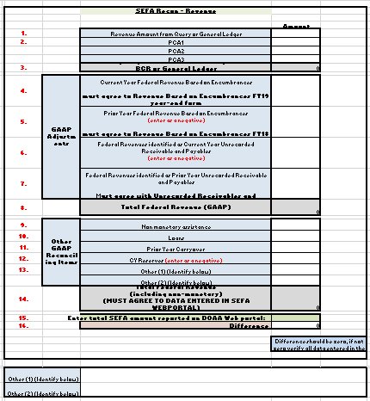
SEFA Reconciliation Form
SEFA Recon - Revenue
There should be no red in “Difference” cell.
Notes:
Note: Use of the other adjustments columns on the SEFA Reconciliation form are rare!
There is additional table for you to provide explanations for reconciling items specific to your agency
Also, there is additional space to tell us any additional information you think is helpful

Slide 54
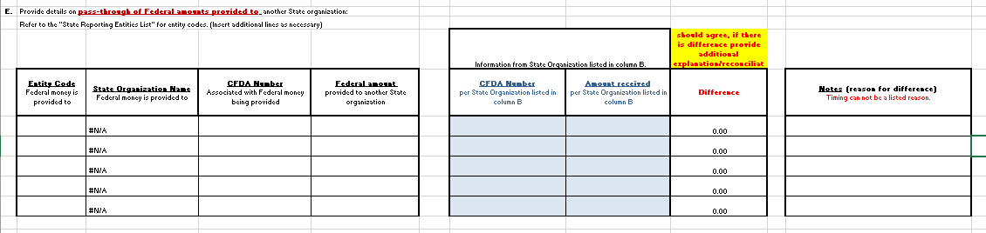
SEFA Reconciliation Form
New Tab: SEFA Recon – In State Passthrough
Passthrough of Federal Amounts provided to another State organization
- Contains tables to report amounts provided and received
- Amounts provided and received must agree
Notes:
- First table: Enter Entity Code, CFDA number and amount for the Entity you are
providing federal money to
- Second table: Confirm CFDA number and amount with the entity you
provided money to. Column “Difference” will calculate difference
between amounts in the first and second table. Difference should be zero.

Slide 55
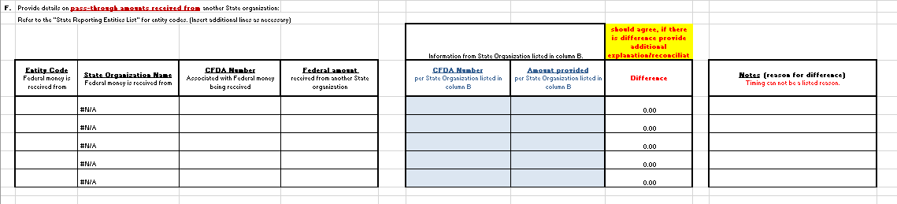
SEFA Reconciliation Form
New Tab: SEFA Recon – In State Passthrough
Passthrough of Federal Amounts received from another State organization
-Start gathering information and talking to other organizations now
Notes:
- First table: Enter Entity Code, CFDA number and amount for the Entity you
received federal money from
- Second table: Confirm CFDA number and amount with the entity that provided
money to your organization. Column “Difference” will calculate difference
between amounts in the first and second table. Difference should be zero.

Slide 56
SEFA Reconciliation Form
Recap:
  Important that you actually reconcile back to your accounting records
  Do not use “plug” numbers to reconcile
    All differences must be fully explained
  If changes made to accounting records, year-end forms or SEFA data then must submit new Recon forms
    Remember RBE and SEFA Recon need to be in sync
    Remember URP and SEFA Recon need to be in sync
  If passing from/to another entity then need to communicate amongst yourselves
    This ensures that both are using same CFDA number, same amount, same designation of research & development, etc.
This data is part of the single audit report which is filed with the Fed Govt, so accuracy of information is important
Notes:
In other words, the amounts on both the Revenue Based on Encumbrance form and the SEFA form need to agree
and the amounts on both the Unearned Revenue and Payables form and the SEFA form need to agree

Slide 57
Training Videos
Training videos for the year end forms can be on SAO’s website under “Training and Calendars”
  Videos may be a little outdated but still provide helpful and relative information
    https://sao.georgia.gov/year-end-training-videos-presentations

Slide 58
SAO Forms Open House
  SAO Forms Open House #1 – July 31st Room 1514C 2 p.m.- 4 p.m.
  SAO Forms Open House #2 – August 20th Room 1514C 2 p.m.- 4 p.m.
  There is no agenda for these sessions. Please bring your forms and specific questions! ☺

Slide 59
Single Audit

Slide 60
Single Audit
Carefully read instructions every year – there is a lot of important information in there (and changes are made to them)
SEFA webportal has many sets of instructions built into as denoted by
  https://sao.georgia.gov/federal-compliance-reporting

Slide 61
Single Audit
SEFA webportal submission:
  Properly identify if monetary vs. non-monetary
    yes, System limits monetary or non-monetary options by CFDA, but if needed reach out to SAO if you need to use a CFDA and the option is not available
  Properly identify research & development
    Should find notation somewhere in grant award documents
  Use listing on SAO’s website to identify proper State Organization
    Use especially when receiving money from an Attached Organization as the System only allows for selection of the lead/parent organizations
  If passed-through make sure amount and ALL other information (CFDA number, R&D answer, etc.) agrees to organization who initially received the money.

Slide 62
Single Audit
SEFA webportal submission:
  Use CFDA number per grant award documents
    Do not just use same CFDA number that was used in past years
  System will be updated to only allow active CFDA numbers to be used, but reach out to SAO if there is one needed to be used that is not valid in the System
    Do not just pick a different CFDA
Interagency pass thru:
    There are still issues with agencies not matching. Please remember “timing” is not an acceptable as both sides should match (may require URP adjustment).

Slide 63
PCA Tips
Post-Closing Adjustments

Slide 64
PCA Tips
PCA entry form is filled out completely and correctly and entry is balanced. Make sure correct account, program, fund source and budget year data is provided.
Program and fund source data on PCA form is reported properly on Fund Balance Appropriations form (FBAF) (e.g. PCA adjusts state funds but federal funds are adjusted on FBAF).
Use one PCA form per entry, do not combine multiple PCAs onto one form.
Do not add lines to PCA short form. If additional lines are needed, use PCA long form, or request assistance from SAO to add additional lines

Slide 65
PCA Tips
PCAs are processed in TeamWorks timely in subsequent fiscal year (do not wait for SAO’s beginning fund balance recon exercise, PCAs should be posted prior).
  Use accounts indicated in the FY19 column of the form as prior year posting in subsequent fiscal year uses account 390001 instead of revenue/expense accounts.
Limit the number of PCAs submitted
  Non-recurring each year as recurring ones should be adjusted in the next year before 998 closes (e.g. PCAs should be non-routine and non-recurring)

Slide 66
Other Items Noted from CAFR Process

Slide 67
Other Items Noted
Common Statewide Findings
These are repeat findings across multiple agencies:
  Financial Reporting
    Strengthen control over accuracy of information in financial statements and required disclosures
    Errors in year-end forms
  IT controls
    Periodic review of user access
    Segregation of duties (user access rights)

Slide 68
Other Items Noted
Clearing Account
  Must be zero by fund type by end of year (ex: BCR,CPF, Agency, etc). Refer to accounting policy: Control/Clearing Accounts-Balancing Requirements for travel related account exceptions
Balances in accounts 196xxx should offset to zero at year end
  Excludes Travel Clearing accounts:
    196040
    196041
    196060
    196061
Balances in accounts 296xxx should also offset to zero at year end

Slide 69
Other Items Noted
Governance List
  Accounts Payable – Encumbrances Payable 200011 should be zero in General Ledger until year end when PO module closes to GL
    Should only have balances from period 998 of CY
    It is ok to post current year manual JVs for accrual of encumbrances to account 200011 in periods 12 and 998
    In period 1 of the following year, manual JVs to account 200011 should be reversed and related adjustments should be made through the PO module
    It is not ok to carry balances in account 200011 that resulted from prior year manual JVs

Slide 70
Other Items Noted
Single Audit Subsequent Events Form
  This form is in addition to the CAFR subsequent event year end form and is used to report significant activity 60 days after CAFR issuance
Charitable Contributions 60180 (Agency Fund) – make sure End Balance is zero at year-end.
  Charitable Contributions Example for Fund 60180: Jeans Donations
    Agencies collect money from employees to be able to wear jeans to work and turn around and give money to charity
    Money sent to third party (charity) should have been sent within 5 days, so there should be no dollars left at year end
  SAO Business policy released October 2018
    Titled “Georgia State Charitable Contributions Program (GASCCP) Cash Management Functions”

Slide 71
Other Items Noted
Transfers
  Interfund transfers (accounts 471001/750001) are flows of assets without equivalent flows of assets in return and without a requirement for repayment (subsidies).
    An example of a transfer would be where the Governor’s office transfers emergency funds to an agency, however the agency does not need to provide goods and/or services back to the Governor’s office. In this case, the Governor’s office is spending funds without receiving a benefit in return; the benefit is received by the public who is being served by the agency who received the transfer in of funds.

Slide 72
A/R Accounts for Revenue Based on Encumbrances (FY19)
In 2017 specific account numbers were established to record Accounts Receivable balances resulting from Revenue Based on Encumbrances accruals.
  122003 – Fed Receivables-Direct-3-RBE
  122004 – Fed Receivables-Direct-4-RBE
  122502 – Fed Receivables-Indirect-2-RBE
  133010 – Other Receivables – RBE
  143073 – Inter Rec-RBE
  143075 – Inter Rec-DOT-GPDuefrGSFIC-RBE
  143078 – Interfund Rec – SRTA – RBE
  143080 – Interfund Rec –DOT-TIA Enc-RBE
SAO encourages all Agencies to use these accounts for FY19 to record their Revenues Based on Encumbrances. Using these accounts should assist in completing the Revenues Based on Encumbrances and SEFA forms.

Slide 73
Reminder of Federal Revenue Accounts (FY19)
As noted above in the CAFR forms section, new specific account numbers have been established to record Capital Grants and Contributions – Federal and Other.
  496010 - Cap Grants & Contrib - Capital Contributions - Federal
  496020 - Cap Grants & Contrib - Capital Contributions - Other

Slide 74
Miscellaneous
Miscellaneous Items

Slide 75
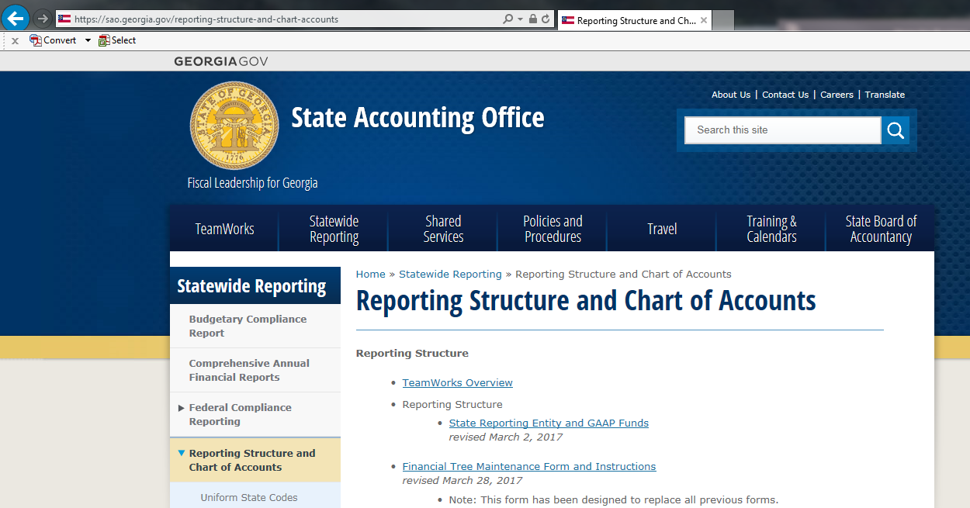
Entity Listings
Listings of other state agencies can be found on SAO’s website here:

Slide 76
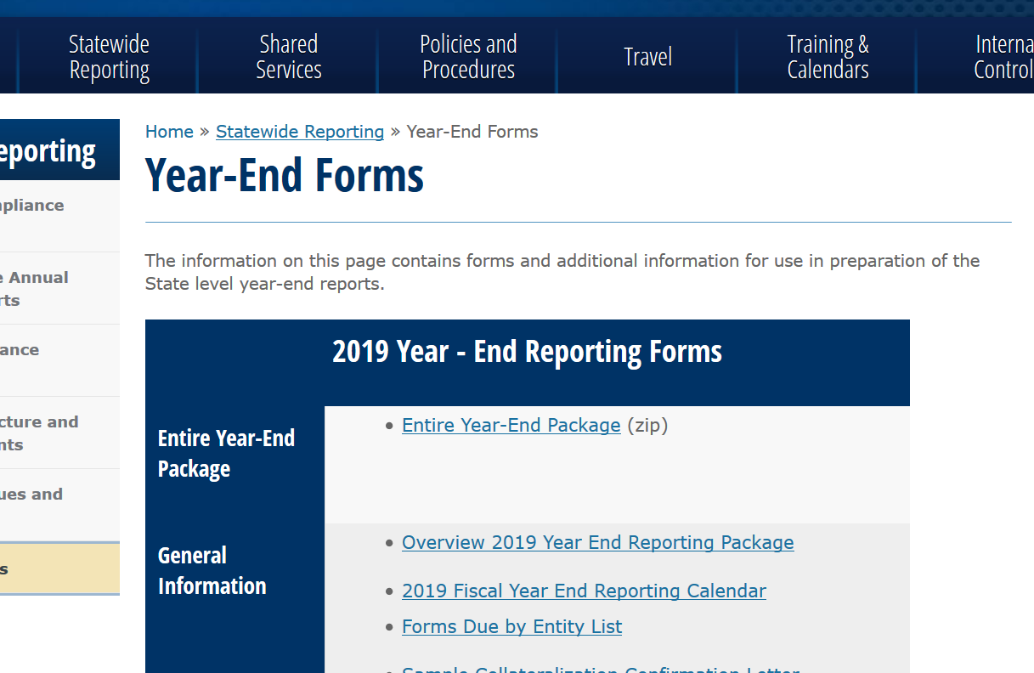
Year-End Forms
Be sure to find the current forms for the applicable fiscal year on SAO’s website. Do not copy and paste or use forms from prior years.

Slide 77
Fund Source Tree Request Form
There have been many changes made to the Fund Source Tree Request form. The form has formulas and conditional formatting which required it to be downloaded from the SAO website with every new Fund Source request to ensure the integrity of the form. Please read instructions in its entirety before proceeding. This form's enhancements include:
• Dropdown boxes for selection convenience.
• Conditional formatting to prompt data entry for required fields.
• Fund Balance Instructions tab has been updated to provide clarity.
If you make a mistake while inputting the data, please delete erroneous row(s). Begin again on the next row to allow all dropdown boxes, conditional formatting, and formulas to work properly.
"To expedite the approval process, please COMPLETE ALL COLUMNS of the form and verify that values to be added are entered into TeamWorks - Design Chart fields. For fund source requests, please include supporting documentation for restricted, committed, nonspendable and assigned fund balance categories. The form should not be submitted with any red cells. Old versions of this form are not being accepted and WILL be sent back for incompleteness or inaccuracies."

Slide 78
AR Write-Off Form
  Improvements were made to the AR Write-Off template to prevent errors and expedite the approval process.
  Information such as obligator’s ID is now a required field on all submissions.
  Conditional formatting added to insure compliance with write-off limits.
  The form is effective 5/31/2019 and located on SAO website:
  Home >> Policies and Procedures >> Business Process Policies

Slide 79
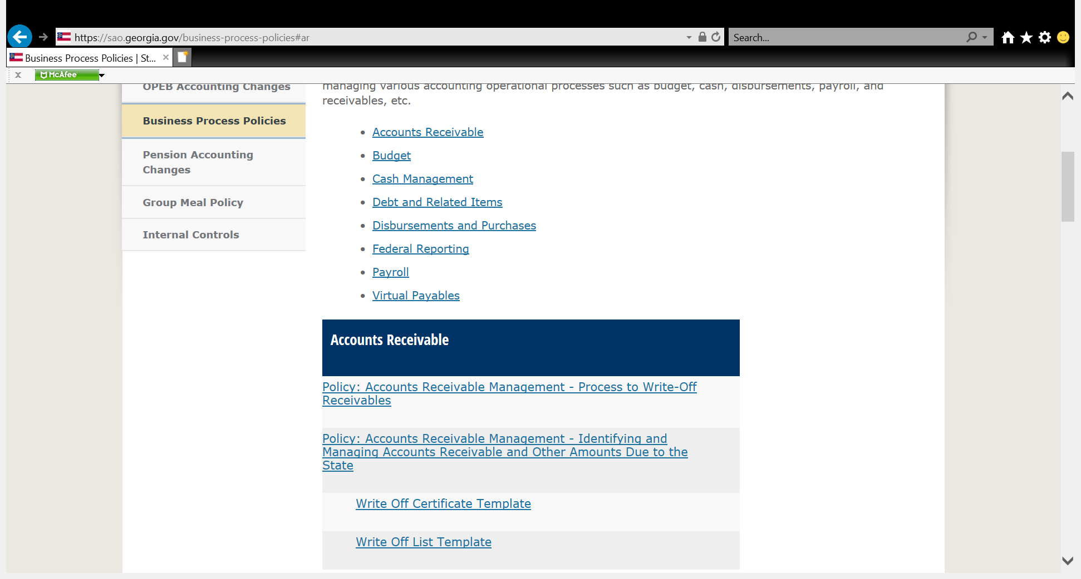
AR Write-Off template

Slide 80
Other
Reminder: May 2018 FMC training presentation is out on SAO’s website
FY19 year-end timeline is available and is similar to FY18 timeline
FY19 forms are available

Slide 81
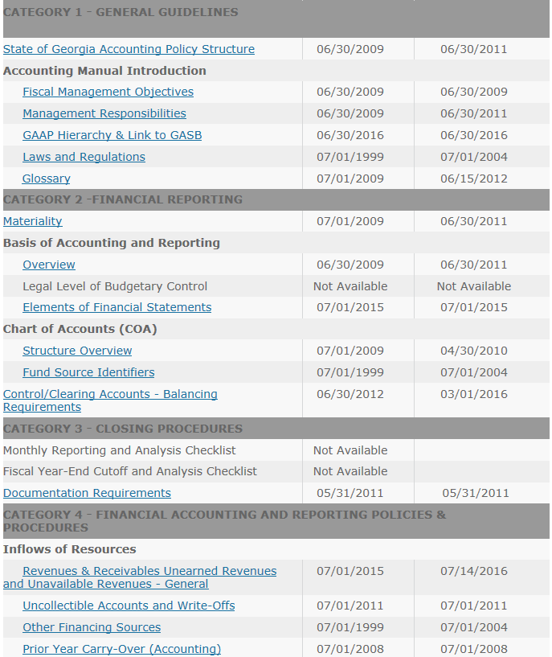
SAO Policies on Web
SAO accounting policies can be found here:
https://sao.georgia.gov/accounting-policy-manual

Slide 82
SAO Policies on Web
The Accounting Policy Manual includes high-level policies and procedures to ensure that financial activity is recorded accurately and consistently across organizations within the state reporting entity (e.g. reported in the CAFR), so that government-wide financial statements will comply with authoritative GASB and legislative standards.
The following slide is a snapshot of the revenue recognition matrix where guidance is given regarding when to recognize revenue and is included in the “Revenues & Receivables Unearned Revenues and Unavailable Revenues – General” policy.

Slide 83
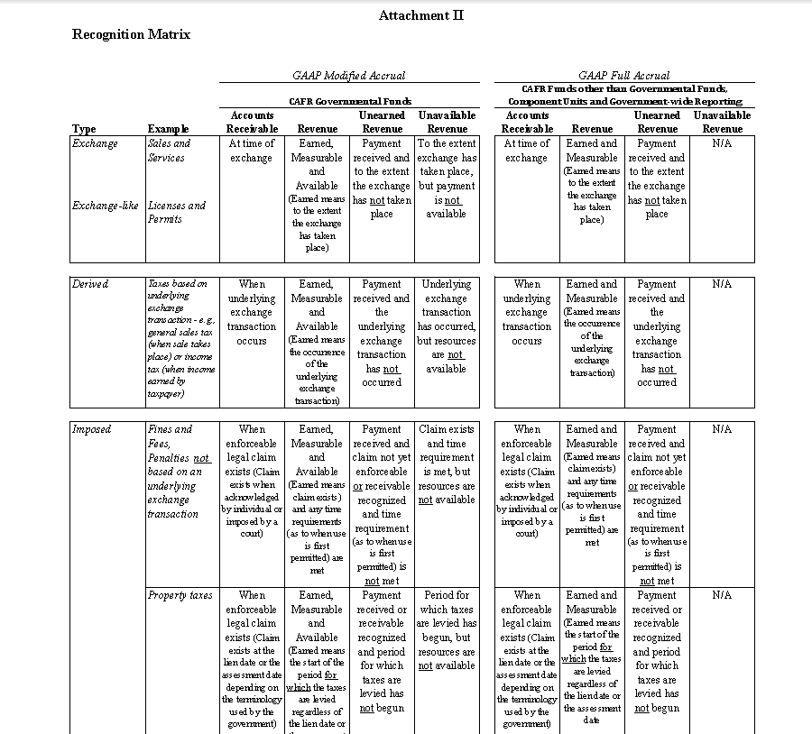
SAO Policies on Web

Slide 84
Communications list
  SAO is working on a form for agencies to complete for updated agency contacts.
  SAO will also be contacting agencies to validate contact information.
    Note – this communication list is different that the Financial News sign up available in TeamWorks.

Slide 85
Questions?

