Slide 1
Log In to GA@WORK for Employees Using Native Login with MFA
DESCRIPTION
This guide will assist Employees with the steps to setup Multifactor Authentication (MFA) using the Microsoft Authenticator Application.
OVERVIEW
The key steps in the process are below:
Download the Microsoft Authenticator Application on your phone.
Login to GA@WORK and setup extra verification.
Scan QR Code.
Enter One-time password code.
Business Process:
Install Microsoft Authenticator
Log in to GA@WORK
Scan QR Code
Enter One-time password code

Slide 2
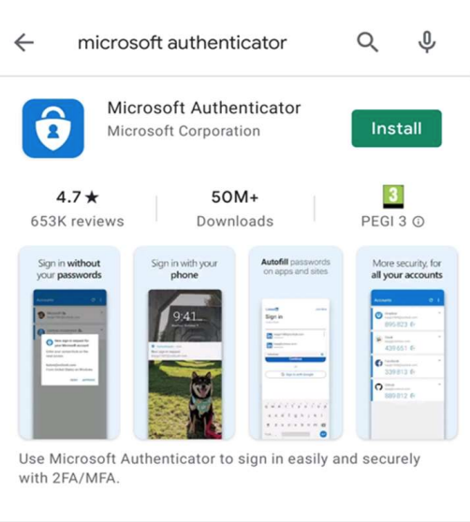
Log In to GA@WORK for Employees Using Native Login with MFA (Part 1 of 8)
INSTRUCTIONS
On your phone, navigate to your phone’s app store and enter the Authenticator App in the search field.
Note: For the purposes of this guide, we are selecting the Microsoft Authenticator. However, you may use other authenticator types such as Google, OKTA or DUO.
Click Install.
1
2

Slide 3
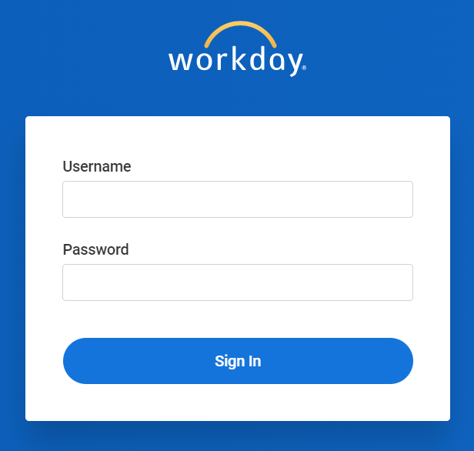
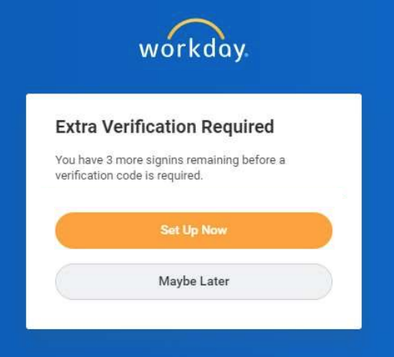
Log In to GA@WORK for Employees Using Native Login with MFA (Part 2 of 8)
INSTRUCTIONS
In a browser, navigate to the GA@WORK sign-in page, enter your username and password.
Click Sign In.
3
4
Click Set Up Now.
Note: If you inadvertently skip the initial MFA setup, use steps 14-19 to access the QR Code from within the tenant.

Slide 4
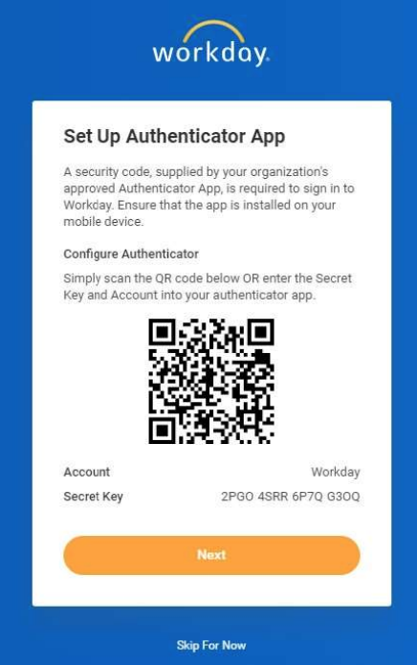
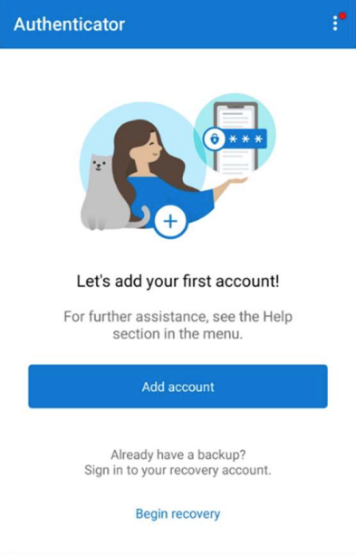
Log In to GA@WORK for Employees Using Native Login with MFA (Part 3 of 8)
INSTRUCTIONS
A QR Code and instructions on how to connect with your authenticator app displays.
On your phone, open the Microsoft Authenticator application and select Add Account.

Slide 5
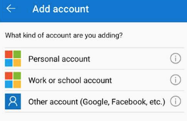
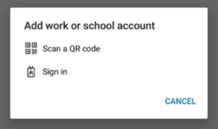
Log In to GA@WORK for Employees Using Native Login with MFA (Part 4 of 8)
INSTRUCTIONS
Select Work or school account.
Select Scan a QR code.

Slide 6
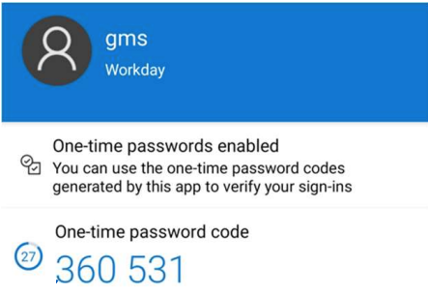
Log In to GA@WORK for Employees Using Native Login with MFA (Part 5 of 8)
INSTRUCTIONS
With your phone, scan the QR Code, then click Next.
On your phone, you are provided with a One-time password code.
Note: When the timer in the bottom left of the Microsoft Authenticator expires, a new code is generated.

Slide 7
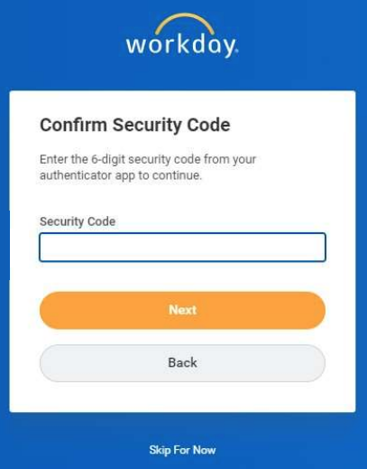
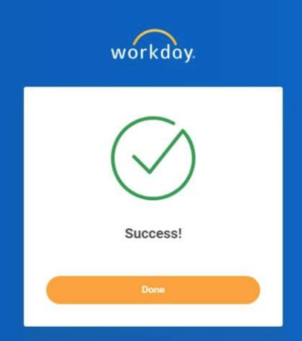
Log In to GA@WORK for Employees Using Native Login with MFA (Part 6 of 8)
INSTRUCTIONS
Enter the One-time password code into the Security Code field.
Click Next.
12
13
A Success screen displays. Click Done to continue to GA@WORK.
Note: Steps 15-19 show how to access the QR Code from within the tenant.

Slide 8
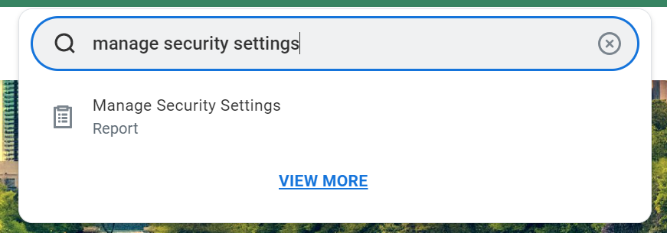
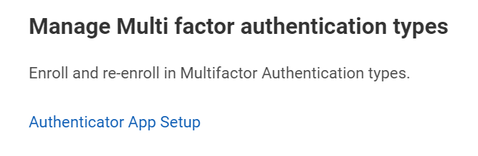
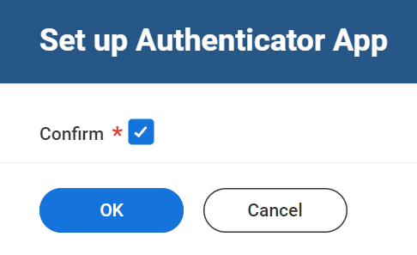
Log In to GA@WORK for Employees Using Native Login with MFA (Part 7 of 8)
INSTRUCTIONS
To locate the QR Code within the tenant, enter Manage Security Settings in the Search field.
Select Manage Security Settings Report.
15
16
Click Authenticator App Setup.
Check the Confirm* box.
Click OK.
18
19

Slide 9
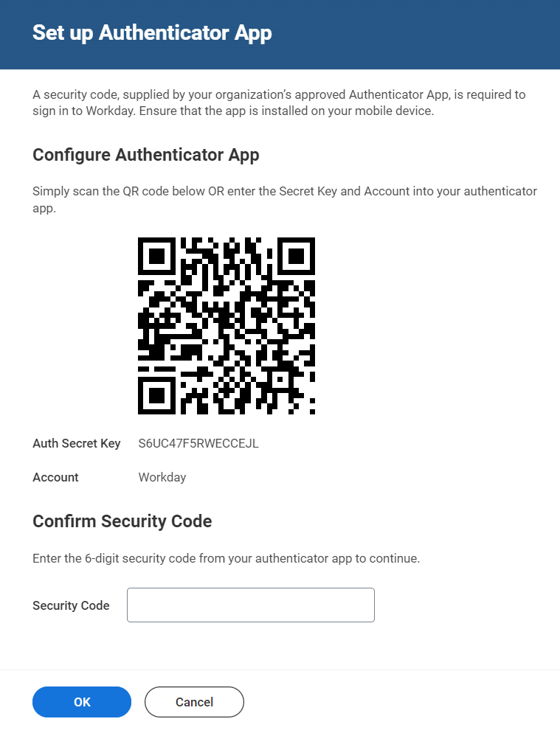
Log In to GA@WORK for Employees Using Native Login with MFA (Part 8 of 8)
INSTRUCTIONS
A QR Code and instructions display. Refer to steps 7-14 to Set up Authenticator App.
You have successfully logged in to GA@WORK using Native Login with MFA.

