Slide 1
Log In to GA@WORK for Employees Using Native Login with Google MFA
DESCRIPTION
This guide will assist Employees with the steps to setup Multifactor Authentication (MFA) using Google Authenticator Application.
OVERVIEW
The key steps in the process are below:
Download Google Authenticator Application on your phone.
Login to GA@WORK and setup extra verification.
Scan QR Code.
Enter numerical code.
Business Process:
Install Google Authenticator
Log In to GA@WORK
Scan QR Code
Enter Numerical Code

Slide 2
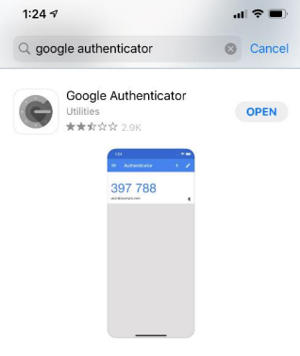
Log In to GA@WORK for Employees Using Native Login with Google MFA (Part 1 of 8)
INSTRUCTIONS
On your phone, navigate to your phone’s app store and enter Google Authenticator in the Search field.
Click Open.
1
2

Slide 3
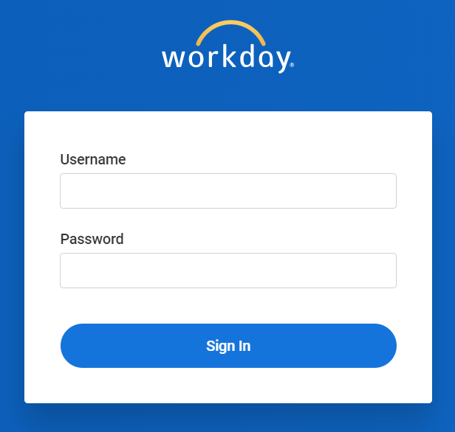
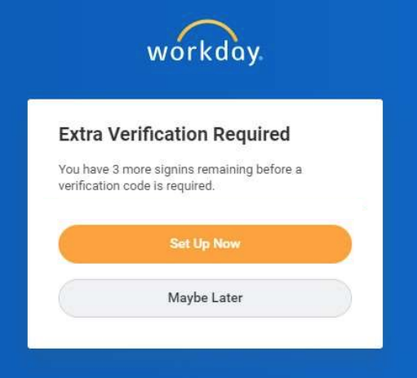
Log In to GA@WORK for Employees Using Native Login with Google MFA (Part 2 of 8)
INSTRUCTIONS
In a browser, navigate to the GA@WORK sign-in page, enter your username and password.
Click Sign In.
3
4
Click Set Up Now.
Note: If you inadvertently skip the initial MFA setup, use steps 14-17 To access the QR Code from within the tenant.

Slide 4
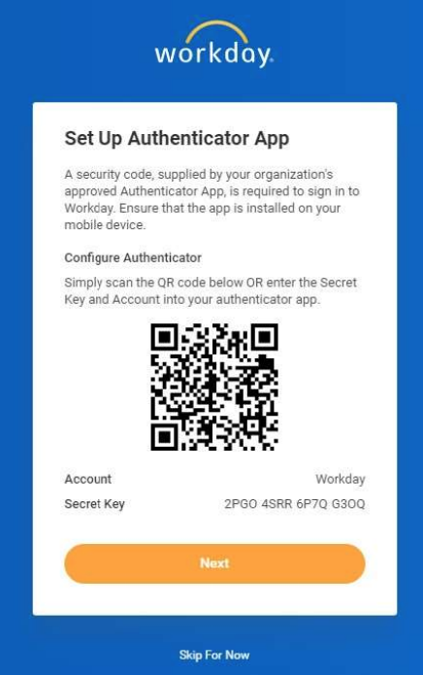
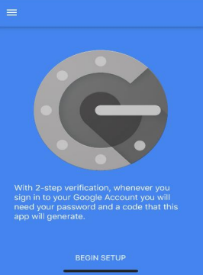
Log In to GA@WORK for Employees Using Native Login with Google MFA (Part 3 of 8)
INSTRUCTIONS
A QR Code and instructions on how to connect with your authenticator app displays.
On your phone, open the Google Authenticator application and select Begin Setup.

Slide 5
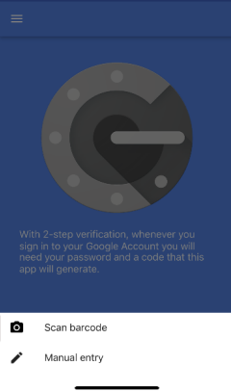
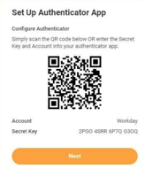
Log In to GA@WORK for Employees Using Native Login with Google MFA (Part 4 of 8)
INSTRUCTIONS
Select Scan barcode.
With your phone, scan the QR Code.
Click Next.
9
10

Slide 6
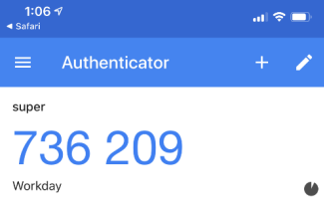
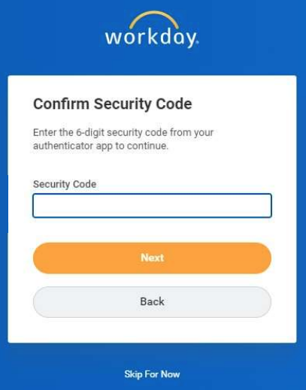
Log In to GA@WORK for Employees Using Native Login with Google MFA (Part 5 of 8)
INSTRUCTIONS
On your phone, you are provided with a numerical code.
Note: When the timer on the bottom right of the Google Authenticator code times out, a new code is generated.
Enter the numerical code into the Security Code field.
Click Next.
12
13

Slide 7
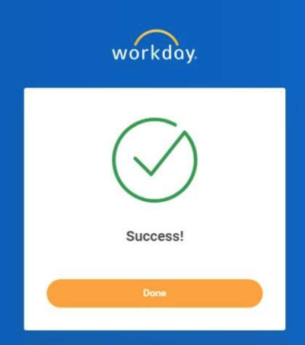
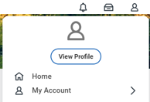
Log In to GA@WORK for Employees Using Native Login with Google MFA (Part 6 of 8)
INSTRUCTIONS
A Success screen displays. Click Done to continue to GA@WORK.
Note: Steps 14-17 show how to access the QR Code from within the tenant.
To locate the QR Code within the tenant, click My Profile.
Click My Account.
15
16

Slide 8
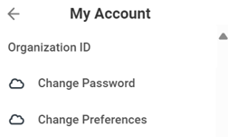
Log In to GA@WORK for Employees Using Native Login with Google MFA (Part 7 of 8)
INSTRUCTIONS
Select Organization ID.

Slide 9
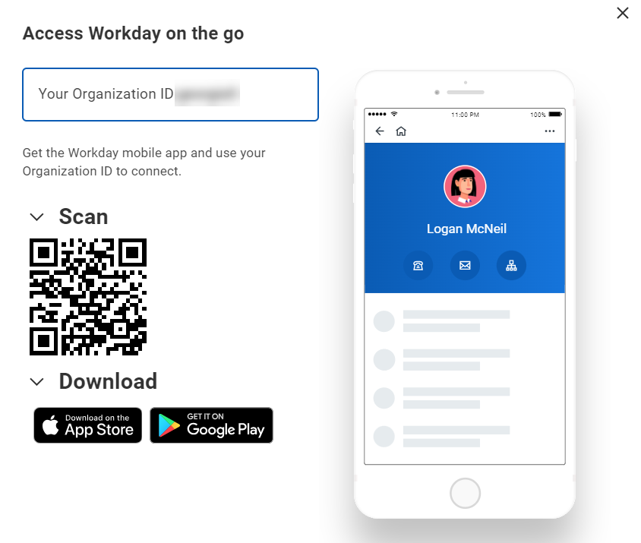
Log In to GA@WORK for Employees Using Native Login with Google MFA (Part 8 of 8)
INSTRUCTIONS
A QR Code and instructions display. Refer to steps 14-17 to complete setup.
You have successfully logged in to GA@WORK using Native Login with Google MFA.

