Slide 1
Log In to GA@WORK for Employees Using Okta (GETS) SSO
This guide will assist GETS Agency employees with the steps to Log In to GA@WORK using Okta Single Sign-On.
Enter Username and Password.
Select Enter a code or Get a push notification.
Click GA@WORK.
Click Submit.
Employee needs to Log In to GA@WORK
Log In to GA@WORK for Employees Using Okta (GETS) SSO
Click Submit

Slide 2
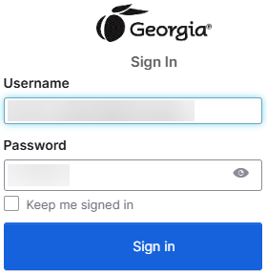
Log In to GA@WORK for Employees Using Okta (GETS) SSO (Part 1 of 8)
Enter your Username and Password.
Click Sign In.
Note: You may click Keep me signed in to allow automatic sign in for future logins.
1
2

Slide 3
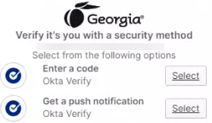
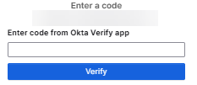
Log In to GA@WORK for Employees Using Okta (GETS) SSO (Part 2 of 8)
If using a code, select Enter a Code.
You will be redirected to the Enter a code screen.

Slide 4

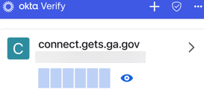
Log In to GA@WORK for Employees Using Okta (GETS) SSO (Part 3 of 8)
On your device, select the Okta application.
Note: Location and appearance may vary by device and personal configurations. This guide, uses an iPhone.
Click the masked code.

Slide 5
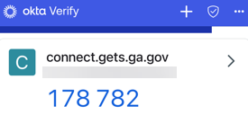
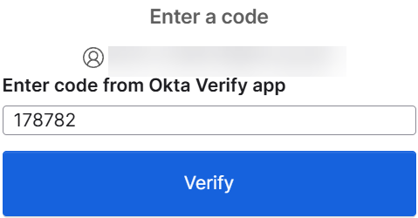
Log In to GA@WORK for Employees Using Okta (GETS) SSO (Part 4 of 8)
The code will be revealed.
Note: This screen will reset code every thirty (30) seconds with a new code.
Return to your computer and ͏Enter code from the Okta Verify app.
Click Verify.
8
9

Slide 6
Log In to GA@WORK for Employees Using Okta (GETS) SSO (Part 5 of 8)
͏Alternatively, if using a push notification, select Get a push notification.

Slide 7
Log In to GA@WORK for Employees Using Okta (GETS) SSO (Part 6 of 8)
On your device, select the Okta application.
Note: Location and appearance may vary by device and personal configurations. This guide, uses an iPhone.

Slide 8
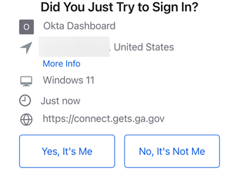
Log In to GA@WORK for Employees Using Okta (GETS) SSO (Part 7 of 8)
͏Click Yes, It’s Me.

Slide 9

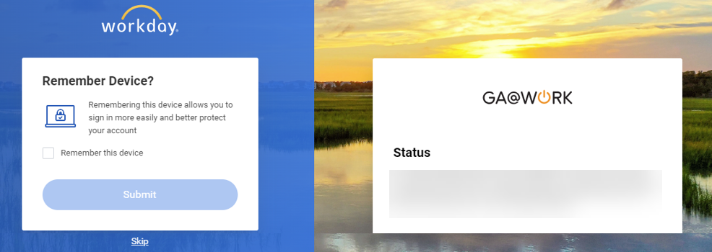
Log In to GA@WORK for Employees Using Okta (GETS) SSO (Part 8 of 8)
͏Click GA@WORK.
Note: Location of GA@WORK tile will vary depending on personal configurations.
You may check Remember this device.
Click Submit.
14
15
You have successfully logged in to GA@WORK using Okta (GETS) MFA.

