Slide 1
Log In to GA@WORK for Employees Using Safe Net SSO
This guide will assist Employees with the steps to Log In to GA@WORK using Safe Net Single Sign-On.
Click Start.
Enter your Username.
͏Select MobilePASS+ or Enter a code.
Click Applications.
Click Submit.
Employee needs to login to GA@WORK
Log In to GA@WORK for Employees Using Safe Net MFA
Click Submit

Slide 2
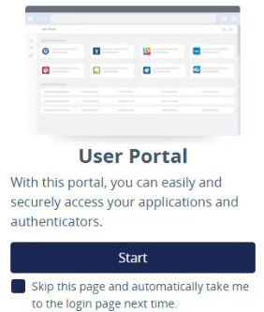
Log In to GA@WORK for Employees Using Safe Net SSO (Part 1 of 6)
Click Start.

Slide 3
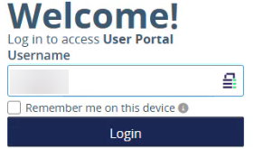
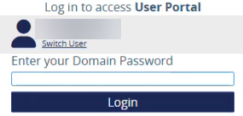
Log In to GA@WORK for Employees Using Safe Net SSO (Part 2 of 6)
Enter your Username.
Click Login.
2
3
͏Enter your Domain Password.
Click Login.
4
5

Slide 4
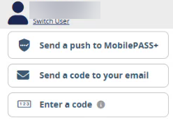
Log In to GA@WORK for Employees Using Safe Net SSO (Part 3 of 6)
If using MobilePASS+, click Send a push to MobilePASS+.
Note: You may also click Enter a code. You will be prompted to enter the code from your MobilePASS+.

Slide 5
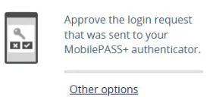
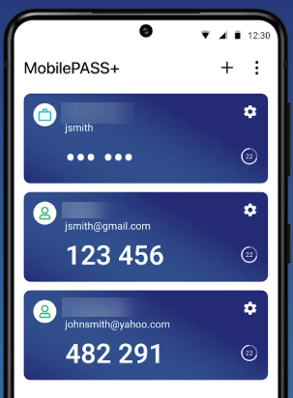
Log In to GA@WORK for Employees Using Safe Net SSO (Part 4 of 6)
A login request will be sent to your MobilePASS+ authenticator.
Note: Click Other options to choose another authentication method, if needed.
.
On your mobile device select the applicable MobilePASS+ and enter the code on your computer.

Slide 6
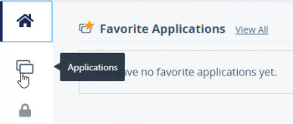
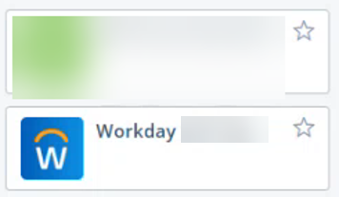
Log In to GA@WORK for Employees Using Safe Net SSO (Part 5 of 6)
͏Click Applications.
Click Workday.
Note: Location of the Workday tile may vary depending on your personal configurations.

Slide 7
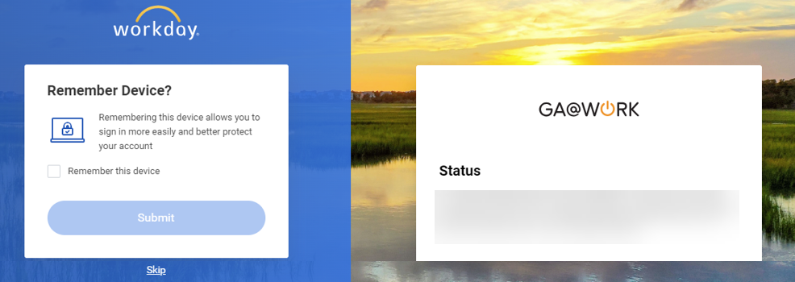
Log In to GA@WORK for Employees Using Safe Net SSO (Part 6 of 6)
You may check Remember this device.
Click Submit.
Note: Click Skip to proceed without checking Remember this device.
11
12
You have successfully logged in to GA@WORK using Safe Net SSO.

