Slide 1
Log In to GA@WORK for
Employees Using SSO (Google)
This guide will assist Employees with the steps to Log In to GA@WORK using Single Sign-On (Google).
Click Apps.
Click Workday App.
͏Select the Applicable Google Account.
Click Submit.
Employee needs to
log in to GA@WORK
Log In to GA@WORK for Employees using SSO (Google)
Click Submit

Slide 2
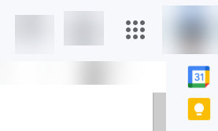
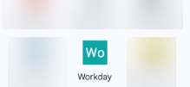
Log In to GA@WORK for Employees Using SSO - Google (Part 1 of 2)
In your Google account, Click Apps.
Scroll to and click the Workday App.
Note: Scrolling and location of app will vary depending on personal configurations. Upon clicking the app, you will be redirected to select the applicable account.

Slide 3
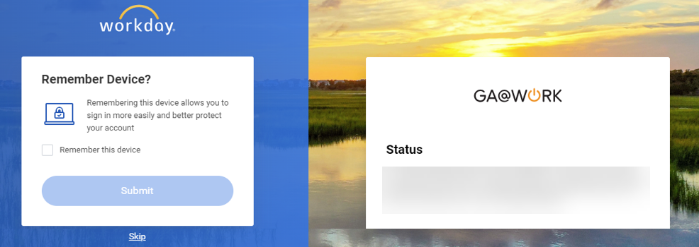
Log In to GA@WORK for Employees Using SSO - Google (Part 2 of 2)
You may check Remember this device.
Click Submit.
Note: Click Skip to proceed without checking Remember this device.
3
4
You have successfully logged in to GA@WORK using Single Sign On (Google).

