Slide 1
Log In to GA@WORK for
Employees Using DUO SSO
This guide will assist Employees with the steps to Log in to GA@WORK using DUO Single Sign-On.
Enter Username and Password.
Click Approve with Cisco Duo.
͏Enter your Passcode.
Click Submit.
Employee needs to
log in to GA@WORK
Log in to GA@WORK Using DUO MFA
Click Submit

Slide 2
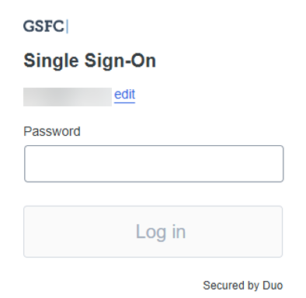
Log In to GA@WORK for Employees using Duo SSO (Part 1 of 4)
Enter your Username and Password.
Click Log in.
Note: For the purposes of this guide, we are using the GSFC (agency) as an example. Your login screen may appear different for your agency.
1
2

Slide 3
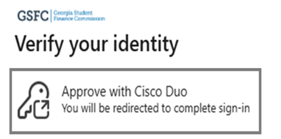
Log In to GA@WORK for Employees using Duo SSO (Part 2 of 4)
Click Approve with Cisco Duo.
Note: The Remember device option is only applicable to employees who have received the functionality approval.

Slide 4
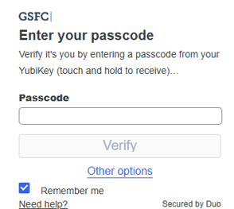
Log In to GA@WORK for Employees using Duo SSO (Part 3 of 4)
͏Enter your Passcode.
Note: Alternatively, you may click Other options to select an alternative authentication method.
Click Verify.
4
5

Slide 5
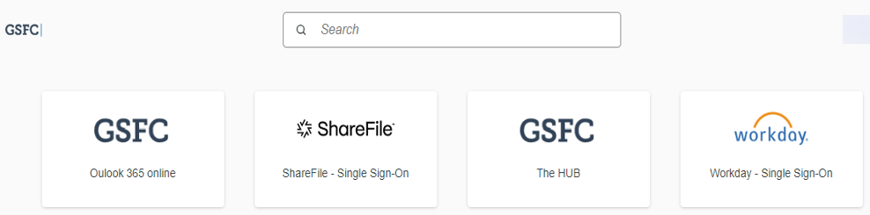
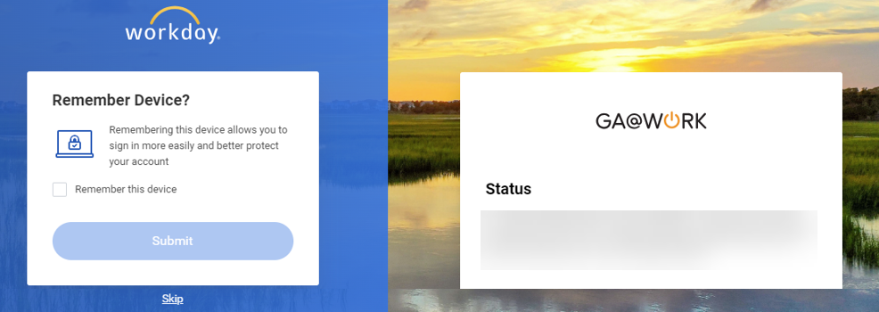
Log In to GA@WORK for Employees using Duo SSO (Part 4 of 4)
͏Click Workday – Single Sign-On.
You may check Remember this device.
Click Submit.
Note: Click Skip to proceed without the device being remembered.
7
8
You have successfully logged in to GA@WORK using Duo MFA.

