Slide 1
Log In to GA@WORK Natively
DESCRIPTION
This guide will assist employees with the steps to login to GA@WORK without the use of MFA (multi-factor authentication).
OVERVIEW
The key steps in the process are below:
Enter Username and Password.
Click Sign In.
Select Remember this device or Skip.

Slide 2
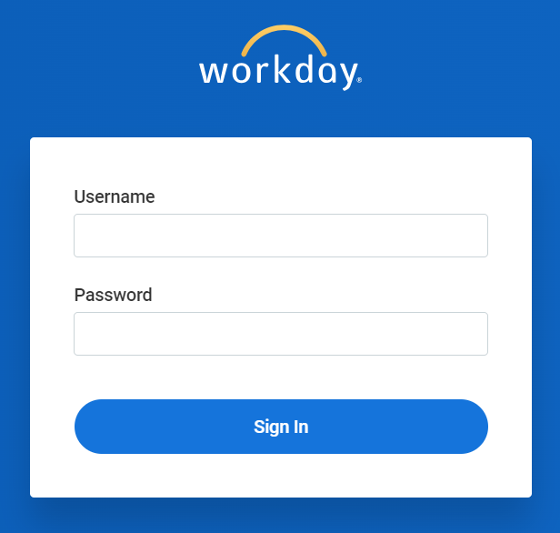
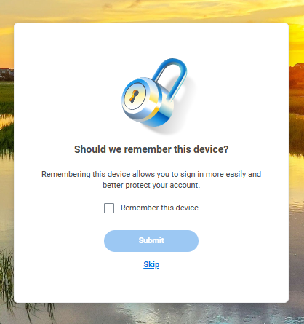
Log In to GA@WORK Natively (Part 1 of 2)
INSTRUCTIONS
In a browser, navigate to the GA@WORK sign-in page. Enter your Username and Password.
Note: Your password must be 8 characters in length and contain an uppercase and lowercase letter, numeric digit and a special character.
Click Sign In.
1
2
Select Remember this device or select Skip.

Slide 3
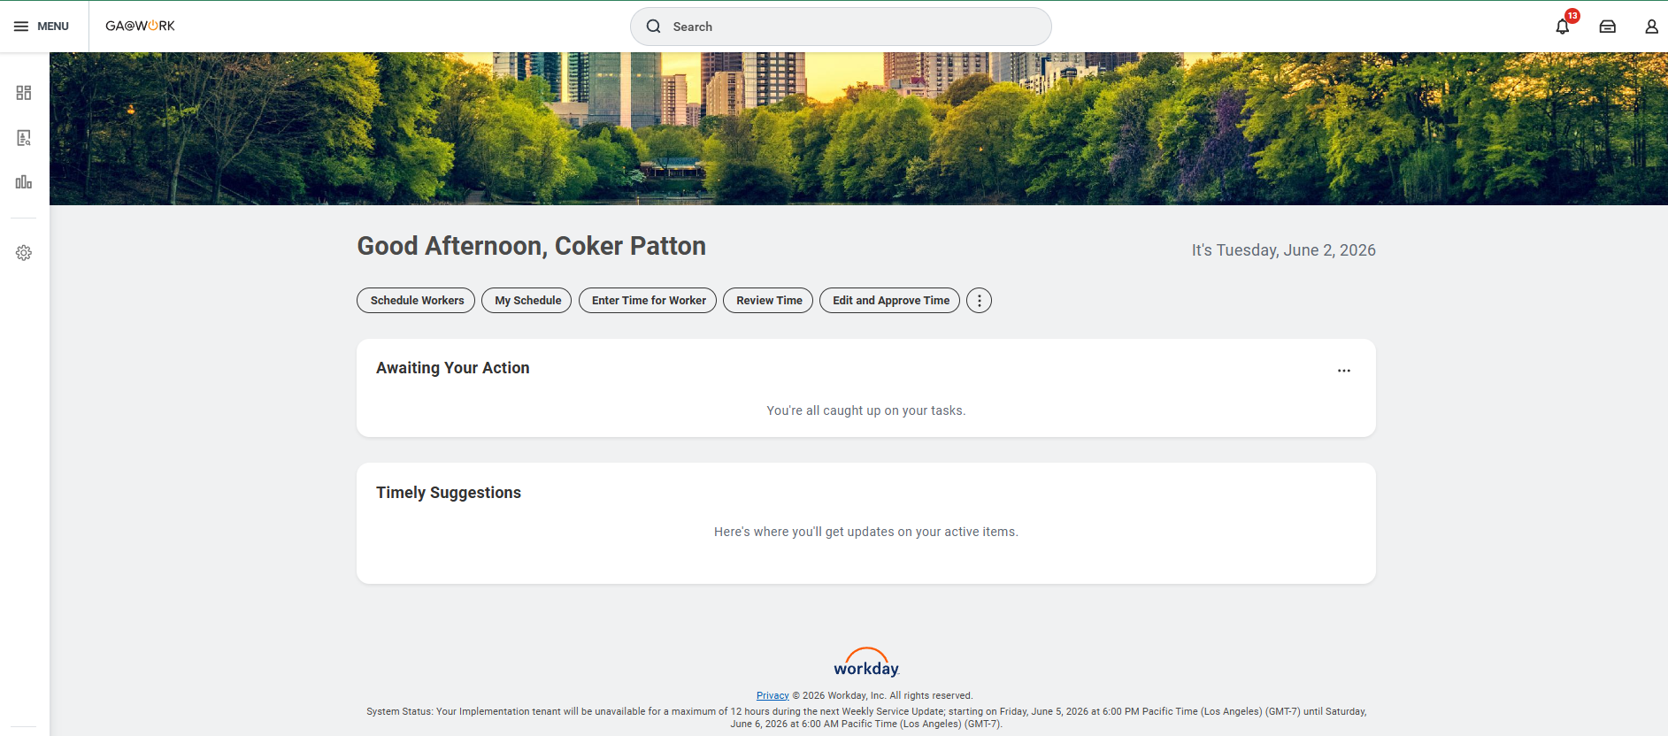
Log In to GA@WORK Natively (Part 2 of 2)
INSTRUCTIONS
View your GA@WORK homepage.
You have successfully logged in to GA@WORK natively.

